Slide 1

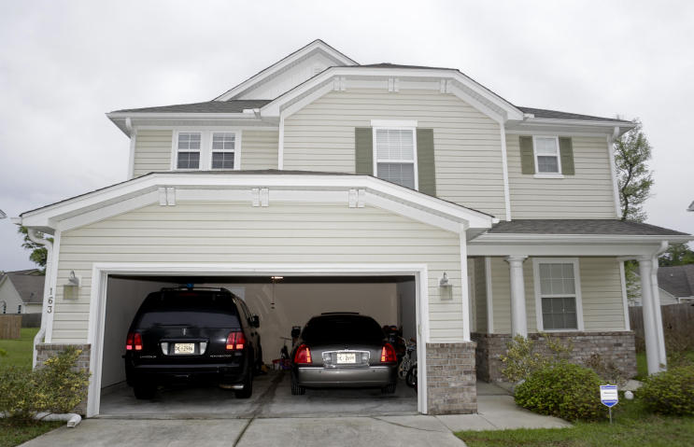
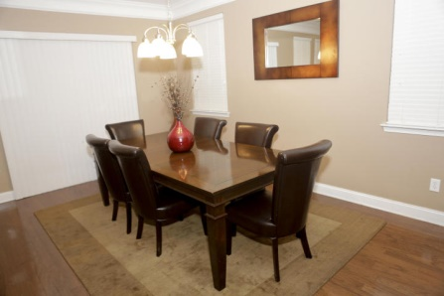
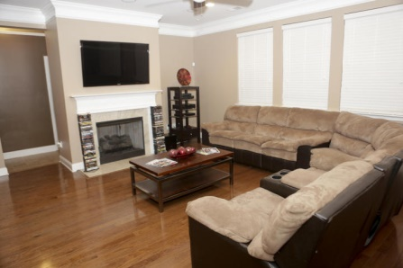
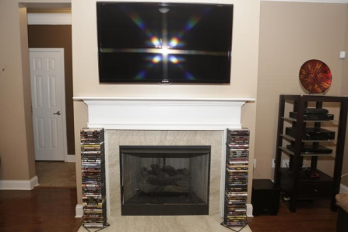
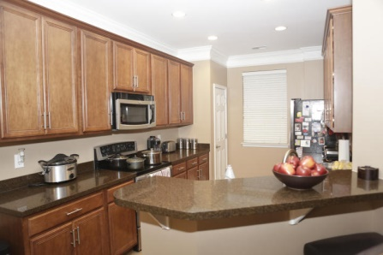
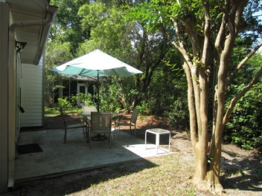
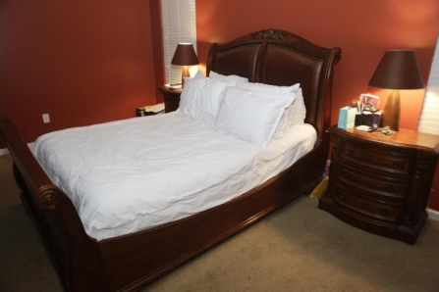
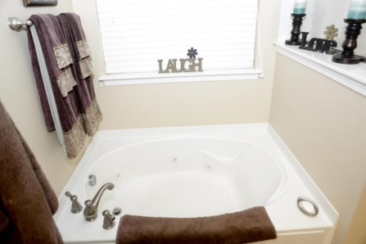
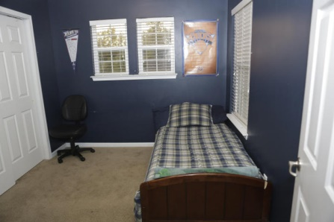
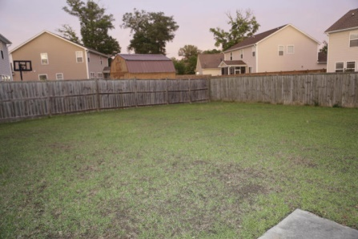

Open House Saturday from 12-2
163 Education Boulevard
Eagle Run
Ladson, SC 29456
MLS# 15011110
$210,000
This home is located in the quiet community of Eagle Run, a short drive to Palmetto Commerce Parkway, Wescott Sports Complex and downtown Summerville.
Your new home offers a spacious open floor plan. This beautiful 2 story home has so much to offer. Upon entering the home you will notice the gorgeous hardwood floors in the foyer area and throughout the first floor. There is a large living/dining room combo with a fireplace.
The kitchen has been upgraded with stainless steel appliances, granite counter tops, ceramic tile flooring, and 42'' cabinets that are absolutely stunning. Glass sliding doors lead to the oversized fully enclosed backyard for privacy. The master bathroom has a garden tub with a separate shower and dual vanity sinks. And last but not least, this home comes fully equipped with surround sound and a security system that will convey.
Come and see for yourself!
The Elite Realty Group of SC
8310- A Rivers Ave
North Charleston, SC 29406
www.ergroupofsc.com
Tiffini Ford Lockwood
Mobile - (843) 330-5805
tiffini_lockwood@yahoo.com

