Slide 1
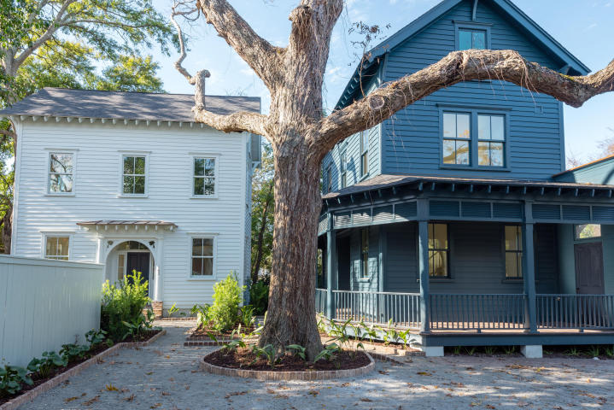

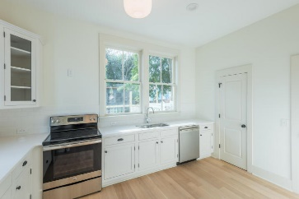
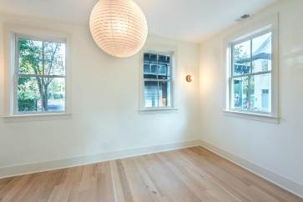
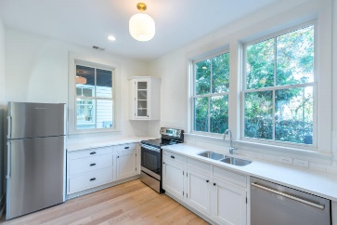
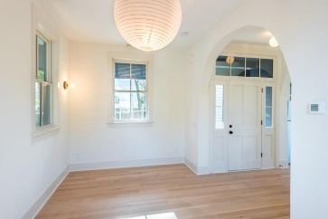
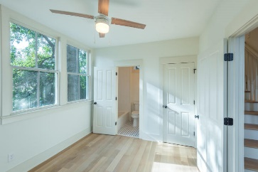
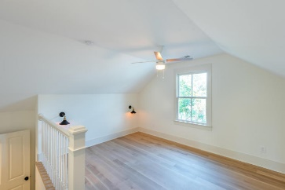
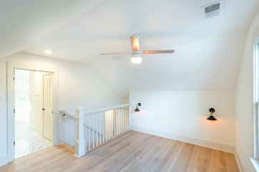
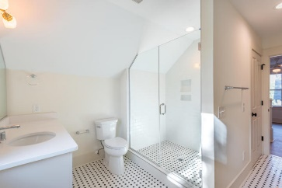
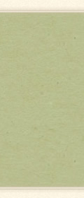

Agent Open House 1/25/18 11:30-3:00
Food & Drinks Served
Includes a Raffle Prize
163 Line Street
MLS# 17023517 | $595,500
165 Line Street
MLS# 17023512 | $595,500
See more about these homes at www.linestreethomes.com
Brand new construction south of the crosstown. Open floor plan with 10 ft ceilings downstairs. Each of the three bedrooms have a private en-suite bath.
Edmund Major
843-343-6666 C edmund@flywaysc.com
www.flywaysc.com
Flyway Real Estate, LLC
1630 Meeting St. Bldg 1
Ste 302
Charleston, SC 29405

