Slide 1
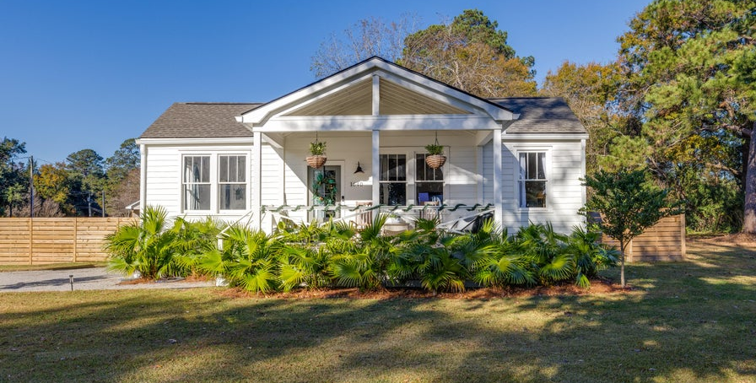
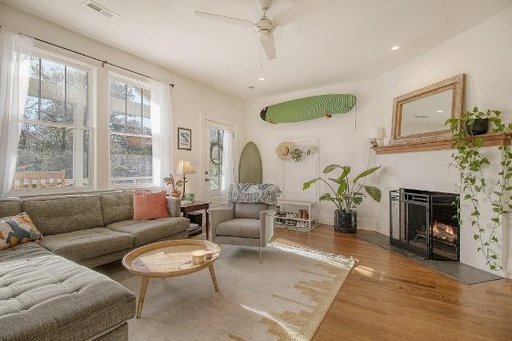
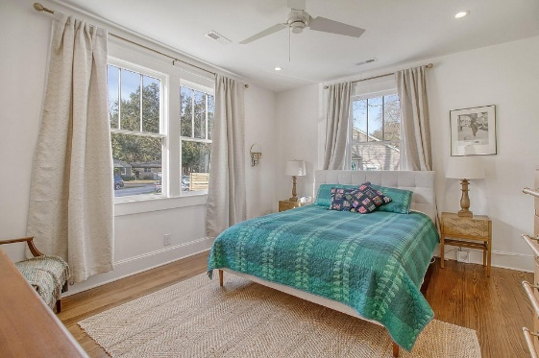
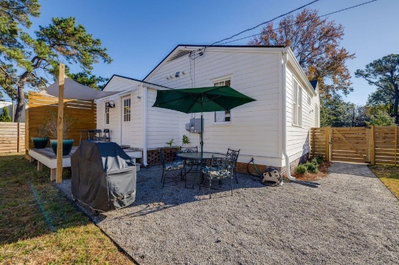

Schedule Your Showing Today!
1640 Pearlott Street
Stono Park | Charleston, SC 29407 | MLS# 25002068 | $635,000
Welcome to 1640 Pearlott Street! Nestled in the heart of West Ashley, this home is minutes away from restaurants, shopping, and the beautiful West Ashley Greenway, a ten-mile path for walking, biking, and jogging. This corner lot features an expansive front yard, fully fenced-in backyard, and sits at just under one-third of an acre. Walking up to the home, you'll be met with a large, welcoming front porch perfect for entertaining and meeting neighbors. Entering the home, you'll step into the living room featuring picturesque windows, cozy fireplace, a sweeping arched doorway, and a flex space that could make the perfect home office or guest room. The dining room then leads into the chef's kitchen where no small detail has been overlooked.
The kitchen features a large gas range with hood, beautiful marble countertops, new cabinetry, and even a wine cooler. The home boasts three bedrooms and two full bathrooms nestled quietly onto one side of the house. Through the mudroom with laundry, you'll find yourself in the oasis of the backyard. The large fence offers privacy and there is also a deck, outdoor shower, bocce ball court, patio, and storage shed - everything you could want. Schedule your showing today!
Kelly Snyder
843-457-5951
kelly.snyder@agentownedrealty.com
Greg Gelber
843-494-2354
greg.gelber@agentownedrealty.com
AgentOwned Charleston Group | 902 Savannah Hwy | Charleston, SC 29407-7802

