Slide 1
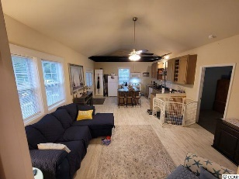
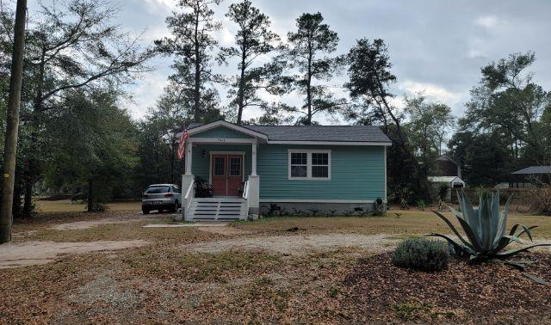
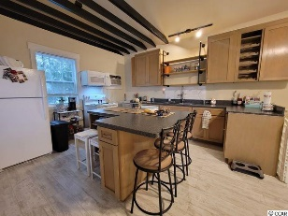
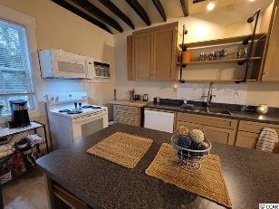
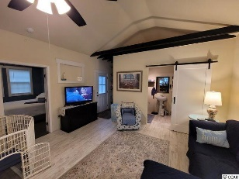
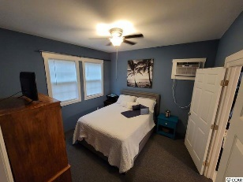
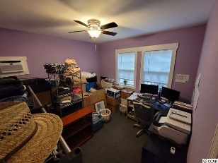
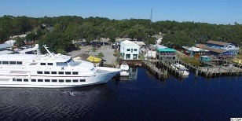





This Is The Quintessential Southern Cottage
1642 Edgewood Dr
Riverview Heights | Little River SC 29566 | MLS# 2200072 | $229,000
This is the quintessential Southern cottage, an appealing light blue color, instant charm and movie-script landscaping with its signature mature magnolia tree and set back on a wonderful, over-sized lot for privacy and innumerable-use-options. This attractive 2 bedroom/1bath residential cottage home was built in 2020 on a large, third-acre property and is secluded but is conveniently located near many businesses and is in the desirable Hamlet of Little River, Horry County's second oldest town, which is renown for its proximity to the Atlantic Ocean via the ICW and rich nautical history including being a notorious, popular pirate port. For boaters, there are several marinas nearby to buy or to rent boat slips. For golfers, there are numerous signature golf courses, plus restaurants, antique and thrift trails, recreation, shopping, access to major highways and medical services, and good schools and parks. It adjoins North Myrtle Beach, which was recently named one of the safest cities in the nation and with one of the best beaches in the U.S., the nearby Cherry Grove Beach, minutes away. However, taxes are levied at low, low Horry County rates. View this inviting, well-priced rustic charmer with magnificent indigenous landscaping for a personal residence, rental or with potential for investment. Walkable: As it is located near the casino boats, great restaurants, the historic district with its own legendary live oaks and other treasured trees and the riverfront/Intracoastal Waterway where development is expected and may include a fishing-village-inspired concept with marsh walk and a marina. This is a spacious lot, and the cottage itself immediately beckons with a coveted A-frame front porch and lots of room to comfortably park cars in the designated tandem front-yard entry. The yard itself, of course, is equally appreciated, for its grand square footage and possibilities. Bedrooms are unexpectedly spacious, too, each 12' x 12', and there is a larger bath which is modernized with a tub/shower, laundry area and barn-door closure -- a nice surprise and easily accessible from bedrooms and for guests from the living area. Entrance is from the rear or the front porch, an inviting, covered entrance to the pretty kitchen with beamed ceiling and farn sink/great room of the home. The main living area is open and the dining area/work island adjoins that open, roomy kitchen. All appliances convey, except washer dryer...The floor plan is workable and is homey. The whole interior boasts a country/retro vibe but with a modern-concept, fun and very livable atmosphere with a great color palette... Pet friendly and not in a flood zone! This small home has BIG potential! Properties in this highly desirable Little River location and with numerous options at such a compelling price are rare! Be retrospective, or even build or build on for a future in Little River, near the waterway and the heart of the action, in this singular community of diverse, treasured homes. Welcome!
Video Tour: https://www.youtube.com/embed/j0GAlikPWcA
Connie Ross-Karl
702-306-2643
conniesross@aol.com
Ronnie Nichols
Realtor / BIC
NEW WAY PROPERTIES MYRTLE BEACH

