Slide 1
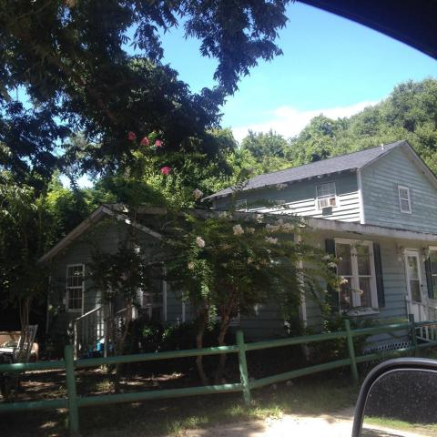
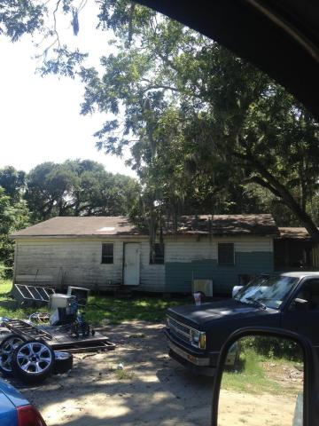
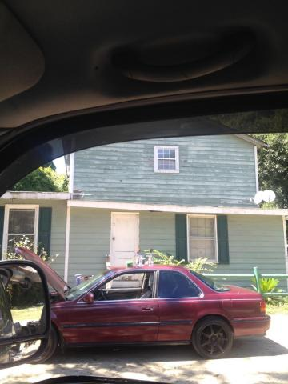
Great Development Opportunity!!!
1643 Rifle Range Road
Mount Pleasant, SC 29464 ~ MLS# 16022420 ~ $399,997
Developers, Builders and Investors this property is for you. This property is .61 acres of property on Rifle Range Rd. This property ripe for redevelopment. Nowhere in Mt. Pleasant can you find a lot this size with two homes for sale. With the right development plan this property looks like it can hold at least 4 homes. The homes are not accessible and are in disrepair. Property is being sold for land value.
Henry Wolfe, Realtor
wolfeorg1@yahoo.com | Mobile (843) 609-5039
Brand Name Real Estate | 4 Carriage Lane Suite 106 | Charleston, SC 29407

