Slide 1
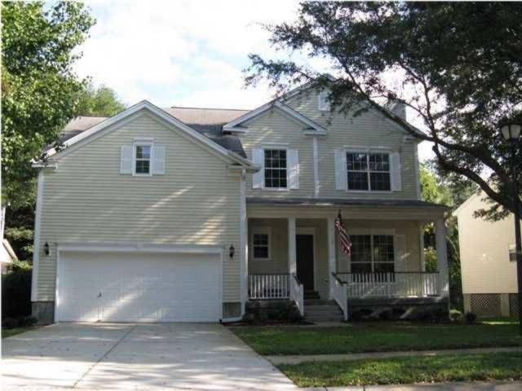

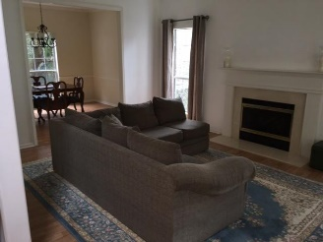
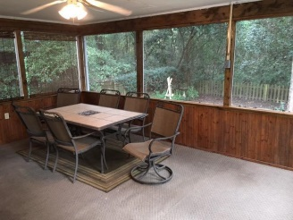
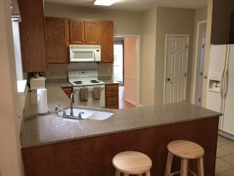
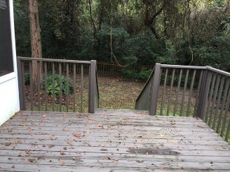
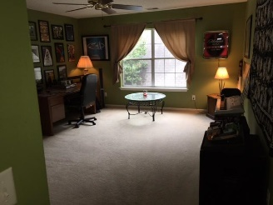
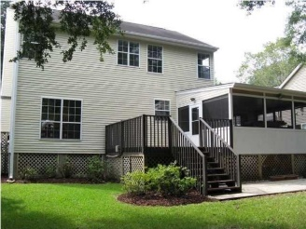
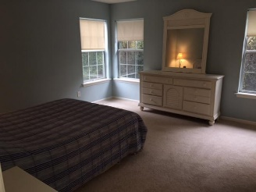
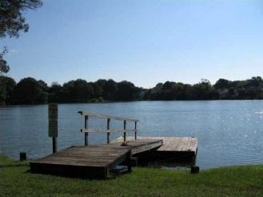
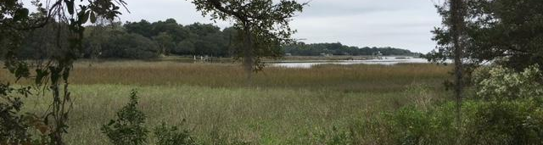


Open House Saturday from 1-4
Send your clients…they will be protected!
1647 Lazylake Court
Charleston, SC 29412 :: MLS# 15028173 :: $325,000
2,051sf :: 4 Bedrooms :: 2½ Baths
Charming and functional family home located in James Island's Wexford Sound Subdivision. Enjoy mature landscape while being 3 houses down from the community fishing pond with a dock - perfect for your canoe, kayak, or stand up paddle-board! LOW HOA FEES as well as a prime location, just 5 miles from Folly Beach and historic Downtown Charleston. This home has a large, bright eat-in kitchen and formal dining room. There is storage space in the attic as well as the two car garage. Enjoy your evenings on the back deck or in the screened porch area with your candles lit!
Jon Moore
Mobile - (843) 732-3365
jonathanwyattmoore@gmail.com
Charleston Real Estate Group. LLC
792 Folly Rd. C1
Charleston, SC 29412
www.charlestonrealestategroup.com

