Slide 1
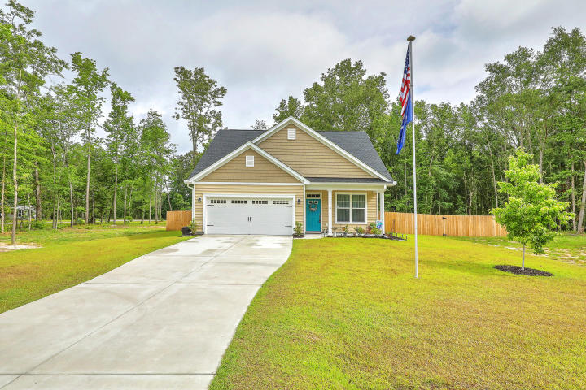
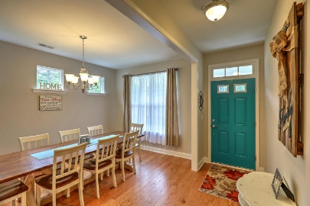
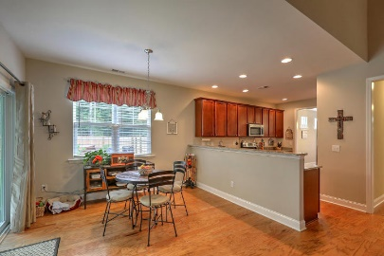
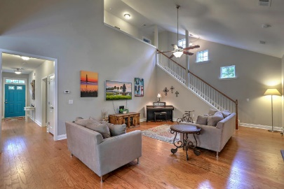
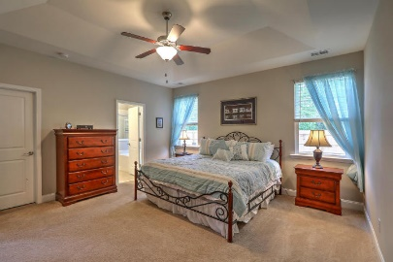
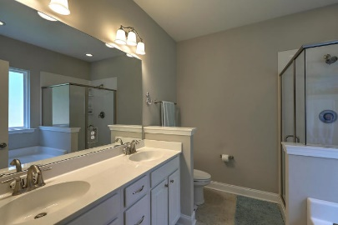
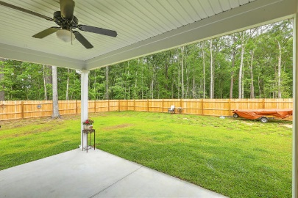
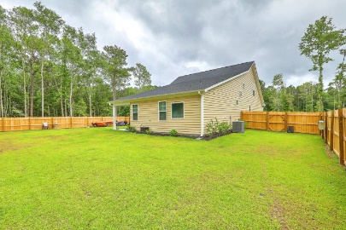


164 Fall Creek Boulevard
Hidden Hills | Summerville, SC 29483 | MLS# 18013658 | $325,000
JUST LISTED
1.15 ACRE LOT
OPEN HOUSE 5/20 1-3pm
Welcome home to Hidden Hills, a hidden gem of a neighborhood that offers 1+ Acre homesites in a country setting where you aren't on top of your neighbors! This is a fantastic opportunity to own a new home that is still under the builder's warranty. Not even a year old, this home offers an open concept floor plan with the Master Bedroom Suite on the main level, hardwood floors throughout the first floor except for tile in the laundry room and carpet in the bedrooms. Formal Dining Room opens to the spacious Eat-In Kitchen which opens to the huge Great Room. 2 additional Bedrooms and full bathroom w/double-vanity and tile floors are upstairs. Large Laundry Room offers additional storage closet. Owners added a Privacy Fence, extra sod, 5 trees(mandarin, pecan, pear, laurel oak and red maple) and cleared more of the lot. Covered patio with sliding glass door off of Eat-In Kitchen offers protected outdoor dining. In addition this home offers gutters, radiant barrier sheathing, 42" upper cabinets and flood lights.
Beth Mandell
M 843-900-1296 | O 843-871-2121
bmandell@century21properties.com
www.bestcarolinahomedeals.com
Century 21 Properties Plus of Summerville | 118 W Richardson Ave | Summerville, SC 29483

