Slide 1


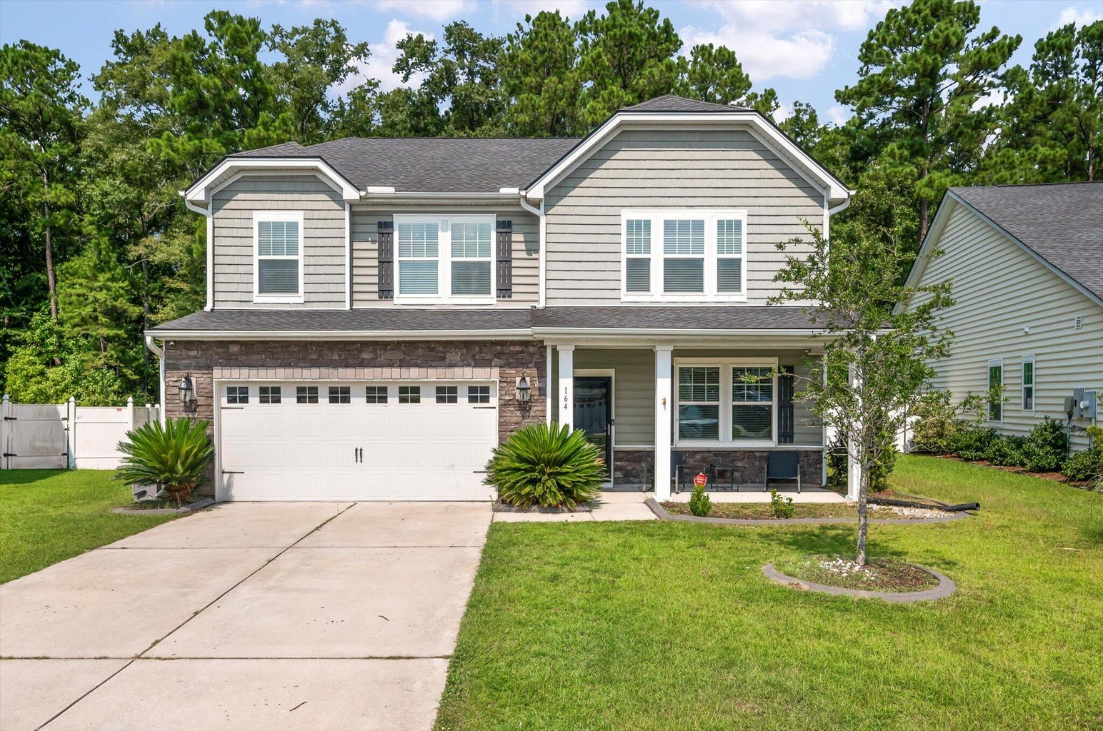
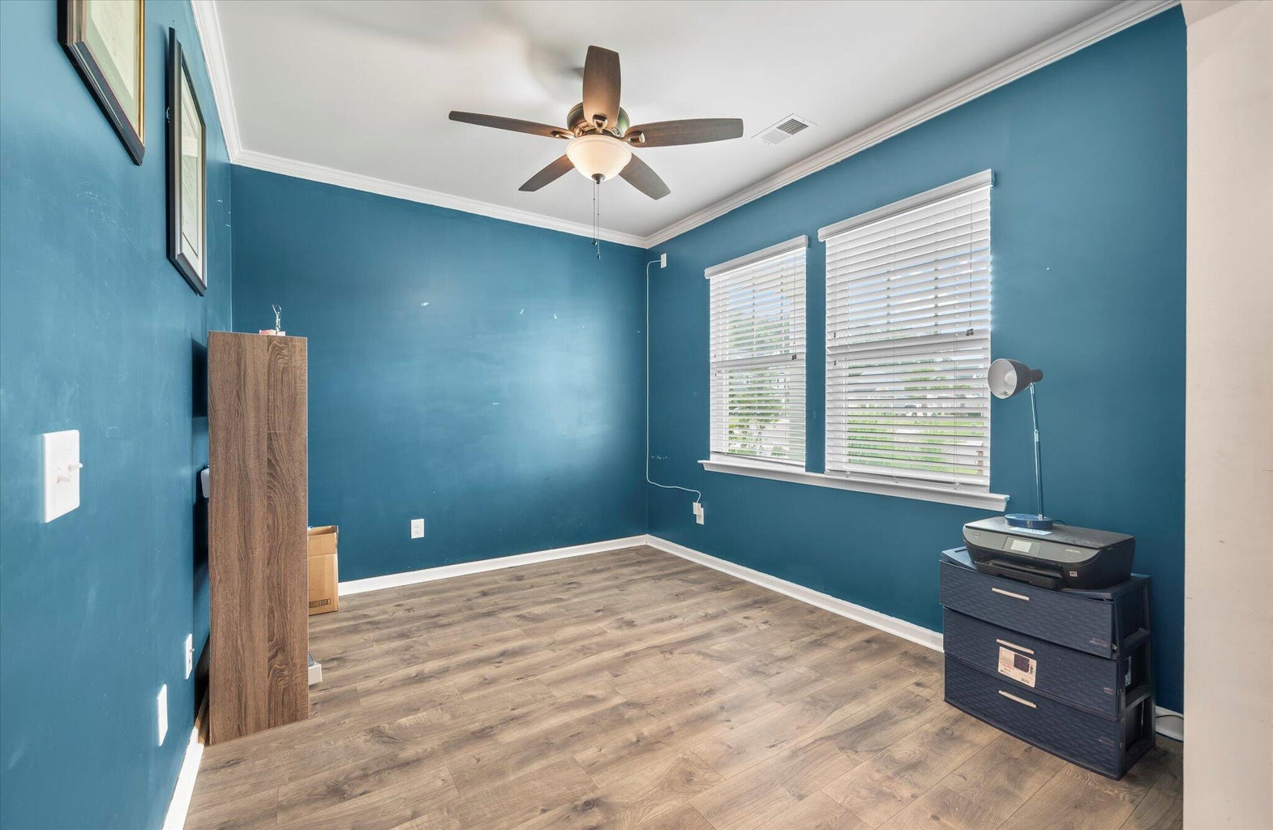
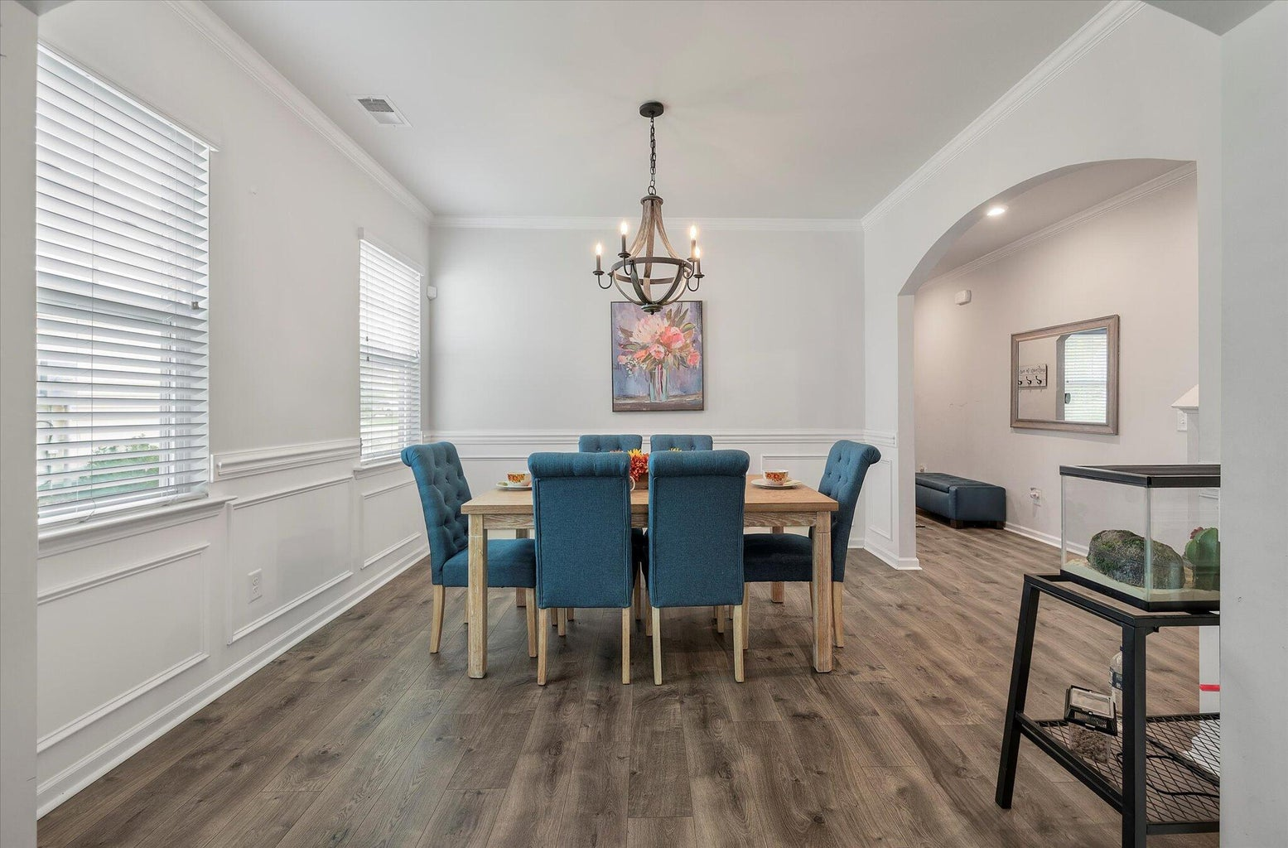
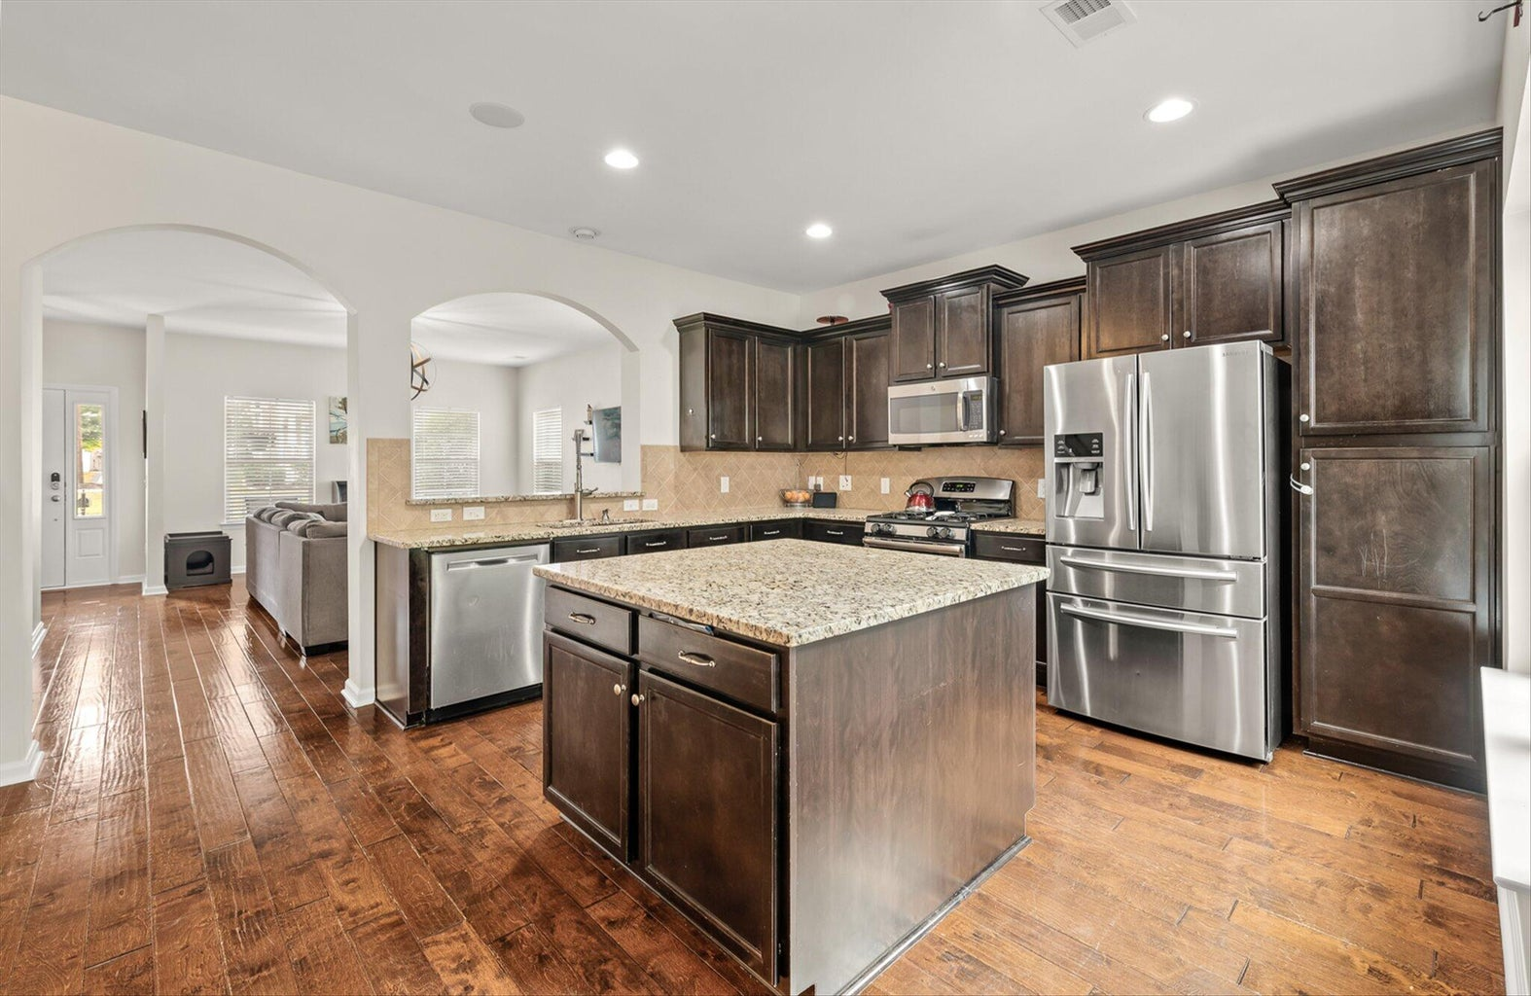
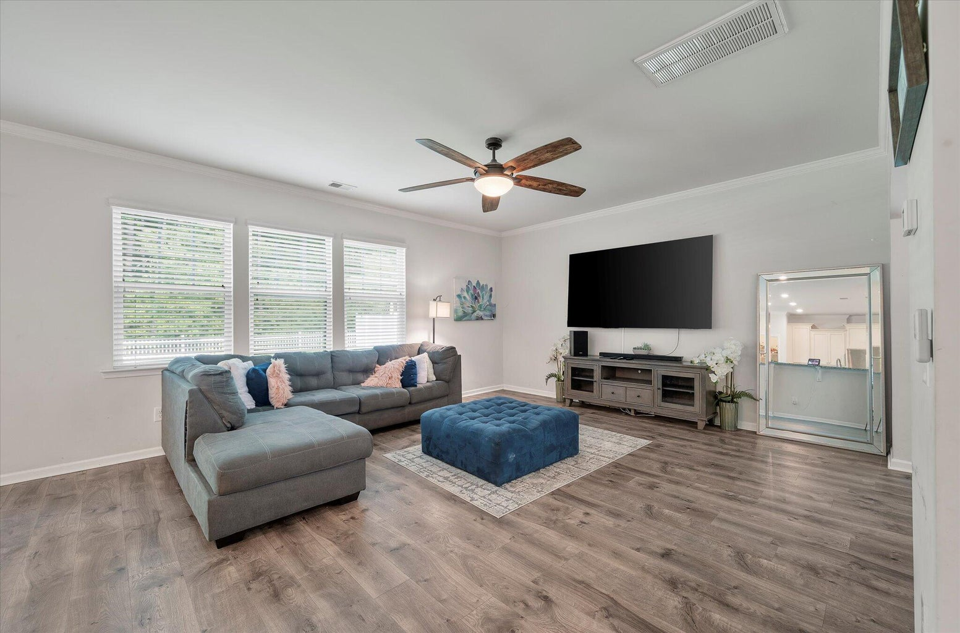
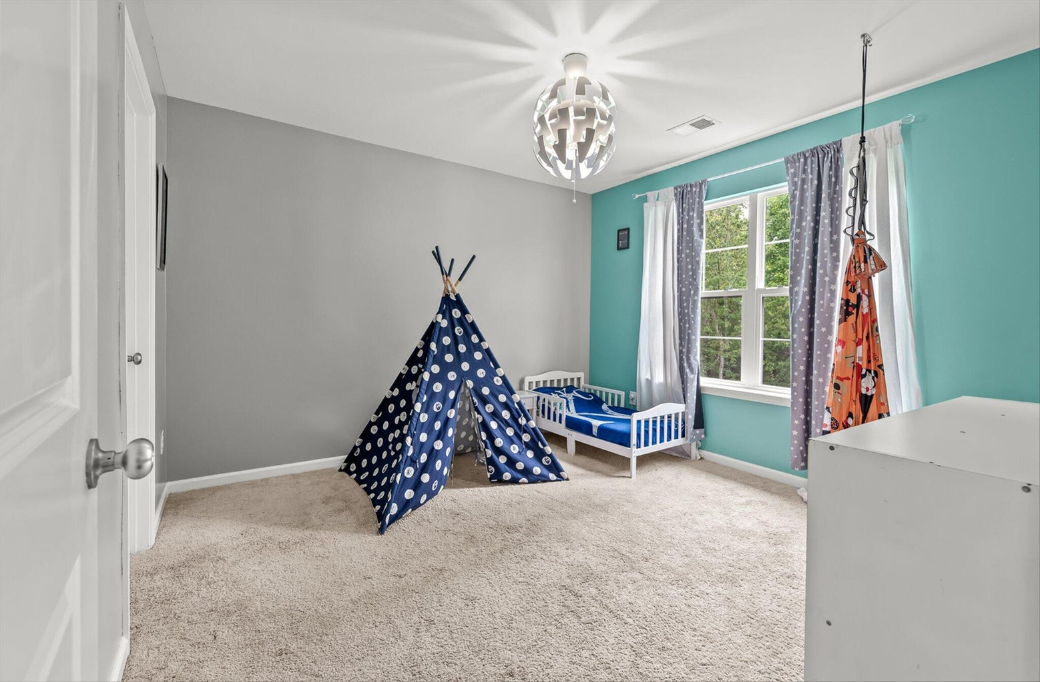
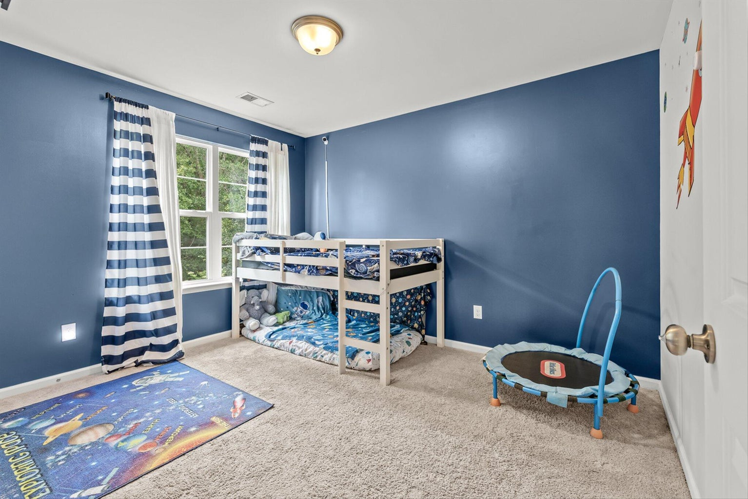
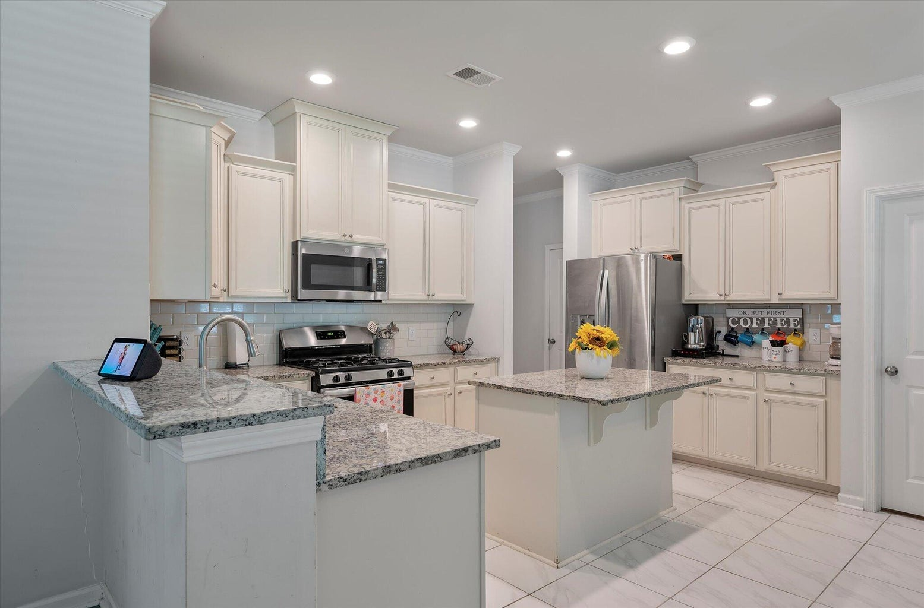
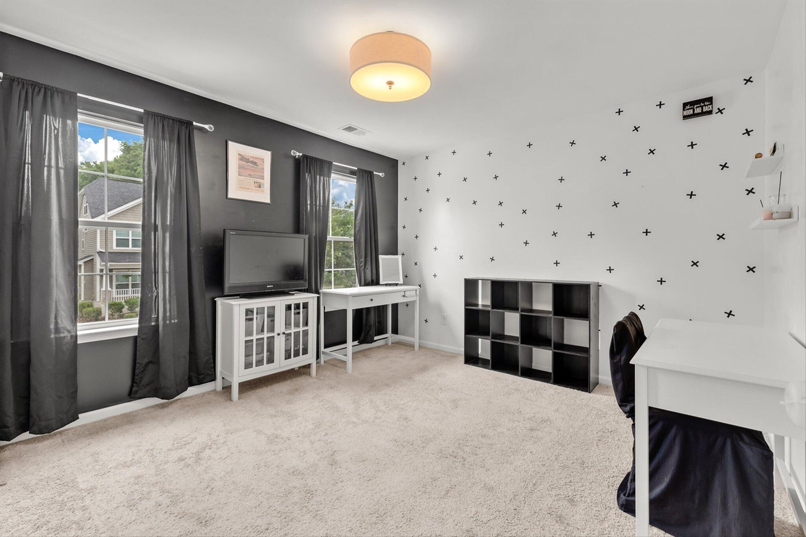
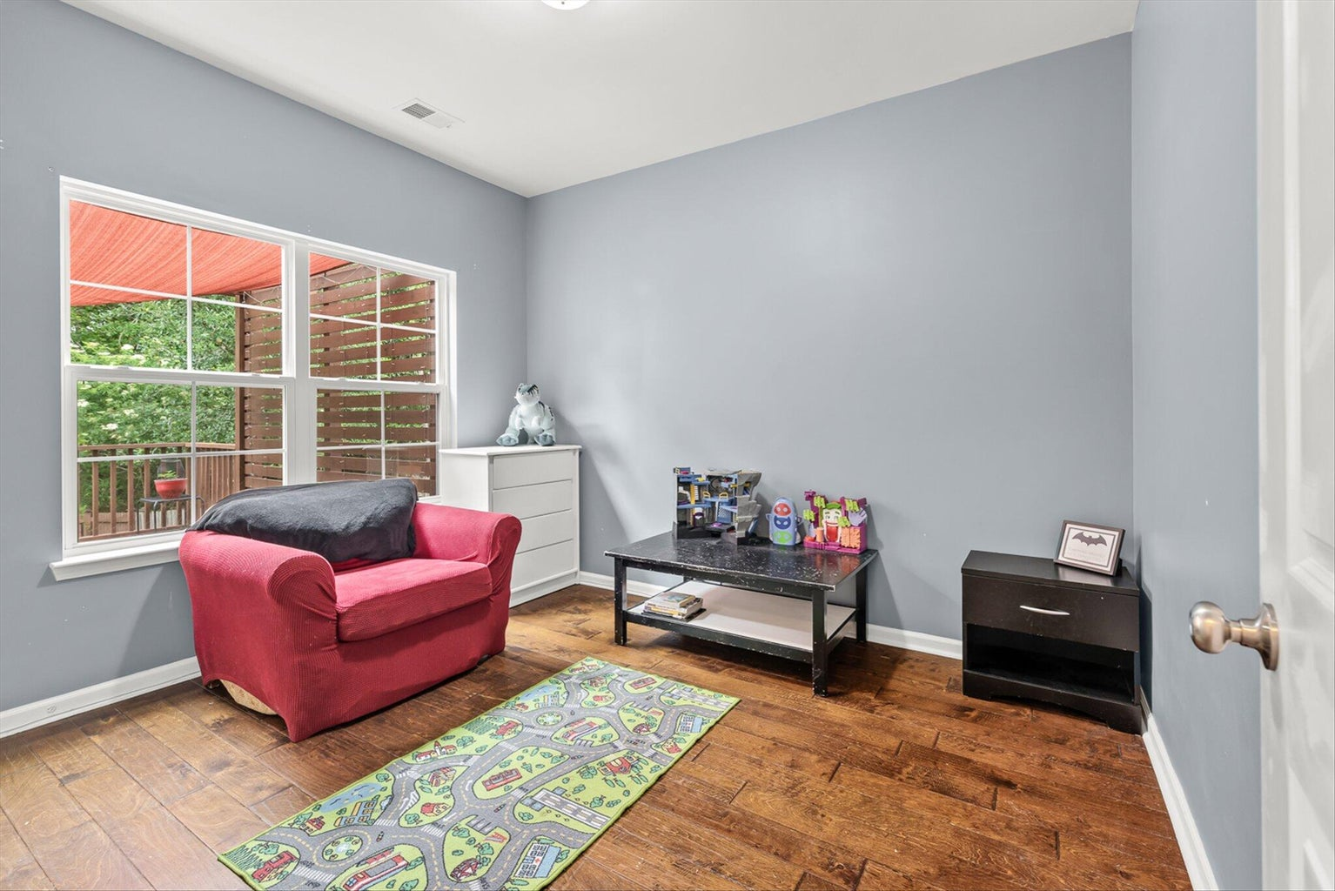
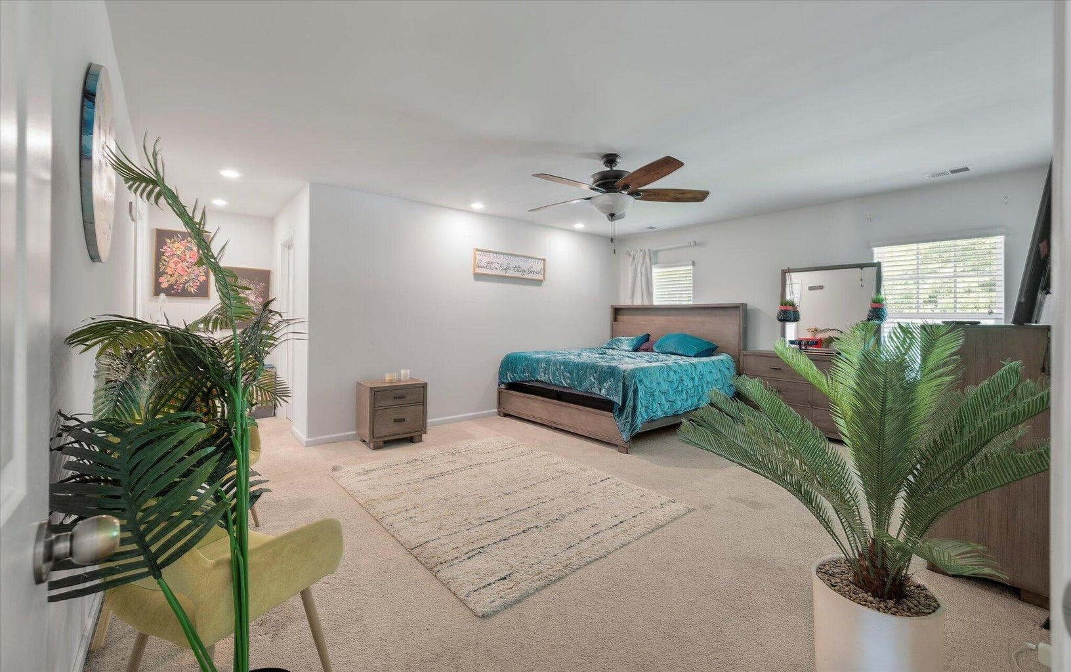
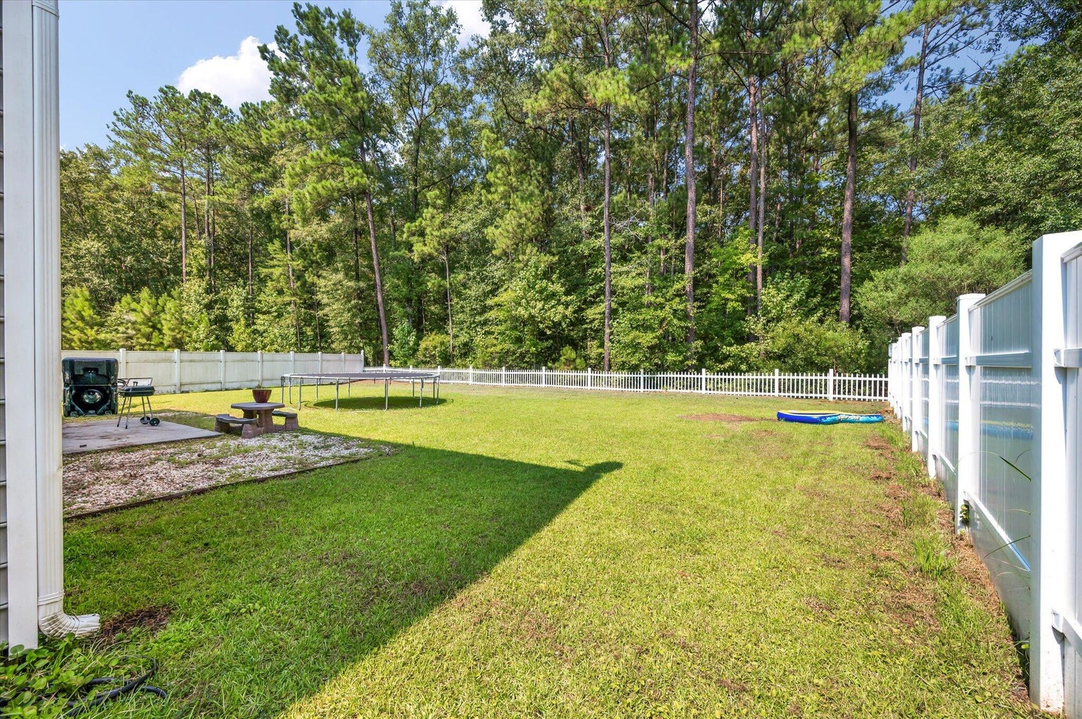
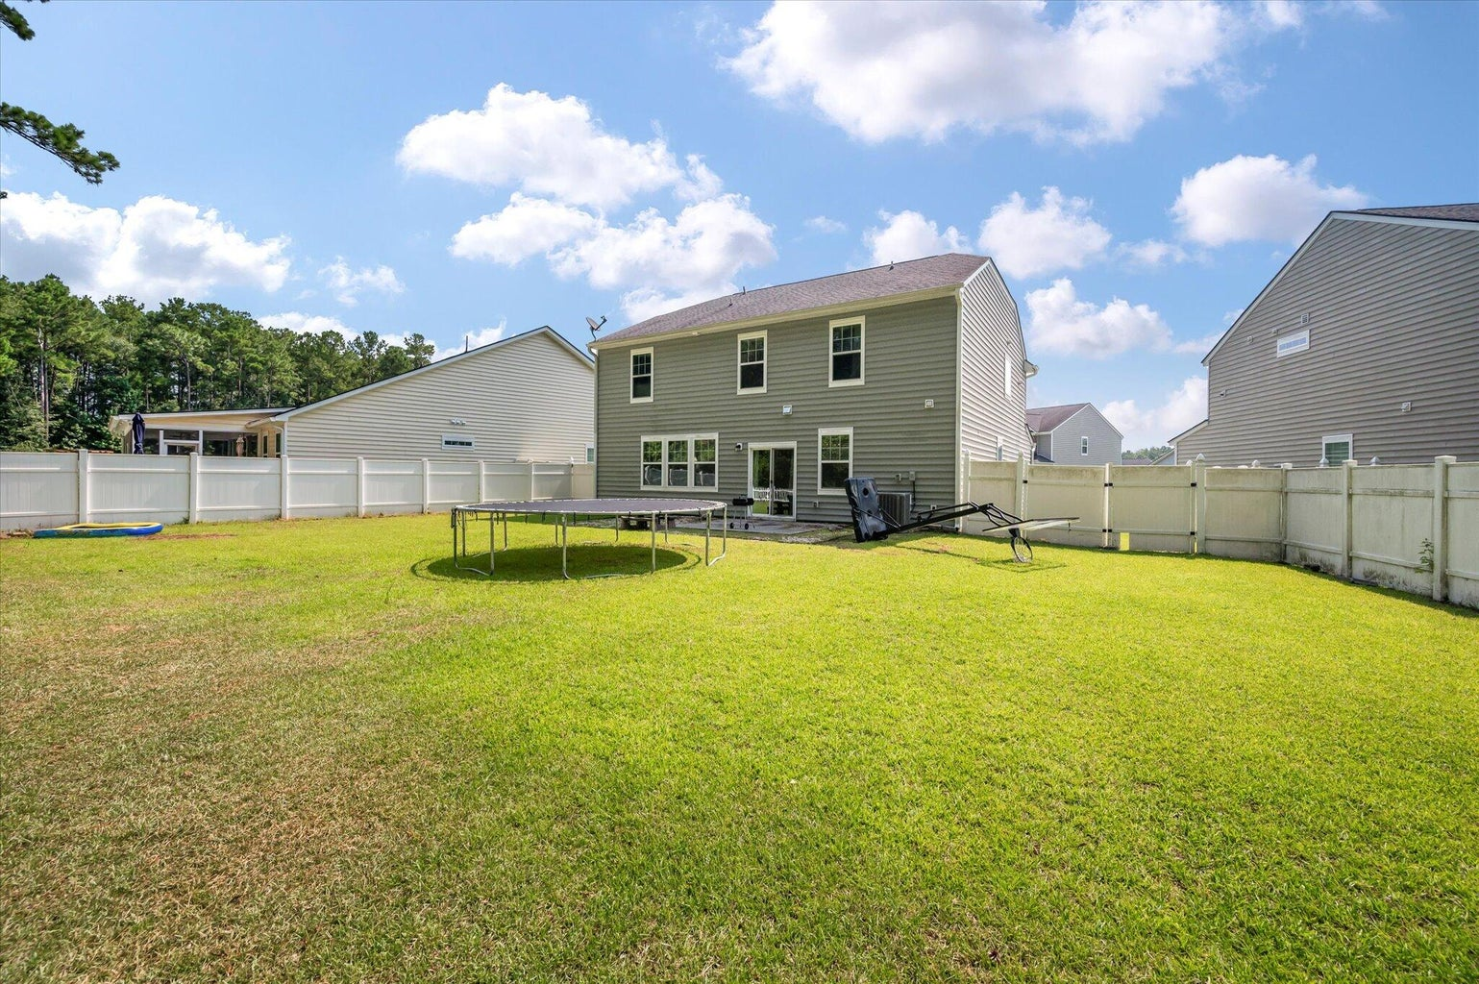
Priced $40K Below Comps
164 Blackwater Way
Fairmont South | Moncks Corner, SC 29461
MLS# 24018186 | $350,000
Check out this 4 bedroom, 7 years young Fairmont South home.
She needs some cosmetic love to include paint, carpet, power wash and a new dishwasher. Estimate in-hand for $25K from Blue Tape Solutions, but with some sweat equity and price shopping, it could be less.
Nothing known that would exclude it from VA or FHA loans. Great candidate for a reno loan as it's priced $40K below comps.
Tina Hartford
EXP Realty LLC
843-779-8646
tinahartford@lowcoasthomes.com

