Slide 1
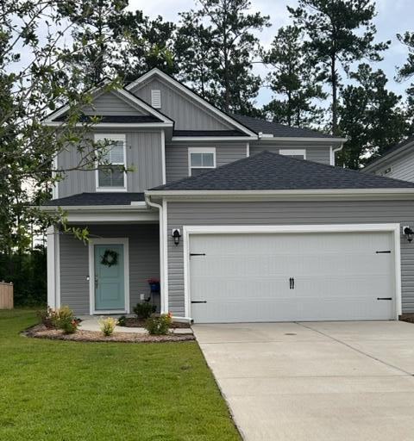
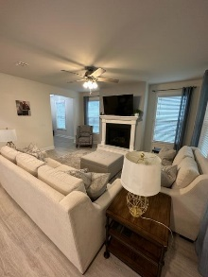
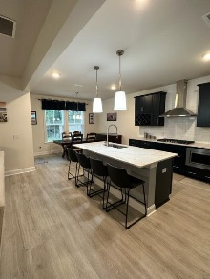
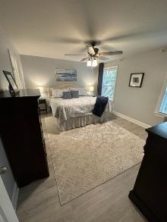
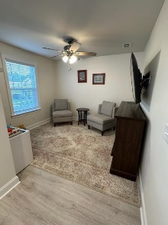
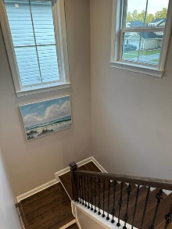
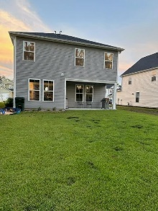


Our Loss is Your Gain...Being Transferred!
164 Wappoo Trace Lane
Cane Bay Plantation | Summerville, SC 29486
MLS# 23014368 | $424,999
Your new home is waiting at Jasmine Pointe in Cane Bay Plantation. Freshly painted with many upgrades an unexpected transfer back to Texas is making this beautiful home available for you! Upon entering you are welcomed into a large foyer with plenty of light, then right into the family room with a gas fired fireplace. With almost 2000 square feet of living space this spacious home, with an open floor plan, has light grey LVP floors and oak treads on the stairs to the second floor. Large windows across the back of the home, looking onto a wooded backyard, the natural light and privacy is an added bonus. The laundry room, half bath and access to the garage are all privately tucked away behind the kitchen. The deluxe kitchen with admiral navy cabinetry & quartz countertops, single under-mount stainless kitchen sink with an upgraded faucet creates an exciting place to make some creative family meals and memories. The stainless-steel double wall ovens & gas cooktop make this kitchen the talk of the neighborhood! It is one of a kind. The backdoor to the covered patio is just steps away for those nights of cookouts where you can enjoy a very private large backyard. Hunter ceiling fans have been added in all bedrooms and in the family room. Upstairs you will find three spacious bedrooms and a loft, with custom shelving in all closets and linen closets. The master bath has tiled walls and floor with a semi-framed shower, while the guest bath has a full-sized tub for those little ones in the family. Don't forget the pool, playground area and access to the 350-acre lake for all Jasmine Pointe residents.
GREEN FEATURES: Energy Star Air Filtration; Energy Star Appliances; Energy Star Central Heat/Air; Energy Star Insulation; Energy Star Windows; Tankless Water Heater. HERS Rated score 55.
Living room TV does not convey.
Susan Day
susan@charlestonbyday.com | 732-754-7554
The Boulevard Company, LLC | 806 Johnnie Dodds Blvd Ste 100 | Mt Pleasant, SC 29464

