Slide 1
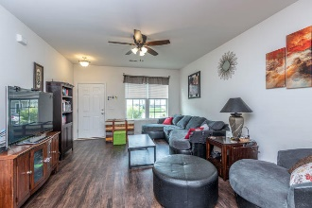
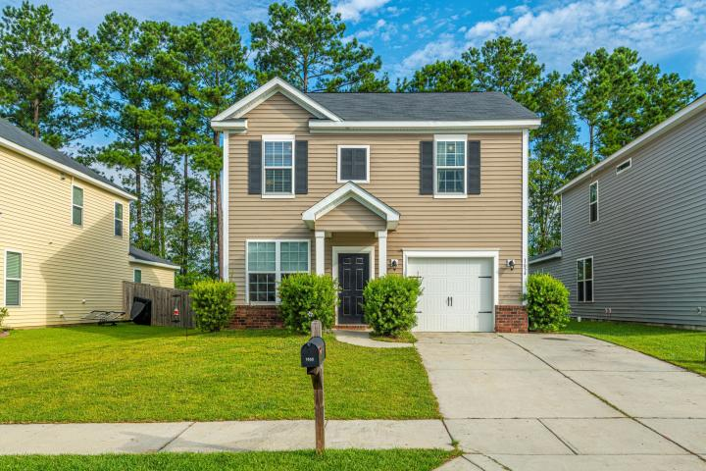
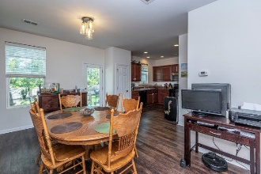
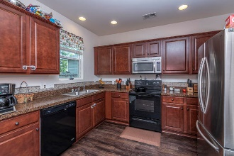
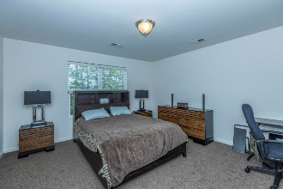
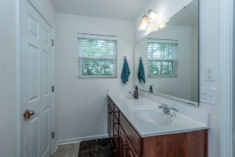
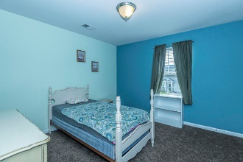
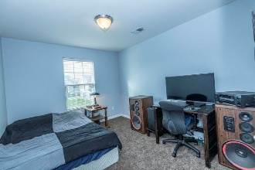
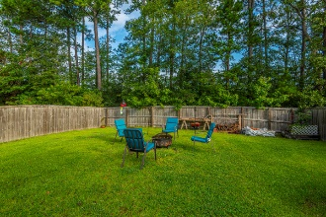
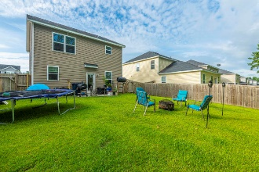


LOCATION! LOCATION! LOCATION!
1654 Eider Down Drive
Drakesborough ~ Summerville, SC 29483
MLS# 20017630 ~ $227,000
MINUTES FROM VOLVO This home is just missing one thing, YOU! Walking in you will be greeted with the very open floor plan with loads of updates, new carpet, new flooring on main, and a brand new AC put in August 2019. The open floor plan is perfect for hosting all the friends and family. The Large open kitchen has updated appliances and has a large pantry. This is a chef's kitchen or perfect for family dinners.
The backyard is right off the kitchen so the party can always move out there in the large back yard with a patio, this home backs to the woods so the privacy is awesome! Three bedrooms up stairs along with the second floor laundry room complete this beautiful home.
Don't miss the opportunity to call it yours!
Cori Fisher
843-952-6278
coridfisher@gmail.com
Carolina One Real Estate :: 1530 Old Trolley Road :: Summerville, SC 29485

