Slide 1
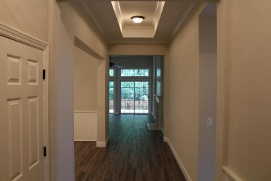
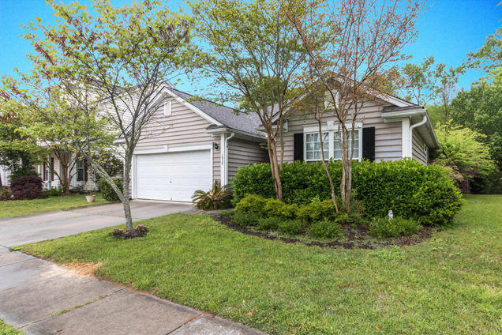
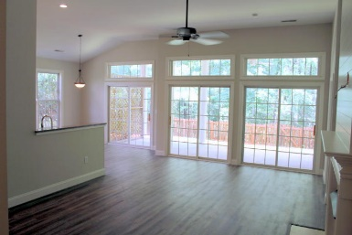
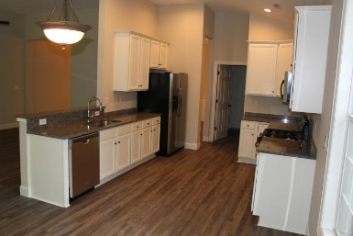
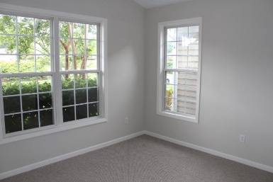
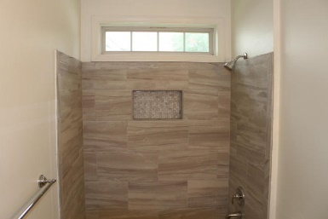
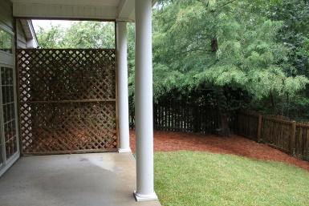
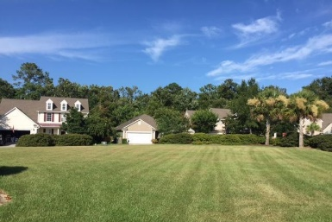

1656 Jorrington Street Park West ~ Mount Pleasant, SC 29466 MLS# 16020755 ~ $395,900
Gorgeous Layout ~ Price Reduced!
Fabulous Park West home in the Berkleigh subdivision nestled on a quiet cul-de-sac so your kids can ride their bikes with no worries of traffic. The home has been meticulously renovated and ready for a new family. The open floor plan and cathedral ceiling accent the numerous upgrades.... Beautiful hardwood floors, Freshly painted in coastal grey hues with ship lap gives the home a coastal feel. New bathrooms with custom tile, new kitchen with granite and stainless steel appliances with a gas stove. The home has a private backyard with beautiful greenspace. Close proximity to the Pool and all of Park West amenities. Elementary and Middle School are within biking distance.
Steven Olson
(843) 412-9848
solson1071@aol.com
Fred McCutcheon
(843) 608-8490
fred.mccutcheon@agentownedrealty.com
AgentOwned Charleston Group | 902 Savannah Hwy | Charleston, SC 29407 | www.agentowned.com | (843) 769-5100

