Slide 1
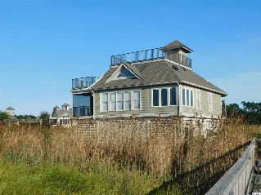
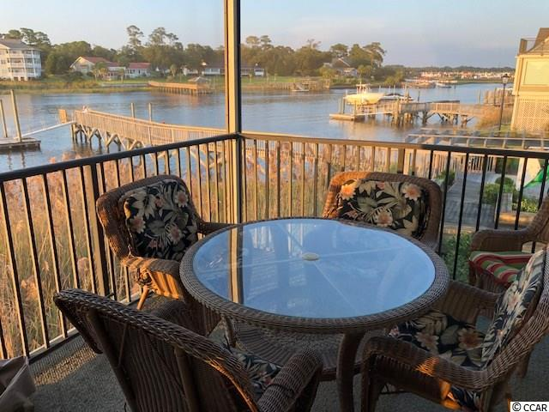
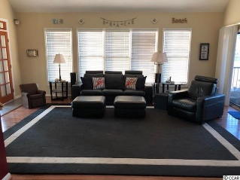
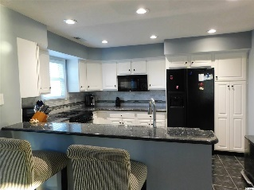
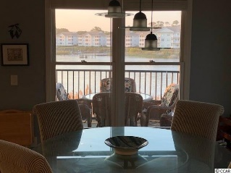
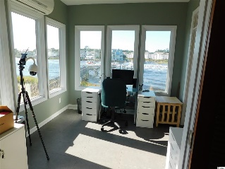
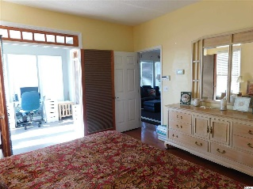
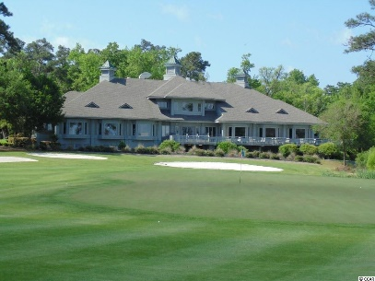
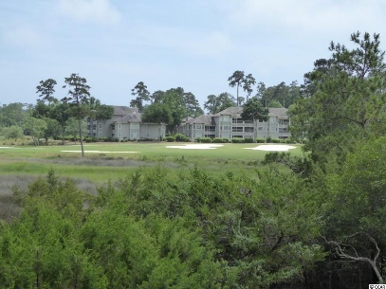
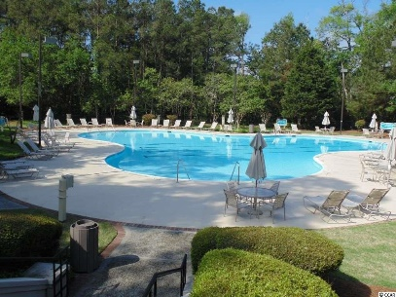
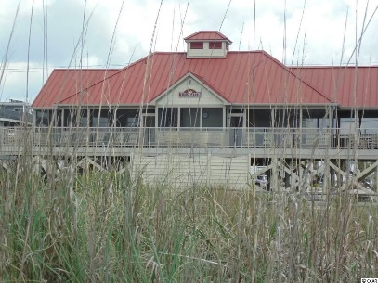
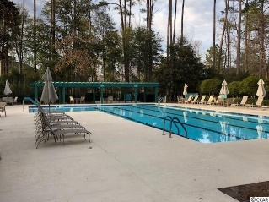
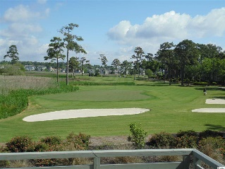
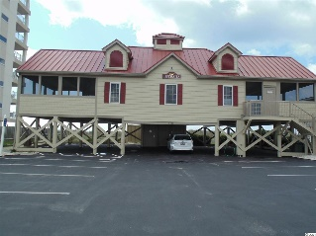


Water Front Property
1657 Harbor Dr
Tidewater Plantation
North Myrtle Beach, SC 29582
MLS# 1921117 | $529,900
Harbor Loft Home in Tidewater Golf Plantation. Magnificent views of Intra-Coastal Waterway from every angle inside and outside. This beautiful 3 bedroom 3 1/2 bath homes gives you the beach life, boating, golf and much more. It offer 3 decks with views of Tidewater Golf Course and waterway also offers a 4 stop elevator. Kitchen has granite counter tops with updated appliances. Home has a shared dock with neighbor. Private boat lift with 2 state of the art lifts one is 10,000 lb lift and second is a 5 lb, lift manufactured by Tide Tamer. This house is next to the Harbor Dock and gazebo enhancing the views and outdoor activities. Views include Little River and to the North and Swing Bridge to the South. Most spectacular sunsets in the evening. Tons of storage under the house with an enclosed storage. If you like single family living but don't want the outside yard maintenance this is for you. All yard word is included in HOA. Tidewater is a 24/7 security community. Homeowners have 2 pools, one for homeowners only and second pool is for guest and rentals, ocean front beach cabana, (for homeowners only), fitness center, golf, restaurant and pro-shop.
Donna Fortney
703-624-3517
dofortney@aol.com
Robert Jacoby
843-455-7075
rcjacoby@aol.com
NEW WAY PROPERTIES MYRTLE BEACH

