Slide 1
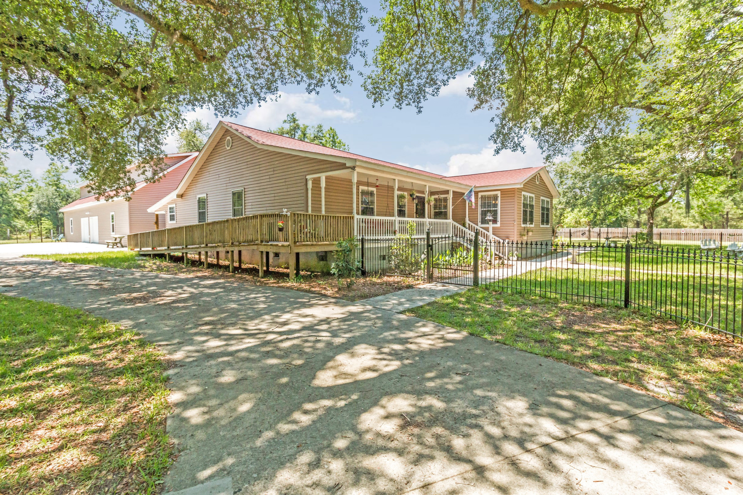
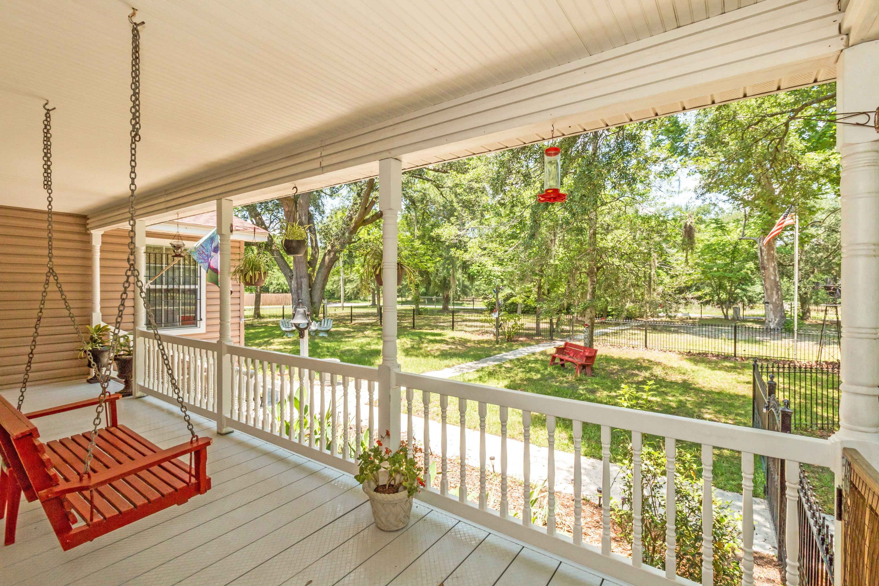
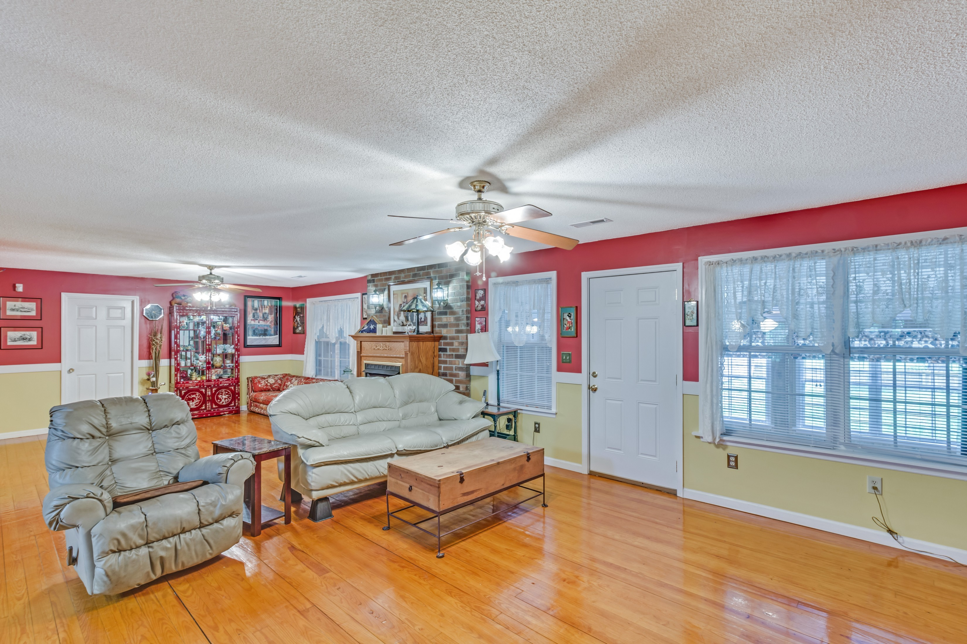
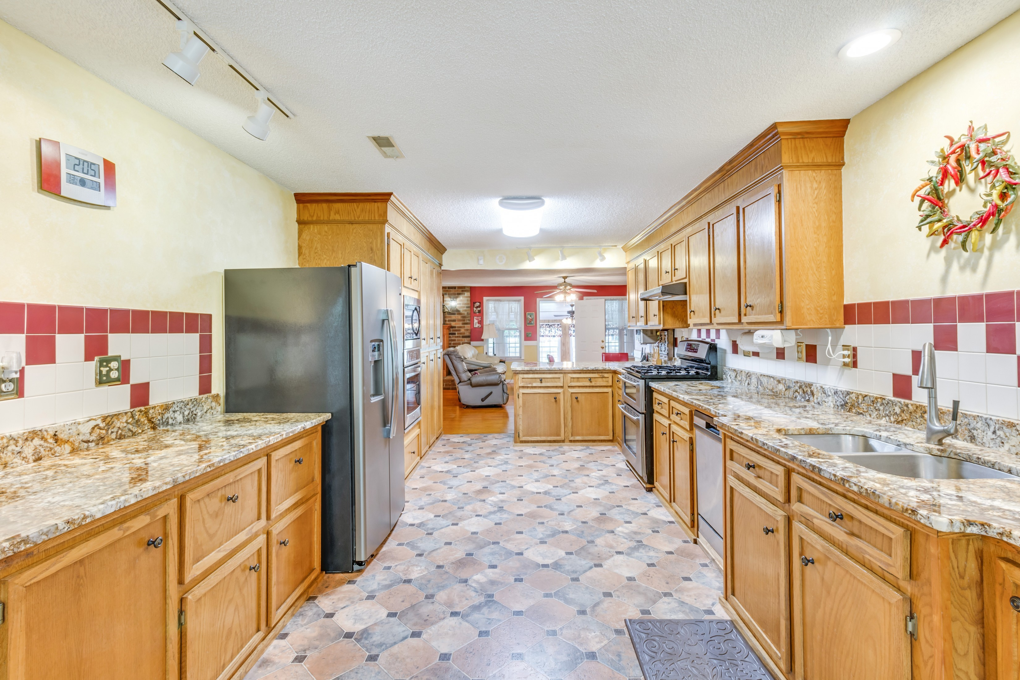
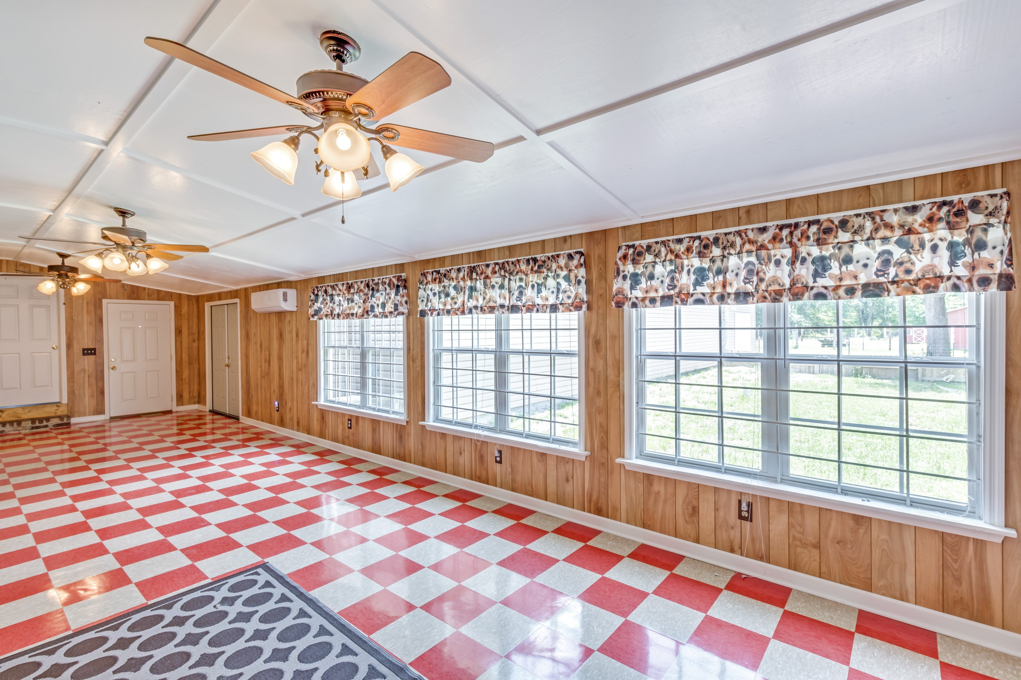
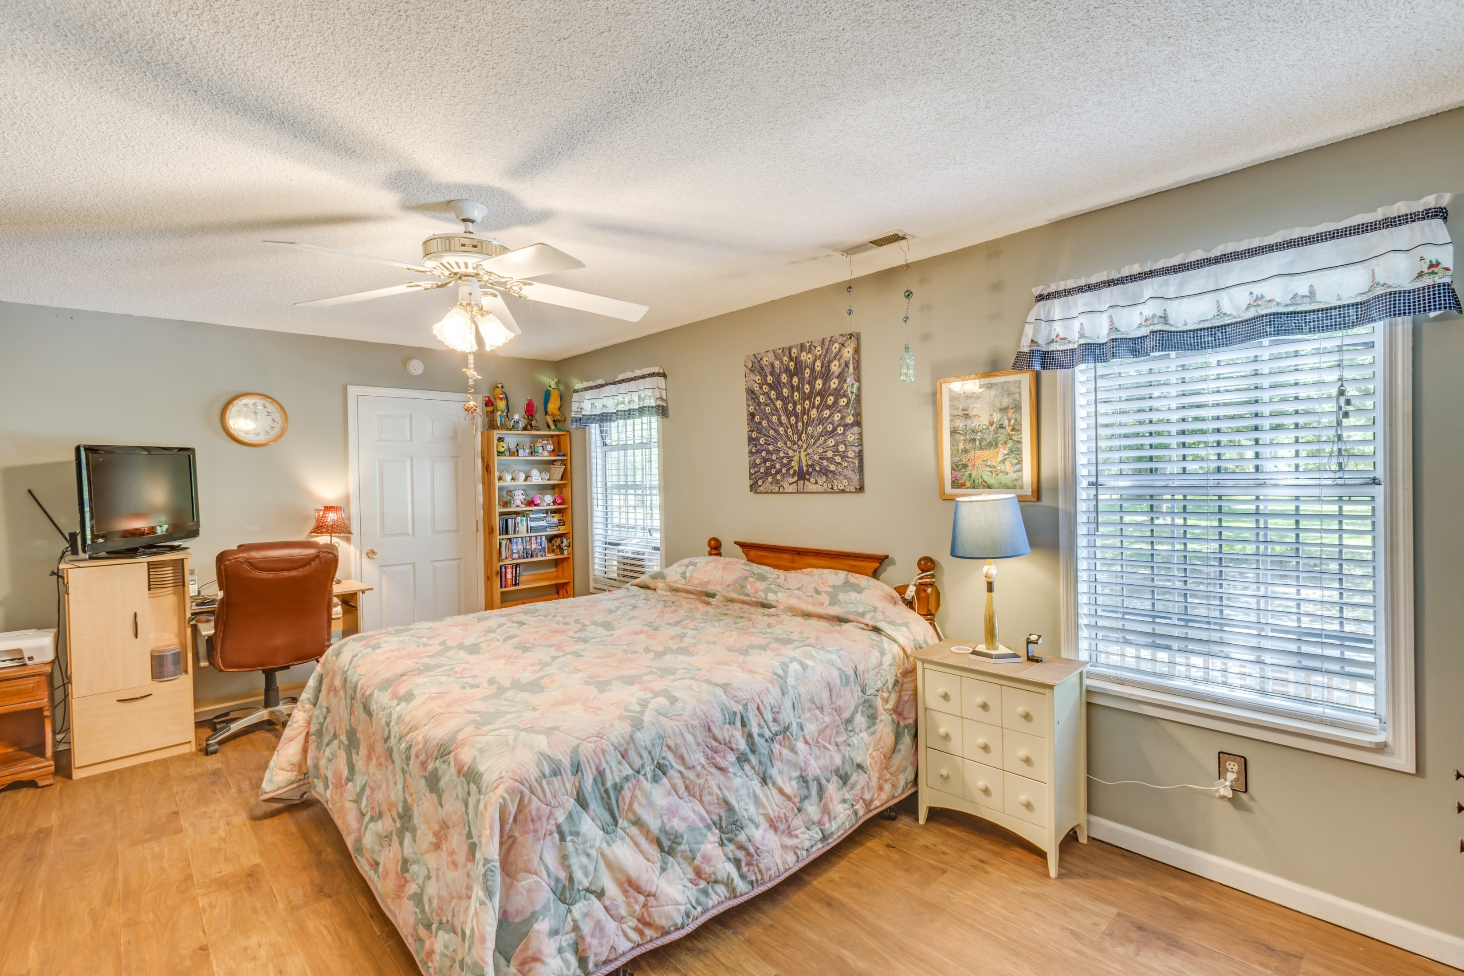
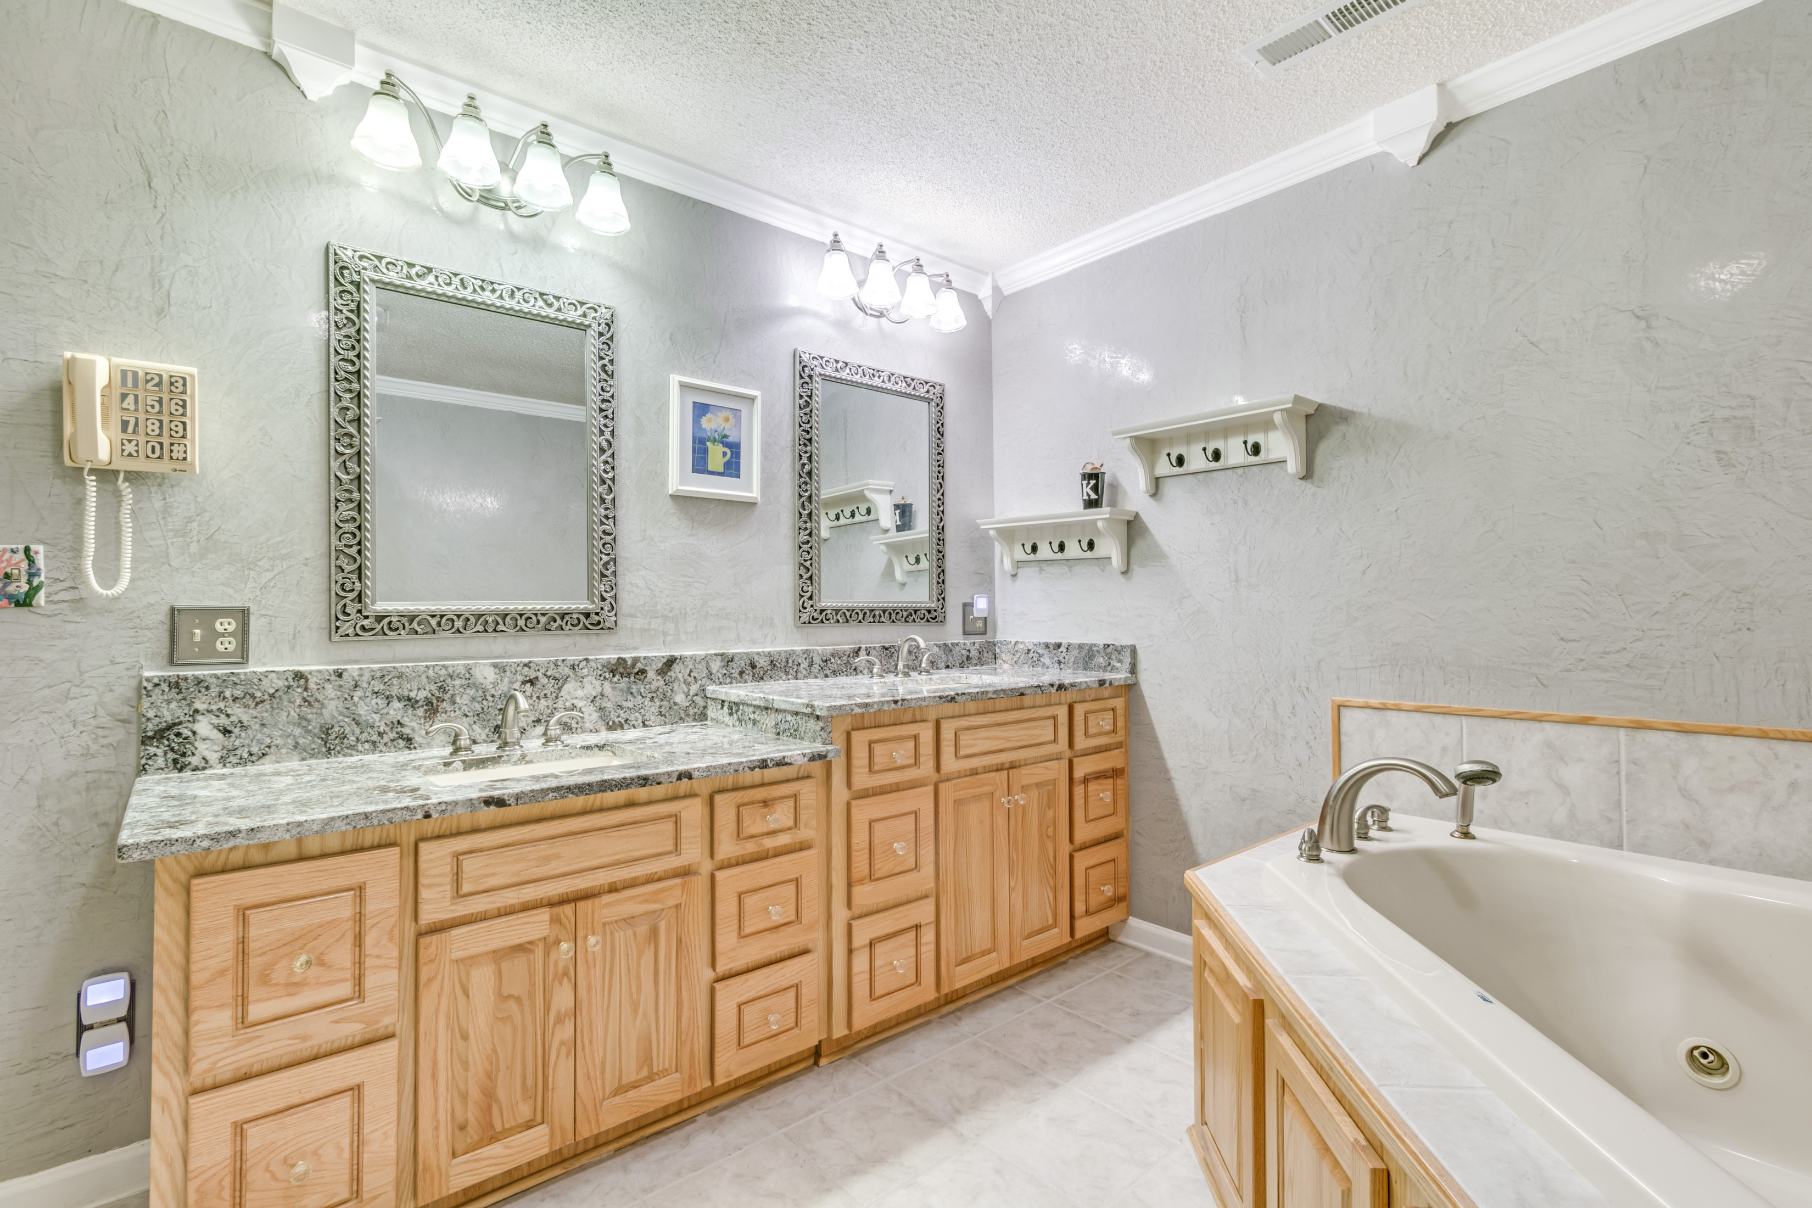
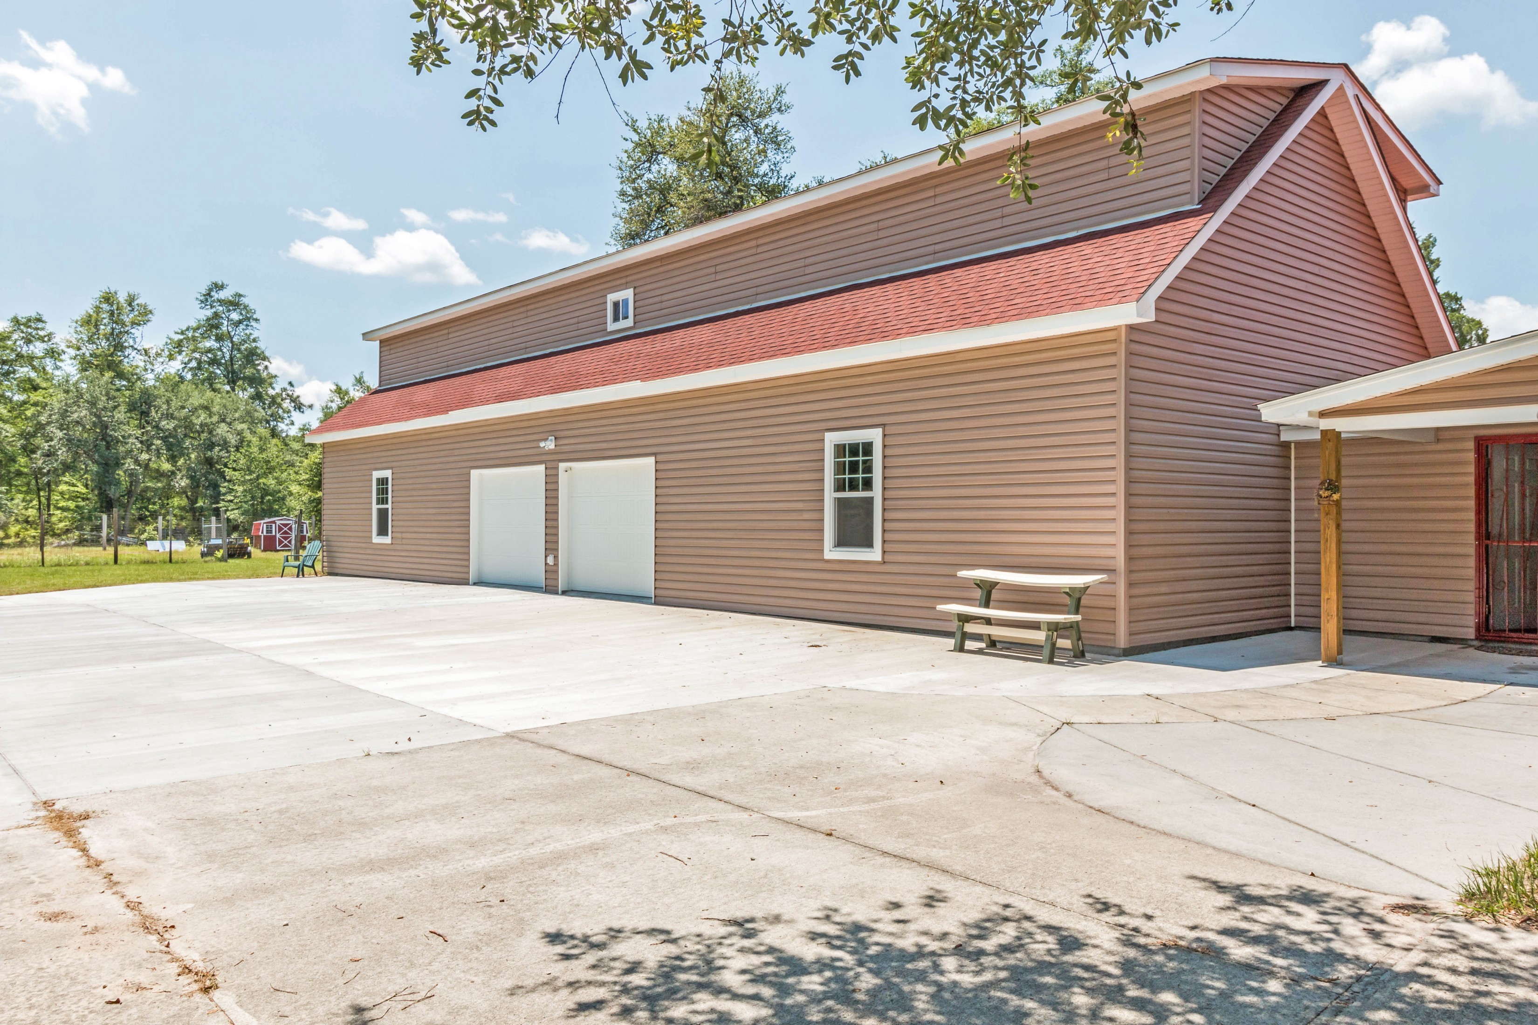
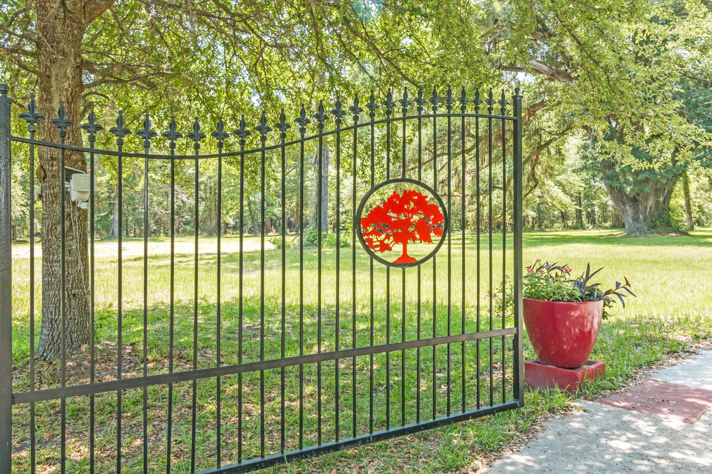


1659 Sandridge Road Lazy J Dorchester, SC 29437 MLS# 16014053 $475,000
Country Estate So Close To It All!
SELLER OFFERING $2500 TOWARDS CLOSING COST AND A ONE YEAR HOME WARRANTY!
One of the most picturesque homes in Dorchester County! This property boasts 12 acres with huge gorgeous live oaks, massive muscadine arbor, pecan trees, stunning dogwoods, pomegranate, fig, and loquat trees. The home is beautiful with it's brand new oak style vinyl siding, new architectural red roof, and brand new custom built ON-SITE wrought iron fencing with 4 gates and a large arched double gate that opens to a beautiful winding cement drive up to your brand new home. This home features brand new high end granite counter-tops in the kitchen and all 3 bathrooms. The kitchen is spacious and offers plenty of cabinet space and a side door entry to the master bedroom porch. The foyer and living room areas are large with original hard wood floors that were just recently refinished.
The living room area also has a gas burning fireplace insert. The master bedroom is large and features a walk in closet, a private porch, and a large brand new remodeled master bath with high end upgrades. The three additional bedrooms are spacious in size and is perfect for a growing family. The back sun room is brand new, large and is perfect for a game room, man cave, or hosting large family events. Enjoy a quiet evening on the
extra large front porch with gorgeous views of large oaks and the serenity this property provides. During the summer months relax in the above ground pool which is only a year old. One of the best features of this home is the brand new built and attached 2000 sq. ft. garage with 3 automatic car garage doors, massive amounts of extra storage, a finished 1200 sq ft second floor space, a workshop with separate 200 amp electrical service, and plenty of opportunities for extra finished space. The home also has another single garage on the opposite end of the home. Property also features a very large barn style shed with tons of shelving, cement pad, and electricity.
Conveniently located and only 20 mins away from Summerville, less than 10 mins to Ridgeville , close proximity to the new Volvo plant, and easy access to I-26 and I-95. If you want peace and quiet with a splash of country serenity then you will not want to miss out on this one of a kind opportunity.
Brandon Ray
(843) 499-1928
brandon.ray@carolinaone.com
www.therightrayhome.com
Carolina One Real Estate
900 N Main St
Summerville, SC 29483

