Slide 1
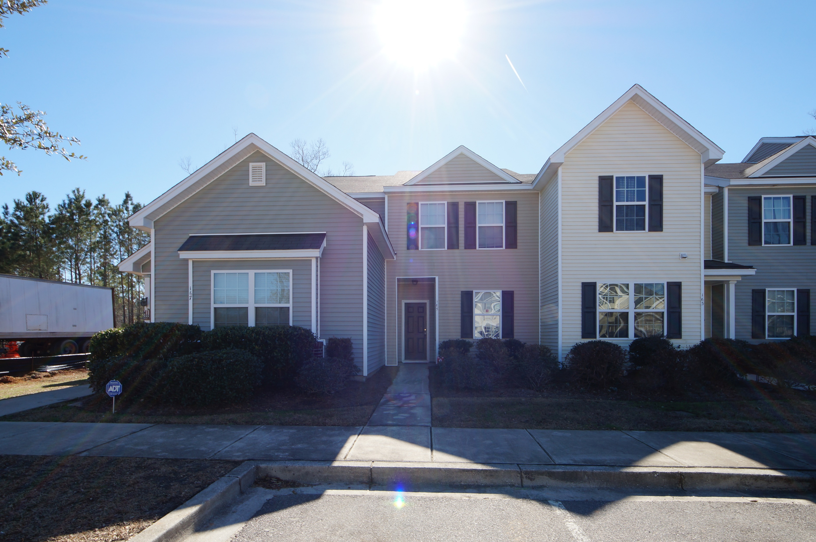
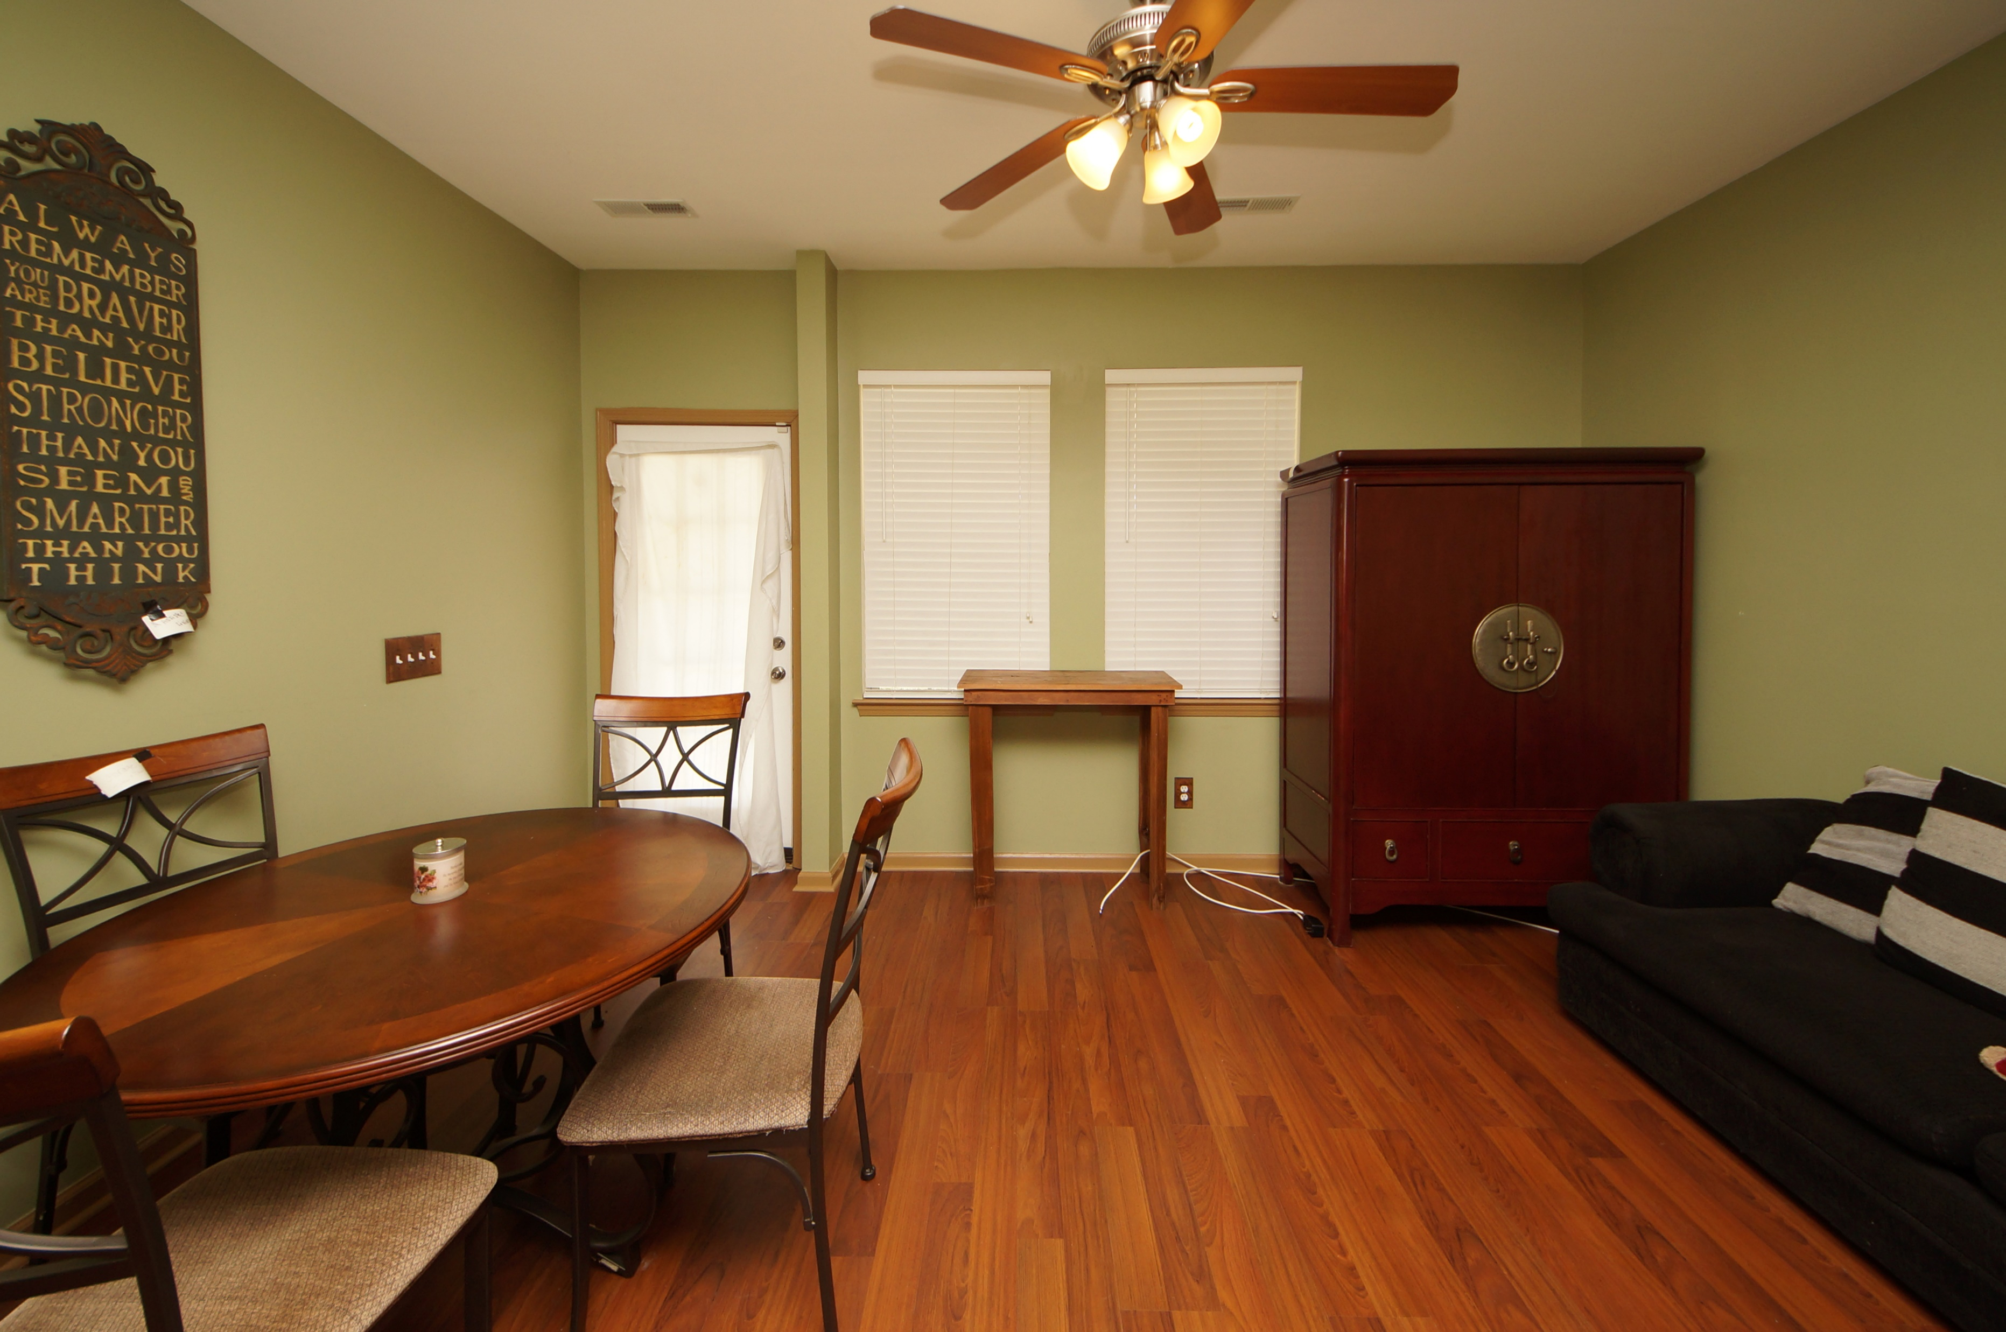
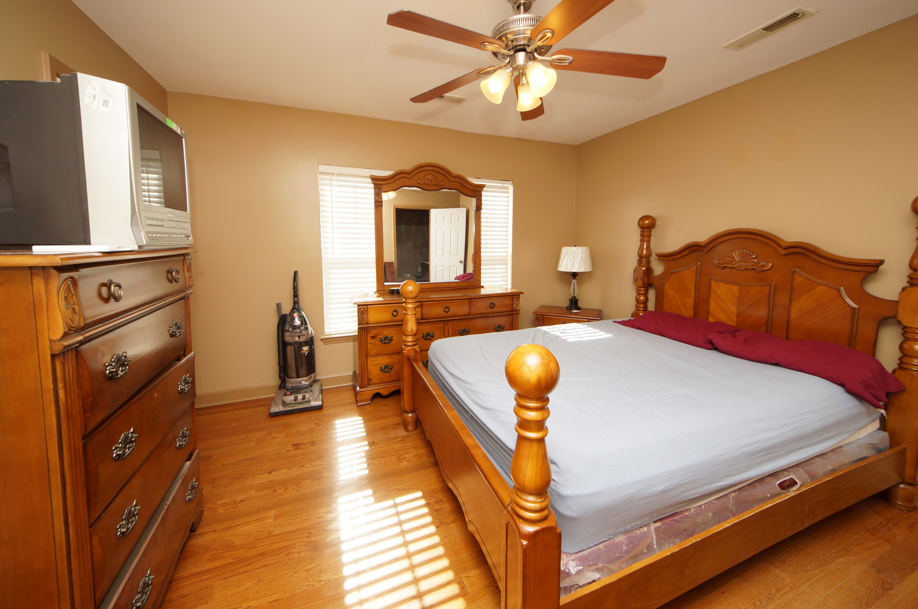
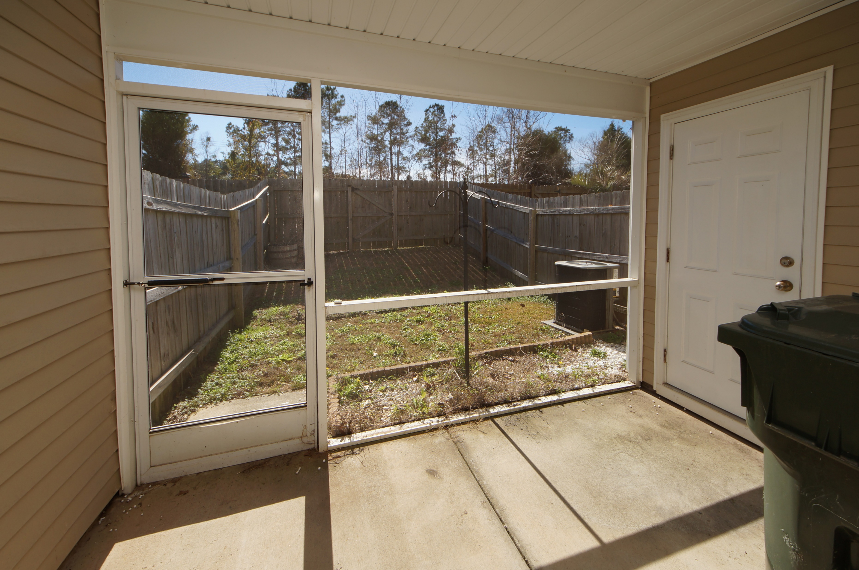


165 Woodward Road Liberty Hall Plantation :: Goose Creek, SC 29445 MLS# 18002756 :: $135,000 2 Bed / 2 Bath
Move-in Ready in Liberty Hall
Just Reduced
This 2 bedroom town home is located in Liberty Hall Plantation in the section of Waterford Townhomes.
Laminate flooring is found throughout the entire home including staircase. 2 spacious bedrooms, 2 full bathrooms and laundry room are located up stairs.
Seller is in the process of moving so this town home is ready for a new owner!
Connie White, Broker
843-532-3356
conniesyouragent@gmail.com
Charleston Homes · 597 Old Mt. Holly Road · Suite 301 · Goose Creek, SC 29445

