Slide 1
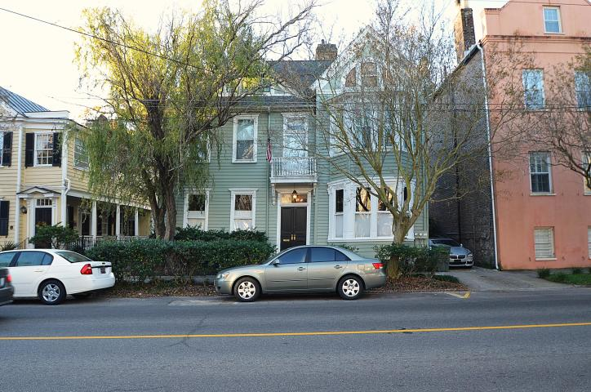
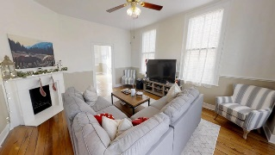
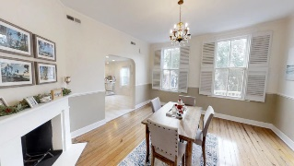
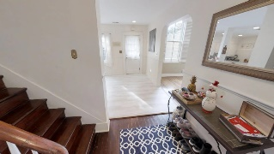
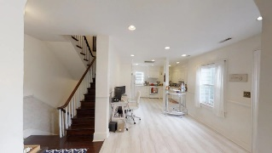
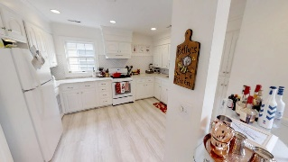
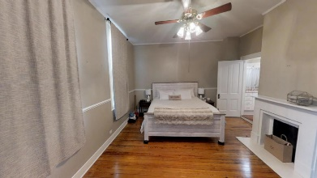
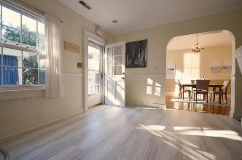
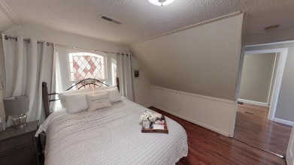
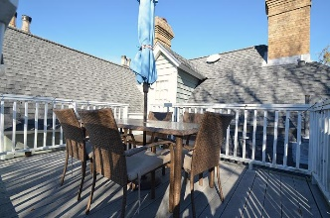
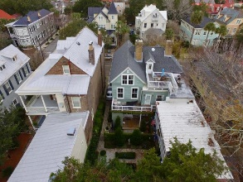



165 Broad Street A2
Charleston, SC 29401
MLS# 18032467
$749,000
Downtown Condo
Just Listed
+
Open House
Saturday, March 24th 11-1
Historic Charleston Home "Survivor" of the 1886 Charleston Earthquake. Situated within the Historic District of Downtown Charleston and a short distance of all that Downtown Charleston has to offer. This is a wonderful and unique home situated on the 2nd and 3rd floors of a once Grand Single Family Residence. Spacious rooms and a wonderful open floor plan this home offers oversize rooms, high ceilings and a great detail of wood molding and trim. Updated kitchen with Quartz countertops and patterned flooring, this home offers the best of a well maintained yet classic design and appeal. Second and 3rd floor terraces and decking provide a sanctuary and serenity not found in many homes. Floor plan and interior photography illustrates the many features found throughout.
Take the Virtual Tour to see what this home truly has to offer.
https://my.matterport.com/show/?m=m5WUGz98Aqn
Andrew Sorrentino
(843) 371-6218
andrew.sorrentino@agentowned.com
The AgentOwned Realty Co
902 Savannah Hwy
Charleston, SC 29407
Real Estate • Mortgage • Insurance
www.AgentOwned.com
Marty Sorrentino
(516) 551-0082
martysorrentino@gmail.com

