Slide 1

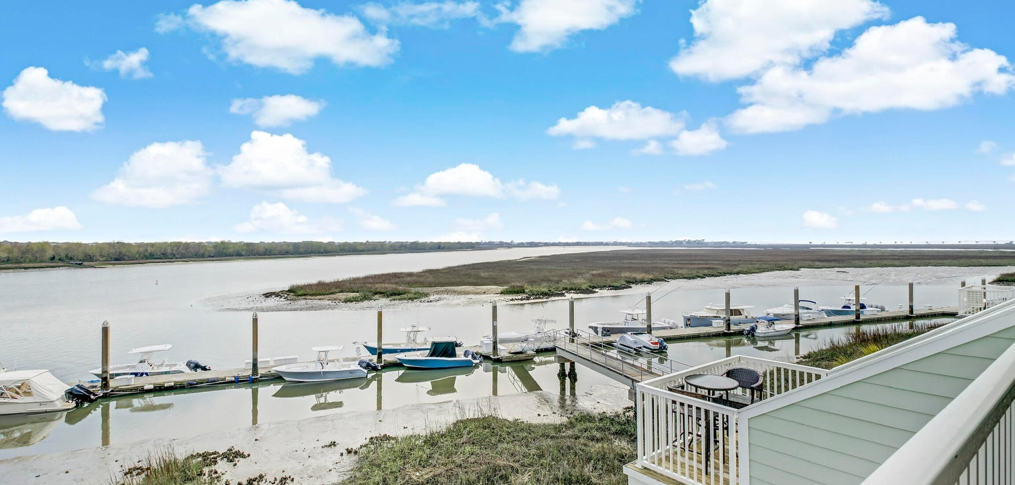
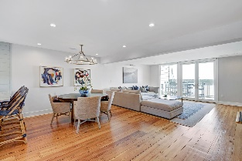
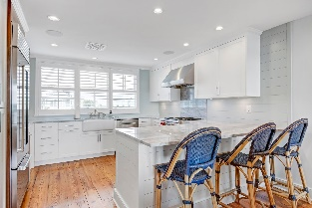
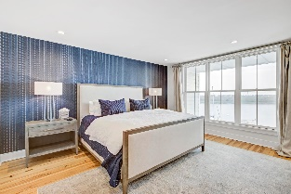
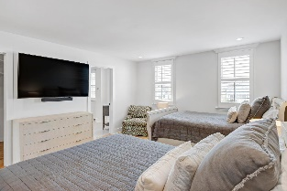
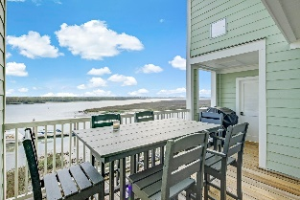
1664 Marsh Harbor Lane C Marsh Harbor | Mount Pleasant, SC 29464 | MLS# 23004200 | $1,575,000
Sweeping Water Views At Your Doorstep
Stunning luxury condo in the beautiful town of Mount Pleasant. This property offers an alluring marsh view with dock access, 15 minutes from shopping at the Mount Pleasant town center, and ONLY 5 minutes from the beach on Sullivan's Island!!! It features an upstairs laundry room, soaking tub overlooking the marsh, a grand open floor plan, fireplace, balconies, and so much more! Enjoy the peace and quiet of the exclusive, gated Tolers Cove Community with access to the clubhouse, pool, tennis courts, exercise facility, and a full service marina! Come see your future home while you still can!!!!
John Vance
843-814-0039
jcvance29483@gmail.com
Alexa Carroll
702.553.7100
alexancarroll@outlook.com
Southwind Realty, LLC | PO Box 94 | Sullivans Island, SC | 843.814.0039 | www.charlestonrealtypro.com

