Slide 1
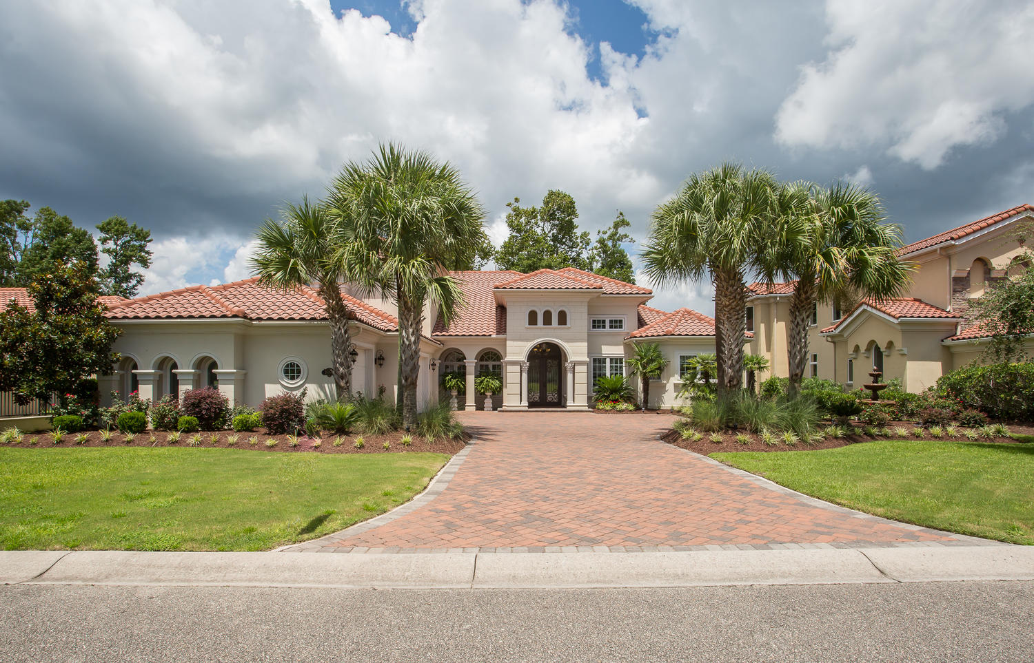
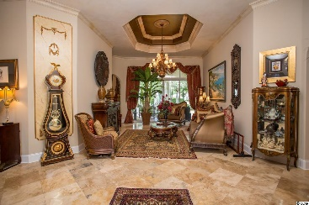
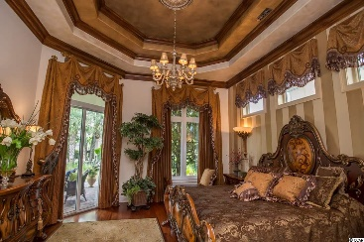
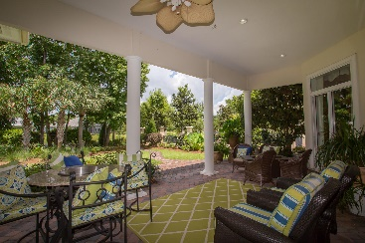
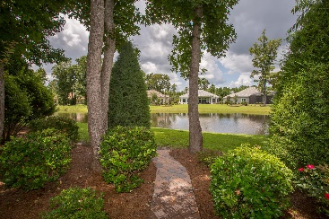

1664 Malaga Cir
Myrtle Beach, SC 29579 ~ MLS # 2005701 ~ $895,000
Grand Dunes
Former Model Home
Open House Sunday 1-4
$599,900
SUN, BEACH, AND GOLF!!!!
This Mediterranean style steel framed two story home features 4 bedroom, 4 full bath with the master bed on the first floor and is situated lake front. Home features artist designer touches which make it one of a kind. The emergency whole house generator and the polished travertine floors, the imported Italian vanities in the master bath and walk through shower are among various features. The 3 car garage has a car lift to make it into a 4 car garage.
This home is priced below appraised value!!
Betsie Babcock 843-446-0064 |  | bbs0064@live.com www.peedinrealestate.com
Peedin Real Estate | 876 Antigua Dr | Myrtle Beach, Sc, 29572

