Slide 1
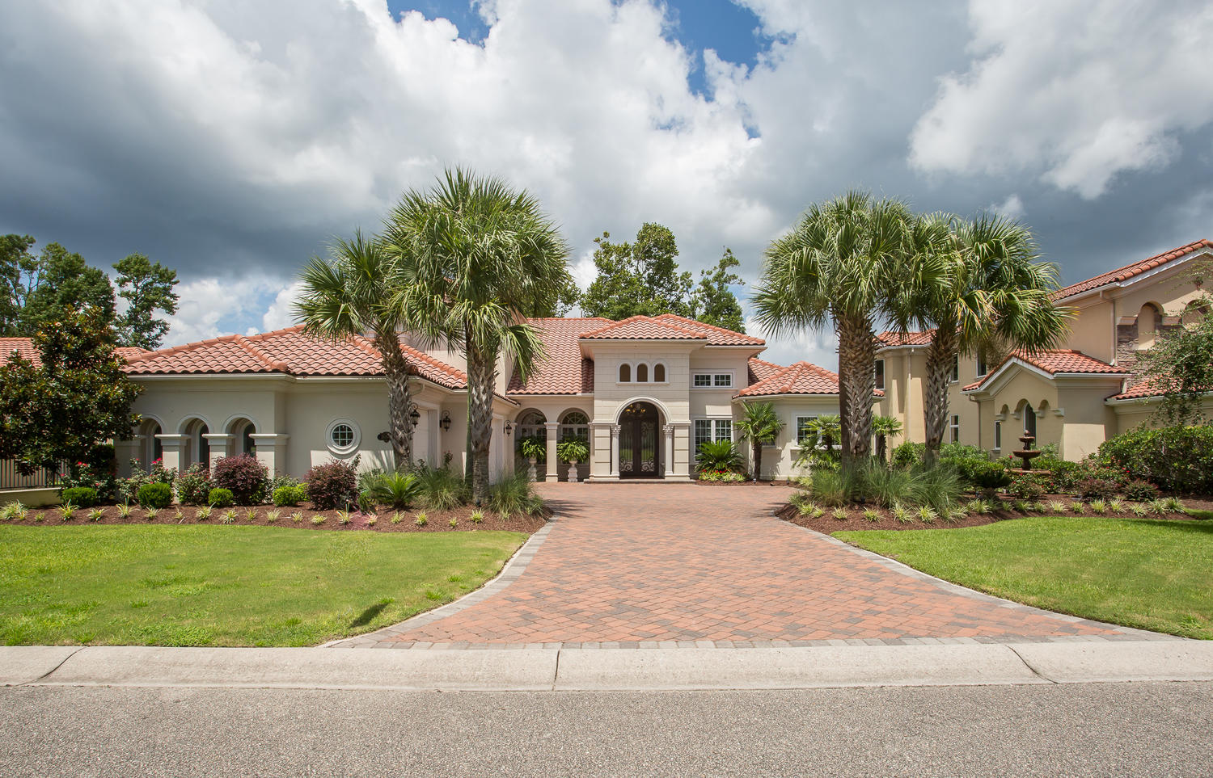
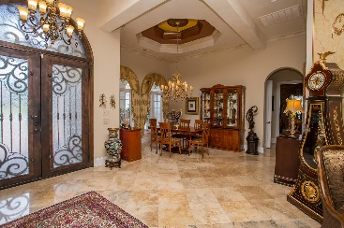
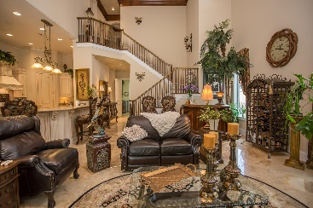
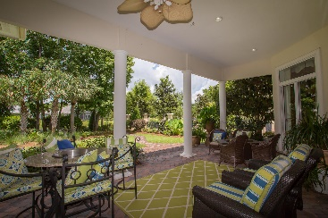
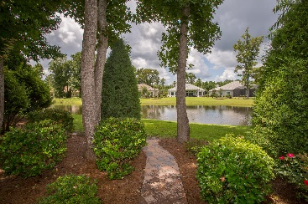

1664 Malaga Cir Myrtle Beach, SC 29579 ~ MLS #1905312 ~ $928,900
Grand Dunes
Former Model Home
Open House Sunday 1-4
$599,900
Significant price improvement -pass through the manned guard house and over the waterway to view this elegant 4br/4 ba lake front home with many extras including a whole house generator located in the grande dunes - myrtle beaches most prestigious gated community which features two golf courses one of which is truly private . residents enjoy membership in the 25,000 square foot ocean club with its private ocean front pools, poolside and formal dining rooms and second floor meeting rooms. this elegant 4br/4ba steel framed home features 4100 sq. ft of living area with over 5700 sq. ft. under roof with whole house automatic generator. features include - first floor master wing with his and hers walk in closets, wine and coffee bar with wine cooler. the adjacent master bath includes his and hers italian hand carved vanities , jetted whirlpool tub and unique walk through shower. the gourmet kitchen features custom cabinetry , hand crafted back splash with granite counter tops and a venetian plaster ceiling. also located on the first floor is a guest suite with ensuite bath, formal living and dining room and an additional full bath with outside access. the family room is amazing with its fireplace and breath taking 25ft. vaulted ceiling . the elegant stair case leads to the second floor which includes two additional bedrooms with ample closets and a full bath. also located on the second floor is a large heated and cooled storage room. every where you look you will see custom hand crafted designer touches which make this home a one of a kind show place.
Betsie Babcock 843-446-0064 |  | bbs0064@live.com www.peedinrealestate.com
Peedin Real Estate | 876 Antigua Dr | Myrtle Beach, Sc, 29572

