Slide 1
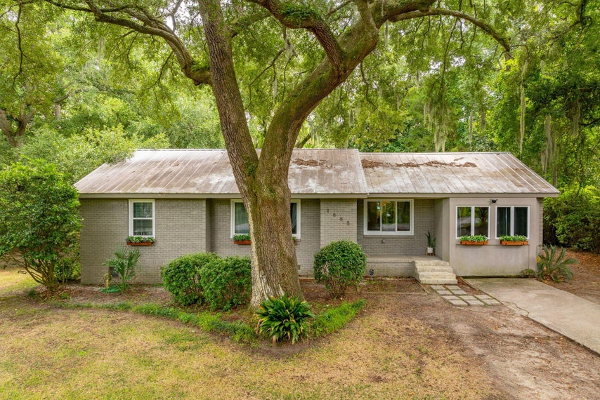
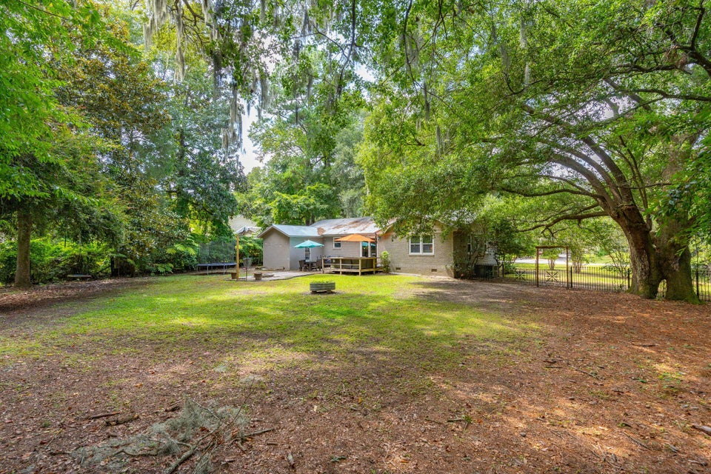
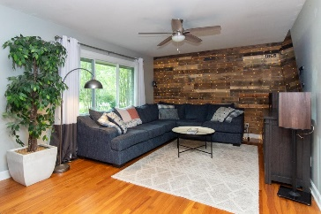
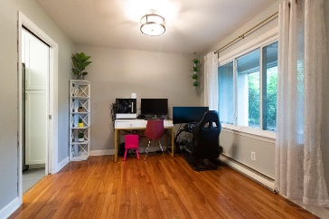
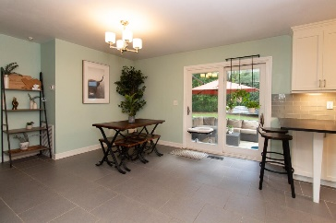
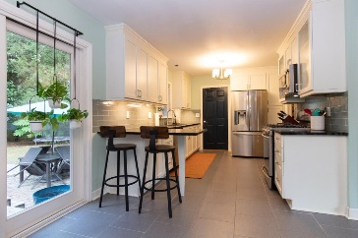
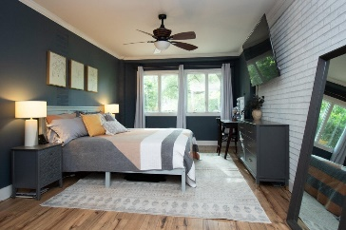
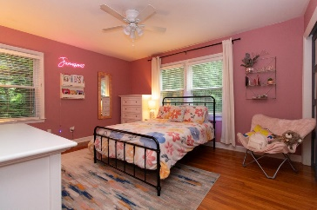
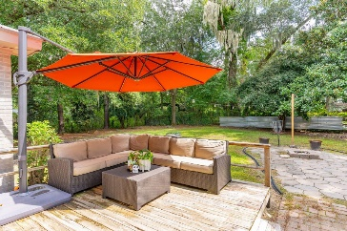
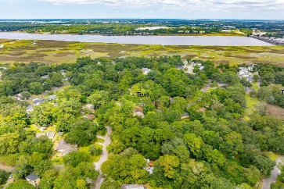
Open House Weekend
Saturday & Sunday 1-3 PM each day
1665 Dogwood Road
Pierpont | Charleston, SC 29414 | MLS# 24016918 | $465,000
This charming single level home sits on a 1/2 ac. lot with beautiful trees and plenty of room for outdoor entertaining or out buildings. A patio, fire pit and a great deck waiting to be enjoyed. The kitchen was updated with gas oven and cook top and beautiful Soap Stone counter tops. A pantry was added giving the kitchen bountiful storage. The walk-in shower and updated primary bath includes a laundry area. The tankless hot water system and storm windows makes this home very efficient. This is not your typical ranch! The floor plan has a very easy flow with large closets in the bedrooms and an updated, charming decor. No HOA!
A Lender credit of $1800.00 is available and will be applied towards the buyer's closing cost and prepaids if the buyer chooses the seller's preferred lender. This credit is in addition to any negotiated seller concession.
Jimi Craddock
843-906-8724
jimi.craddock@carolinaone.com
Carolina One Real Estate
191 Rutledge Ave
Charleston, SC 29403

