Slide 1
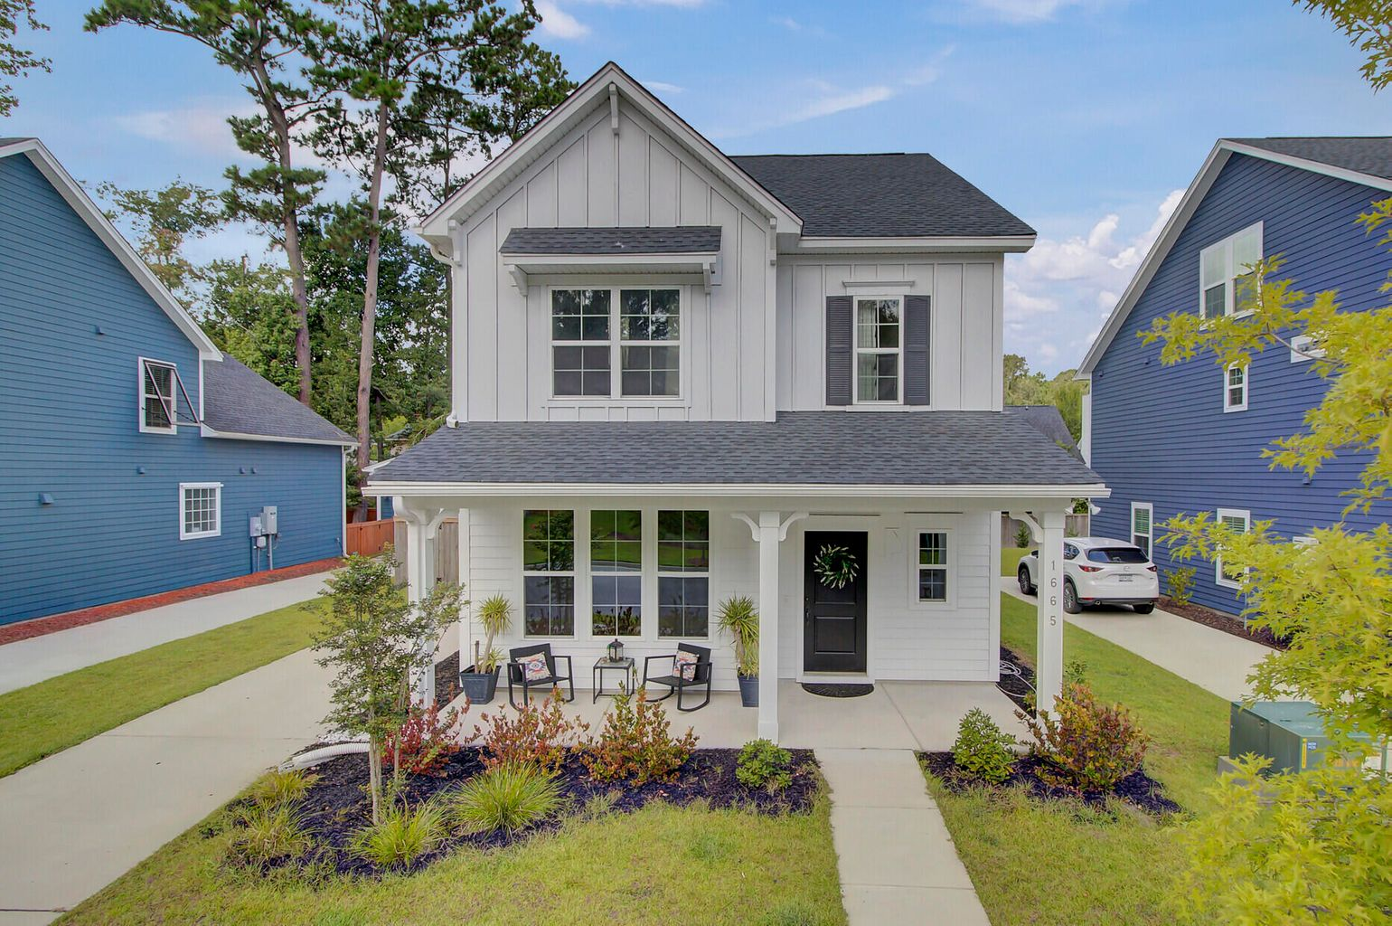
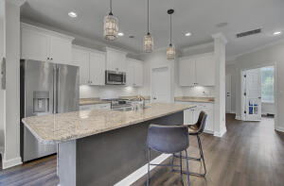
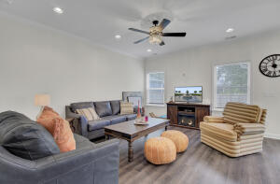
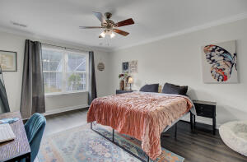
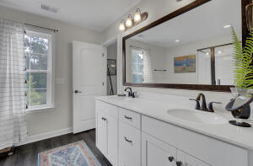
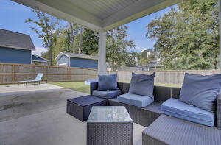
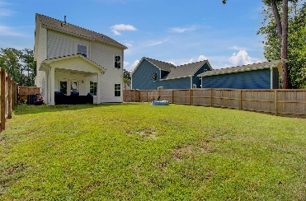


Open House
Sunday 10/24
1-3pm
1665 Emmets Road
The Oaks at St Johns Crossing
Johns Island, SC 29455
MLS# 21024369
$450,000
CHARLESTON SINGLE STYLE HOME
4 BEDS/2.5 BATHS/LOFT
MASTER BEDROOM DOWN
YARD W/PRIVACY FENCE
HARDIPLANK SIDING
HOME ONLY 2 YEARS OLD
QUARTZ COUNTERTOPS
STAINLESS APPLIANCES
REFRIGERATOR INCLUDED
COVERED PORCH
PERFECT JOHNS ISLAND LOCATION
1 MILE FROM SEVERAL RESTAURANTS/SHOPS
BLINDS AND WASHER/DRYER INCLUDED
LESS THAN 10 MILES TO DOWNTOWN CHARLESTON
12 MILES TO KIAWAH OR FOLLY BEACH
This two year old Charleston single style home is located in one of the most convenient communities on Johns Island – less than 10 miles to downtown Charleston and 12 miles to either Kiawah or Folly Beach! Even staying close to home is fun with so many new restaurants and shops just 1 mile away. As soon as you move in you can have fun adding your personal touch to the home. The big things have been thought of and already taken care of for you! The home has Hardiplank siding (very low maintenance), a long driveway for several cars and a large backyard (one of the largest in the neighborhood) with a nearly new privacy fence! The design options and colors chosen are beautiful, airy and light. Throughout the entire home is luxury vinyl plank flooring – so easy to keep clean! The kitchen was designed for entertaining...a large island looking into the great room, custom lighting, quartz countertops, a large pantry and all smart home stainless appliances are included. The great room is very open and functional while letting natural light come through. Upstairs you will find all 3 bedrooms which are a very good size; the master featuring a large walk in closet and separate tub and shower in the bathroom. The laundry room is conveniently located near the bedrooms and includes the washer and dryer. If you need an office, you don't need to worry about taking up one of the bedrooms for it. There's one downstairs with 15 lite doors for privacy without making it dark. There are many more features that you'll appreciate like the prewire for smart home security, cat5 wiring to both the doorbell and porches and gas lines for a grill and gas lantern - so schedule your showing today and prepare to fall in love!
Pam Bosart
843-452-0757
pam@awsellshomes.com
Adler Wayman Real Estate
1247 Nexton PKWY Ste 201
Summerville, SC 29483
www.adlerrealtychs.com

