Slide 1
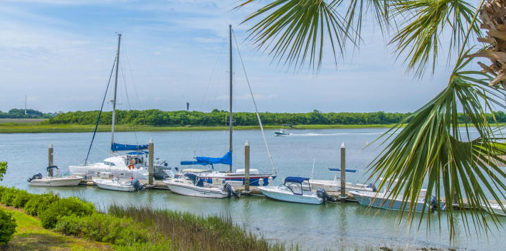
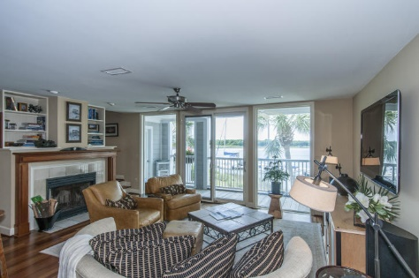
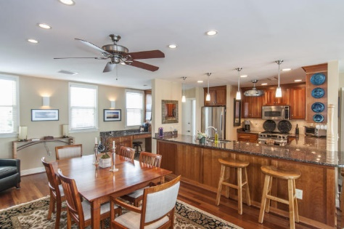
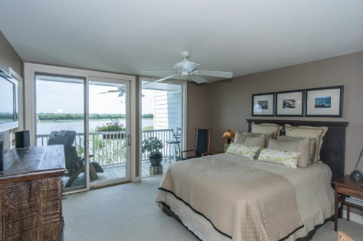
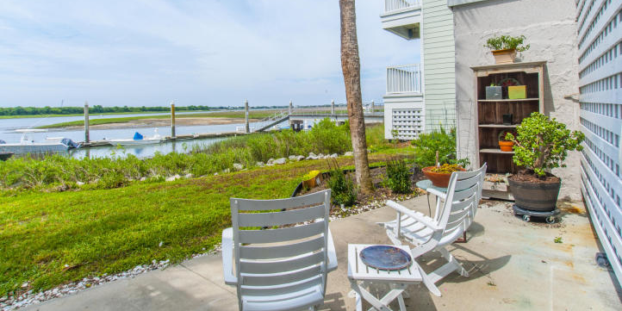
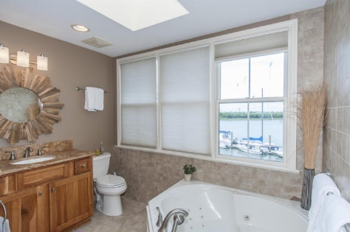


1666-A Marsh Harbor Ln, Marsh Harbor, Mt Pleasant
Amazing waterfront condo on the Intracoastal Waterway with views of Sullivan's Island - beautiful sunrises and gorgeous sunsets.
Totally remodeled with wonderful upgrades. You will be welcomed with an open floorplan beautiful hardwood floors, fireplace, built-ins, opening to a relaxing deck overlooking the waterway and Sullivan's Island. The gourmet chefs kitchen features granite counter tops, stainless appliances, gas range, custom cabinets plus eat-in dining. The upstairs master has a second deck with even more amazing views. The master bath has granite counter tops, tile floors, whirlpool tub, and shower. The second bedroom has it's own private bath. On the ground level is a private patio for entertaining or just relaxing with a good book. Boat slip available to purchase separately. Amenities include swimming pool, club house with exercise area, tennis courts and dock facilities. Just a short walk or bike ride to the beaches of Sullivan's Island.
Asking $688,000
MLS# 15013126
1,670 SqFt
2 Bed/2½ Baths
Expect to be impressed!
Don Dawson 843-514-0452 ddawson@carolinaone.com Carolina One Real Estate • 2713 Highway 17 North • Mount Pleasant, SC 29466
www.TeamDawsonSC.com

