Slide 1
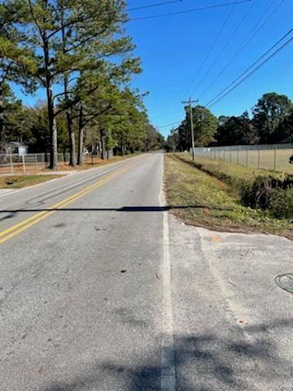
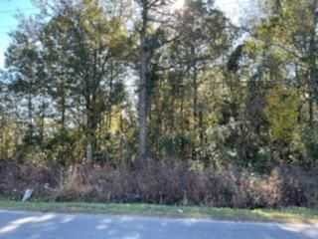
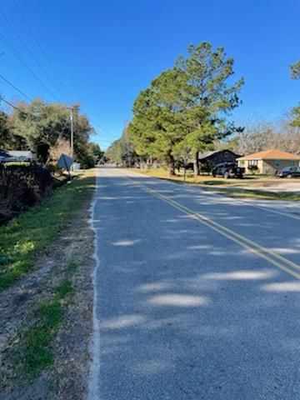
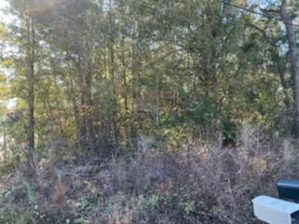


Reduced
1667 Snowden Road
Snowden · Mount Pleasant, SC 29464
MLS# 20033607 · $110,000
Michael Dew
O 843-769-5100
M 843-870-7000
michaeledew@gmail.com
www.michaeldewrealestate.com
Almost .5 acre in great location.
Great lot to build on.
AgentOwned Charleston Group
902 Savannah Hwy
Charleston, SC 29407
Real Estate ● Mortgage Insurance ● Business Brokerage

