Slide 1
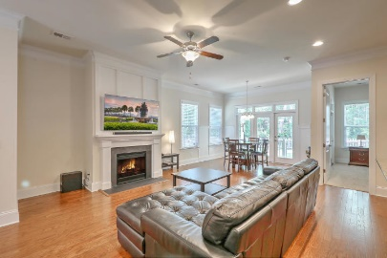
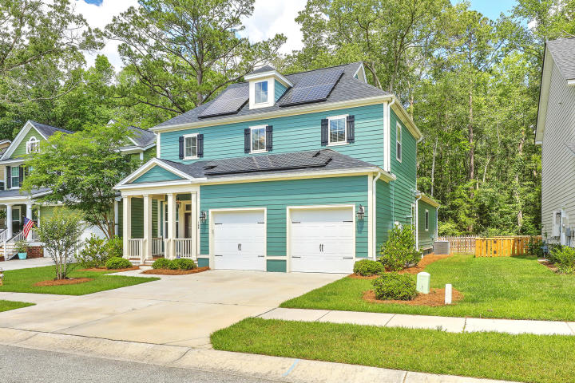
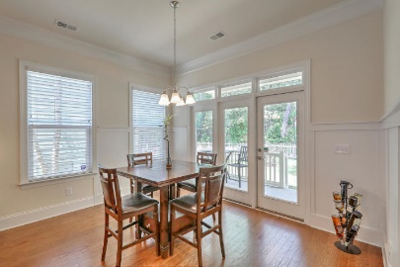
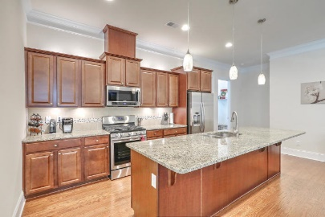
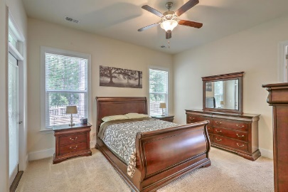
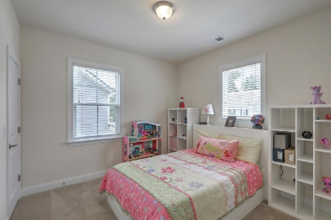
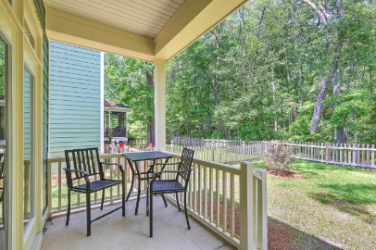
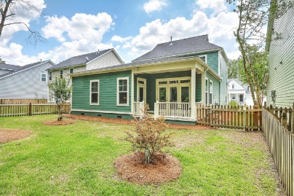


166 Ashley Bluffs Road
The Bluffs at Ashley River | Summerville | MLS# 19013648 | $294,000
REALTOR OPEN HOUSE FRIDAY & SATURDAY
October 5th & 6th from 11A TO 2P
This home is an absolute beauty - impeccably kept and beautifully designed for today's modern family! 166 Ashley Bluffs Road is located on a quiet street just before the cul-de-sac with many friendly neighbors. You'll see people walking dogs, kids riding bikes and families hanging out at the neighborhood playground and pool. As you approach, you'll notice the tasteful craftsman style home with amazing curb appeal. The front porch is inviting you to see what waits beyond the front door. As you enter, you will be greeted by the feel of luxury with the upgraded moulding surrounding you in the foyer area. Then as you proceed, you'll see the home open up to a huge living space to include the family room, dining room and kitchen. Be a part of all the action as you cook in your beautiful kitchen with top-of-the-line appliances, granite countertops and backsplash. Relax in front of your gas fireplace watching a movie or spend time eating with friends in the designated dining area, all decked out as well with detail trim everywhere. In addition, both the master bedroom and the laundry room are also on the main floor, so you could practically live everyday on the first level! So much natural light floods into the master bedroom from large windows and a door that leads out to the porch and backyard. The master bath comes complete with a soaking tub, separate shower, private commode area and a large walk-in closet with custom shelving. The laundry room is huge with plenty of room to sort and fold laundry as well as for additional storage. To round out the first floor, there is a powder room with more beautiful detailing. As you walk the wooden treaded staircase to upstairs, you'll enter what could be either a super fun haven for kids to hang out, an office area for mom or dad or whatever you need it to be! With space for toys, desks, workout equipment, the possibilities are endless. In addition, there are two more spacious bedrooms and a large full bath with double sinks. Last but not least is the covered back porch that looks over the large fenced in yard. The home backs to woods so there is complete privacy behind. What more could you ask for?! Oh, don't forget the FULLY PAID FOR solar panels that have saved the owner hundreds of dollars already. The average monthly utility bill this past year was just $91! With this home looking like brand new, it is perfect in every way. So come take a look today and fall in love!
Kimberly Mosher
(843) 697-4928
kmosher@century21properties.com
Century 21 Properties Plus | 3301 Salterbeck Ct Suite 100 | Mt. Pleasant, SC 29466

