Slide 1
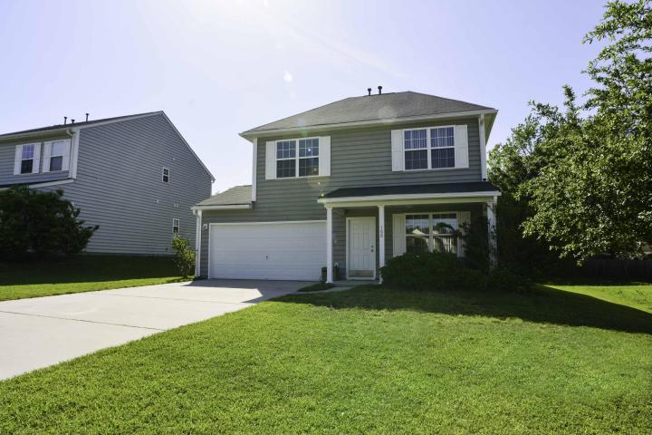
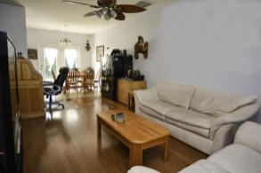
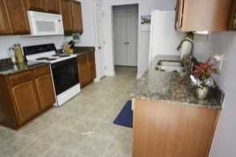
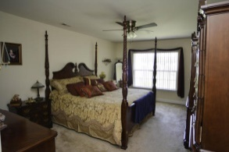
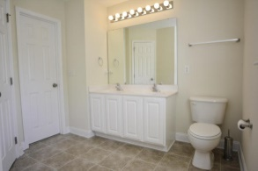
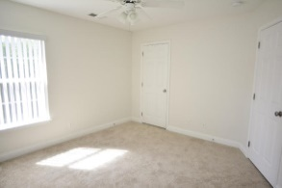
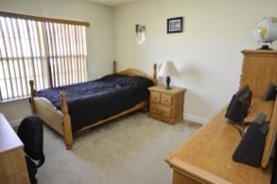
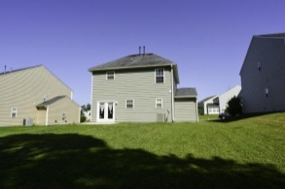
Just Reduced!
166 Balsam Circle
Madison Ridge
Summerville, SC 29485
MLS# 15010868
$164,900
Very charming 3 bedroom home that is in pristine condition and move-in ready! Living room has real hardwood oak floors. Granite countertops and real wood cabinets make this kitchen very attractive. Oversized 18' x 12' master bedroom with walk in closet. His and her sinks and garden tub in master bath. Ceiling fans in all bedrooms. Finished 2 car garage with finished cabinets. Garage also is plumbed for shop air and has upgraded lighting. Upgraded hurricane garage door. All appliances to convey. Maytag washer and dryer also to convey. Madison Ridge is a community inside the Award Winning Dorchester II School District. Located conveniently to everything! You wont find a better house at this price in highly desirable Madison Ridge!
David Hickman | 843.505.0456 | davidisyouragent@gmail.com | www.omnicarolinarealestate.com
Omni Carolina Real Estate | 126 Eston Dr | Goose Creek, SC 29445

