Slide 1
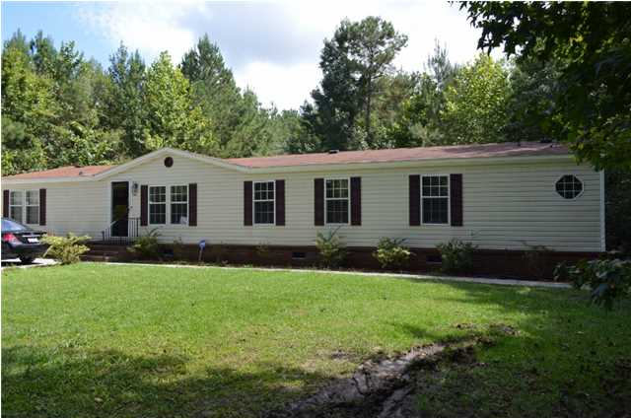
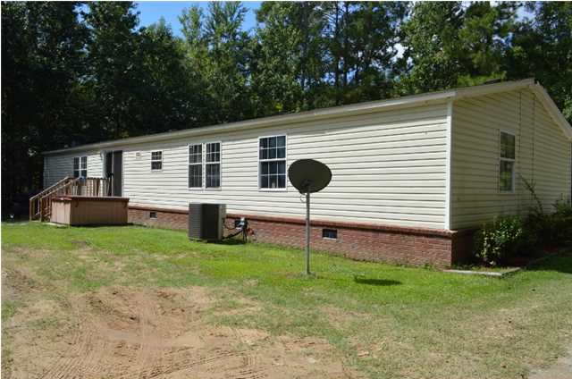
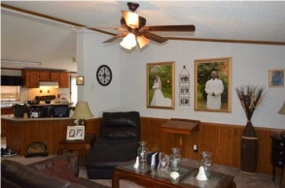
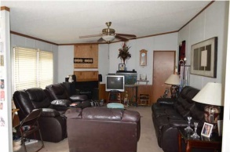
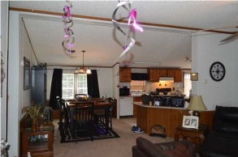
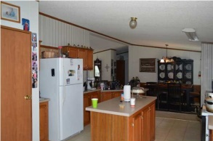
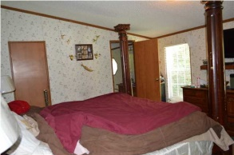
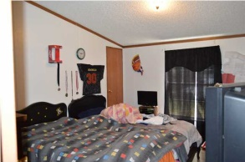
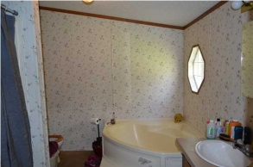
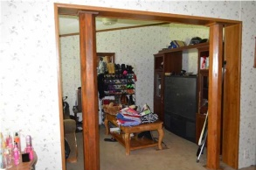
WOW!
166 Pinckney St
Lincolnville
MLS# 1425034
$154,900
Check out over 3 acres inside city limits! No HOA fees; just country living on private land right here in town. This 4 bedroom, 2 bathroom home is in great condition and has an open, flexible floor plan. As you walk in, you'll notice there is a sitting room right in front. There's room for a formal dining room table and china hutch in the dining room area, and the kitchen is wide open with a long island and plenty of cabinet and counter space. Behind the kitchen is another living room, complete with a fire place! You'll notice the master bedroom is separate from the other bedrooms, giving you extra privacy. As you walk into the master, you'll notice it has an extra sitting room! Don't forget to look at the bathroom, which hosts a garden tub and separate shower. All of this is practically brand new, since no one lived in it until 2009! And it has been de-titled, making it FHA/VA eligible!! This is two parcels being sold together for one low price (other TM# 385-05-00-038 is 1.9 acre)! Don't want that much land? Or do you just want the land to build on? We can and will separate the parcels out. This acreage in town won't last long!
Brooke Madsen | 843-834-1241 | brookemadsen.realtor@gmail.com | www.omnicarolinarealestate.com
Omni Carolina Real Estate | 126 Eston Dr | Goose Creek, SC 29445

