Slide 1
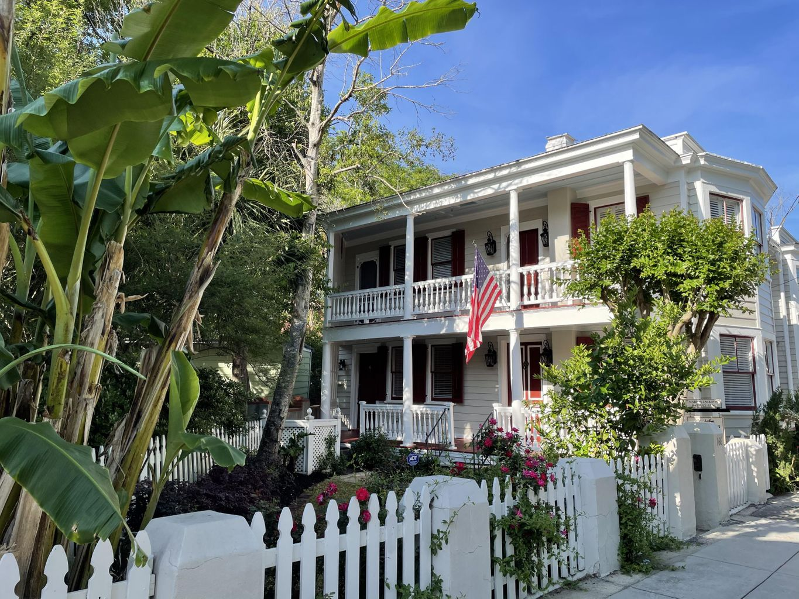
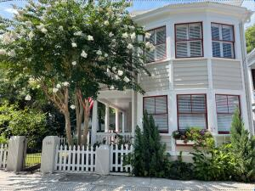
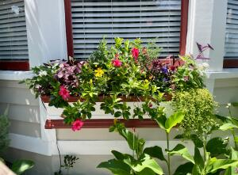
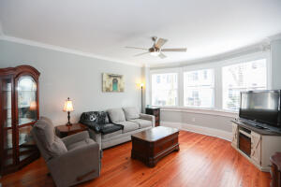
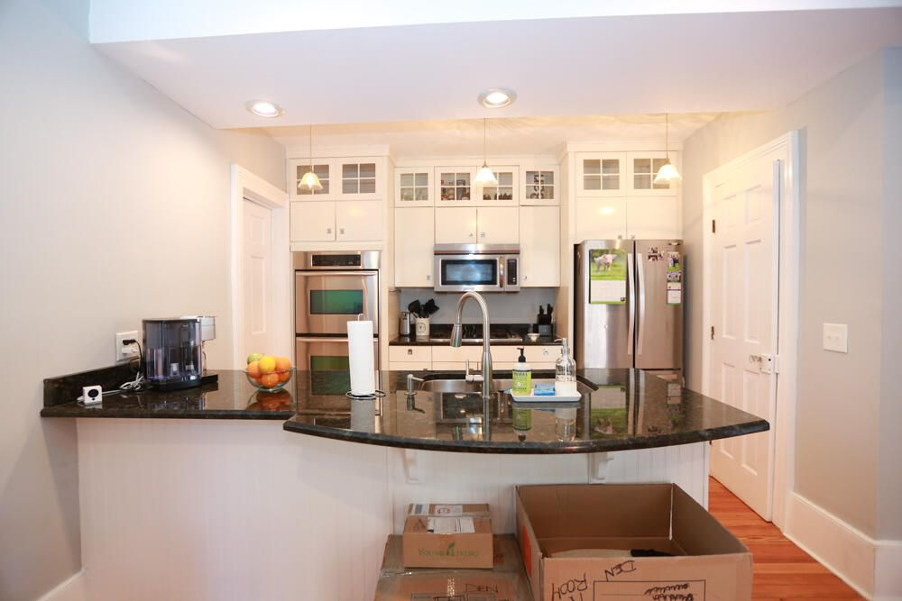
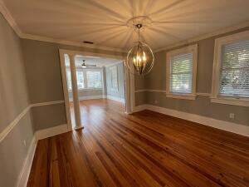
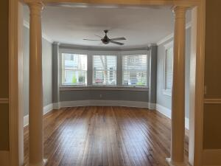
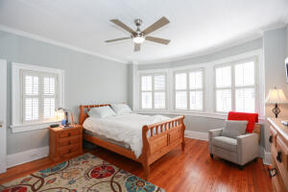
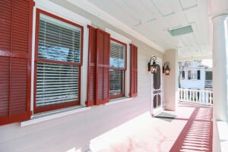
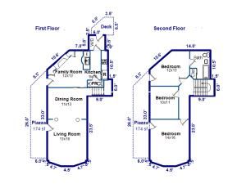

Open House - South of Broad Thursday, June 30th from 11 - 12:30
166 Tradd Street
Charleston, SC 29401 | MLS# 22017181 | $978,000
Historic South-of-Broad home with charm to spare! Steps from the Battery, Colonial Lake & the City Marina. Open living space downstairs with a half bath, plus three bedrooms and a full bath upstairs. Warm hardwood floors throughout with porches upstairs & down facing sunset each night. Stainless steel appliances include a Viking stove & a double oven plus a small grilling deck out back through the laundry area and a fenced-in yard; perfect for gardeners or pet lovers! Come see this wonderful spot in Charleston!
Marion Jackson
Mobile - (843) 442-4404
marionjacksonrealtor@gmail.com
Charleston Property Brokers | 151 St. Philip St. Apt A | Charleston, SC 29403

