Slide 1
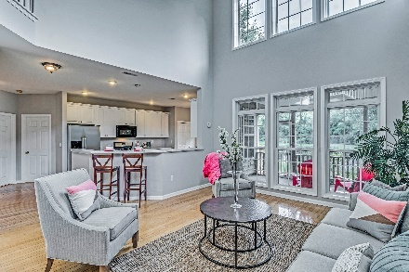
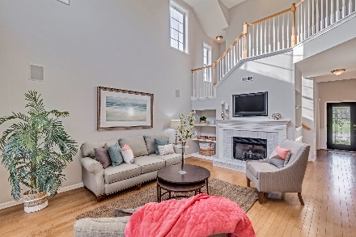
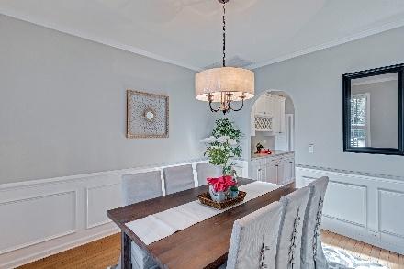
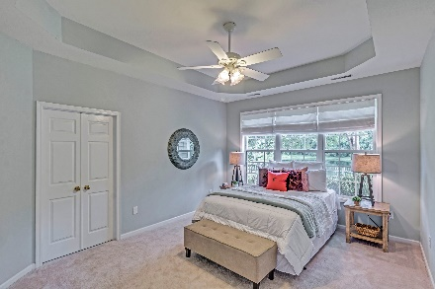


Public Open House Tomorrow, July 8th from 1-3
Agent Open House Wednesday, July 11th from 11:30-1
Peaceful abode on pond offers excellent wildlife viewing through all 4 seasons!
1672 Jorrington Street
Park West ~ Mount Pleasant, SC 29466
MLS# 17002828 ~ $474,900
Peek out the back windows at the pond and see if you spot a heron or deer.
The open floor plan of 1672 Jorrington’s first floor allows for ease of
gatherings for family and friends.
Features
Freshly-painted soothing gray
New carpet
Hardwood floors
Butler’s pantry in foyer
New light fixtures in Foyer, Dining Room, Breakfast area
Large 2nd-floor bonus room
First-floor master bedroom with garden tub, shower and walk-in closet
Pond in back offers peaceful wildlife viewing from screened-in porch, featuring new ceiling fan
Spacious laundry room on first floor
Public lawn for parties across the street
4 bedrooms/2.5 baths
Distressed white painted brick gas fireplace
Wooden fence surrounding rear yard
Open floor plan featuring family room/dining room/office/kitchen
Atrium ceiling in Family room with 9’ ceilings remainder of first floor
Situated close to excellent public grade schools (elementary, middle, and high)
Attached 2-car clean garage
Ease of access to parks, restaurants, and shopping
Park West amenities: crab dock, creek side park, boat storage, pool, tennis courts, nature trails, nursery school on campus, playground
Laurel Hill Charleston County Park adjacent to Park West
Walk-up 3rd floor attic prepared to be finished for additional SF
Kay Kennerty
MBA, ABR, CRS, GRI
843-345-5011
KKennerty@aol.com
www.KayKennertyHomes.com
The AgentOwned Realty Company
824 Johnnie Dodds Blvd, Mt. Pleasant, SC 29464

