Slide 1
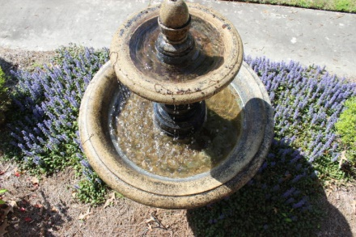
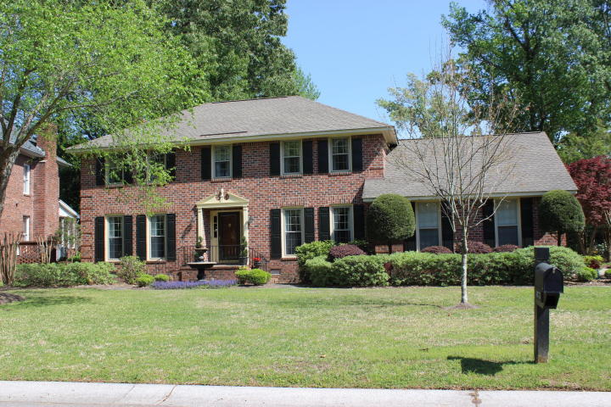
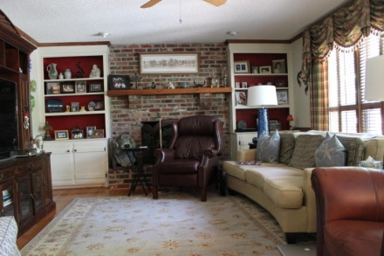
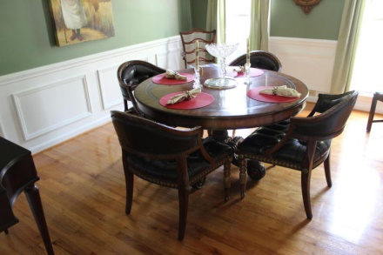
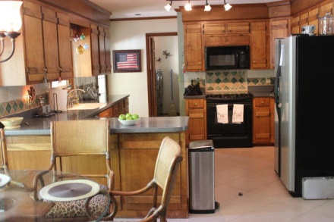
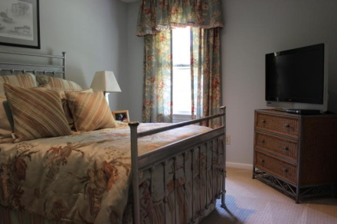
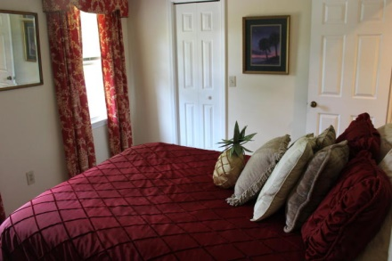
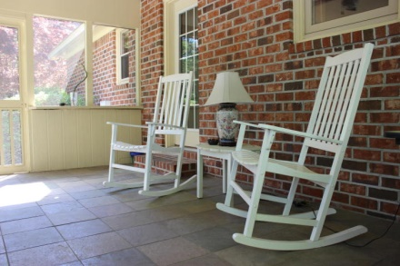
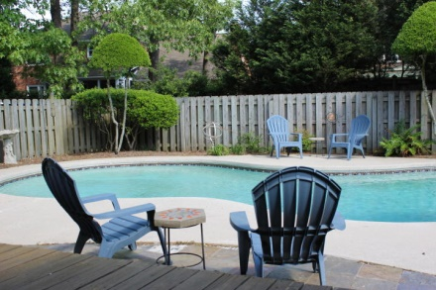


Just Listed in Ashley Harbor
1673 Seignious Drive
Charleston ~ MLS# 15009516 ~ $499,000
Come join the good life at Ashley Harbor, one of the few gated communities in Charleston. Ashley Harbor is only minutes away from just about any corner in Charleston. It is 15 minutes to Downtown Historic Charleston, Boeing and the Charleston International Airport are less than a 10 minute drive while most of the largest employers in the area are within a 25 minutes commute. Ashley Harbor has much to offer. There is a boat ramp and storage for the boating enthusiasts and for those who kayak and paddle-board the estuaries of the Ashley River. Fishing, kayaking and paddle boarding are also allowed on the neighborhood's huge lake. For those who are looking for a tennis game in the neighborhood, there are the tennis courts. All of this is easily accessible by foot or with your golf cart. 1673 Seignious is a lovely home that has been carefully maintained. The in-ground pool offers a wonderful setting for entertaining during the day with a pool party or by setting the mood for an evening soiree. The back of the house flows from the Family Room to the Breakfast table to the Kitchen allowing the cook to enjoy their family. The Foyer, Formal Dining Room and the Living Room (which easily can be a study/office) compliment the front of the house. The Laundry Room is off the garage. The two car garage is over sized with a wall of built-in cabinets for additional storage and there is a work area also in the garage. Upstairs is the Master Suite, three bedrooms and the FROG. This house has the flexibility to be a comfortable home for a growing family, an empty nester or two professionals. Come home and enjoy the comfortable life at 1673 Seignious.
Kay Kennerty MBA, ABR, CRS, GRI
843-345-5011
Kay@agentownedrealty.com
www.KayKennertyHomes.com
The AgentOwned Realty Company
824 Johnnie Dodds Blvd
Mt. Pleasant, SC 29464

