Slide 1
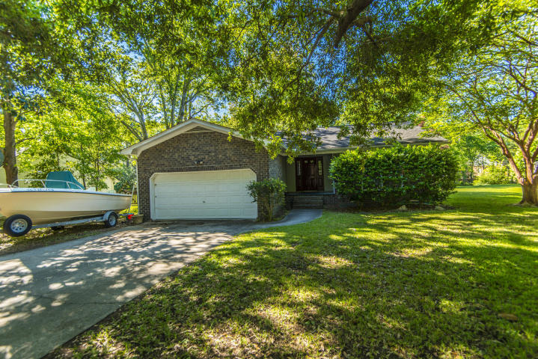
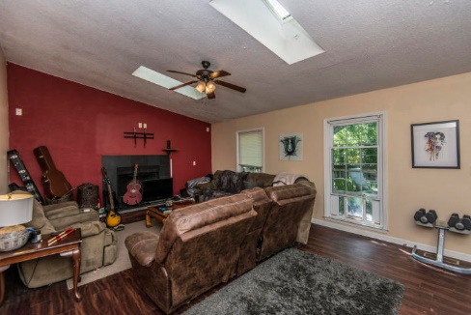
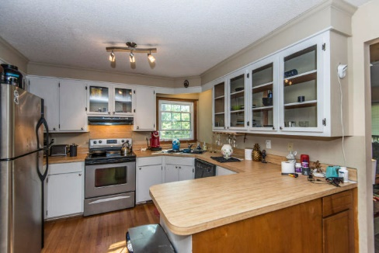
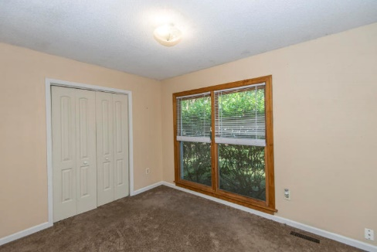
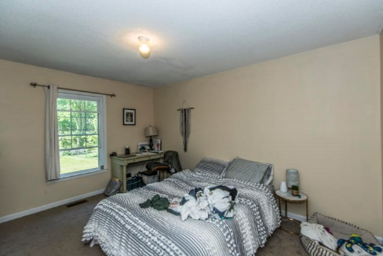
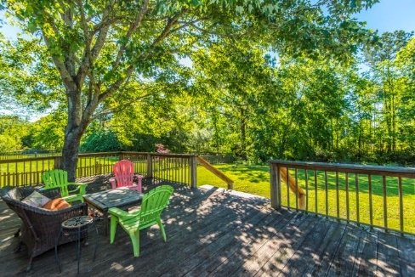
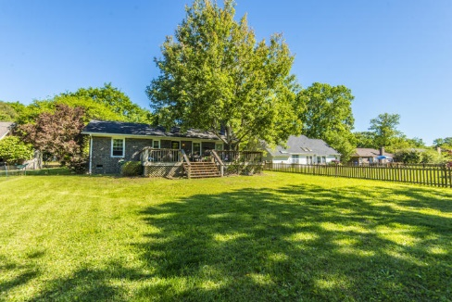


Why wait for new construction?
This Park Circle area home is LESS THAN 2 YEARS!
Central Mt. Pleasant for $355k
1676 Babington Way
Wando Lakes
Mount Pleasant, SC 29464
MLS# 19011647
$355,000
Welcome to 1676 Babington Way in the Wando Lakes subdivision of South Mount Pleasant! This 3 bed, 2 bath brick ranch sits on 0.33 acres of a wooded lot that backs up to a pond. This central location is next to the new Indigo Square shopping center as well as the big Town Center. It has been a great investment property for many years.
Del Shaffer
843.408.6821
dshaffer@carolinaoneplus.com

