Slide 1
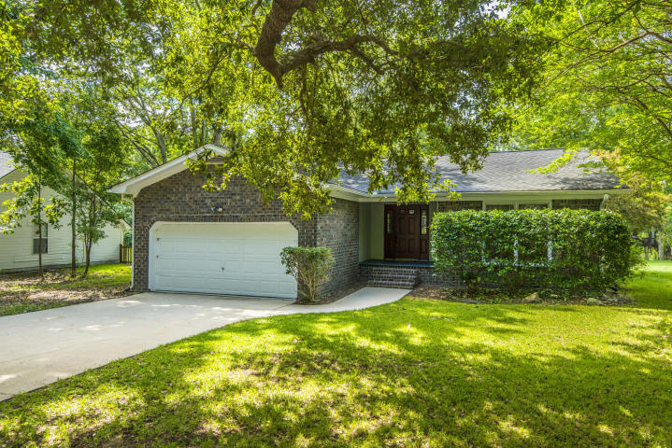
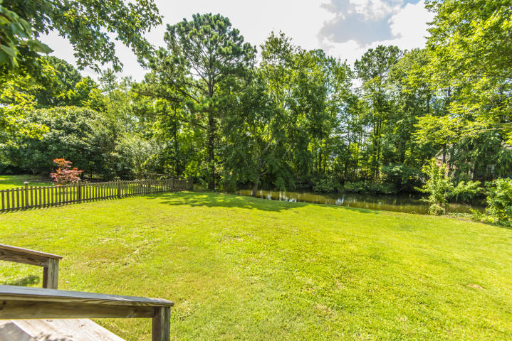
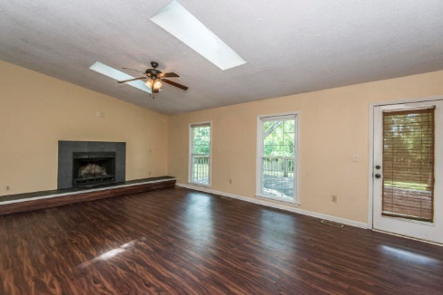
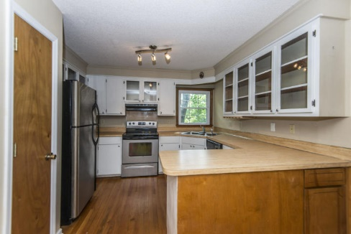
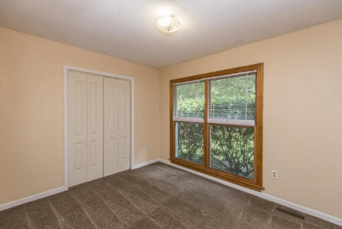
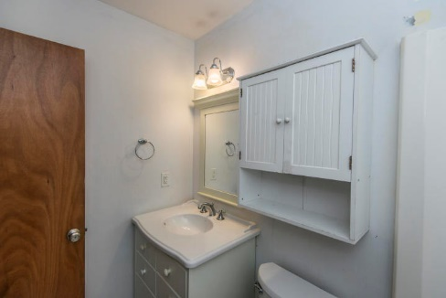
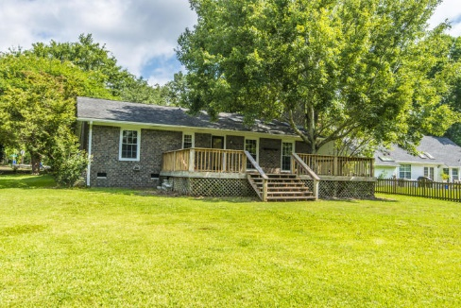
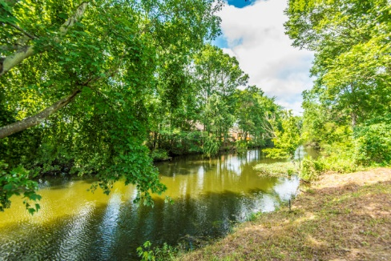



Why wait for new construction?
This Park Circle area home is LESS THAN 2 YEARS!
Central Mt Pleasant ~ $10k Price Drop!
1676 Babington Way
Wando Lakes ~ Mount Pleasant, SC 29464 ~ MLS# 19011647 ~ $325,000
Welcome to 1676 Babington Way in the Wando Lakes subdivision of South Mount Pleasant! This 3 bed, 2 bath brick ranch sits on 0.33 acres of a wooded lot that backs up to a pond. This central location is next to the new Indigo Square shopping center as well as the big Town Center. It has been a great investment property for many years. A $1,800 Lender Credit is available and will be applied towards the buyer's closing costs and pre-paids if the buyer chooses to use the seller's preferred lender. This credit is in addition to any negotiated seller concessions.
Del Shaffer
843.408.6821
dshaffer@carolinaoneplus.com
2713 Highway 17 North
Mt. Pleasant, SC 29466

