Slide 1
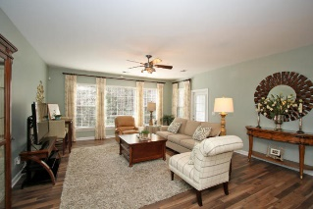
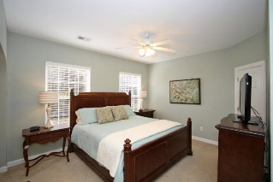
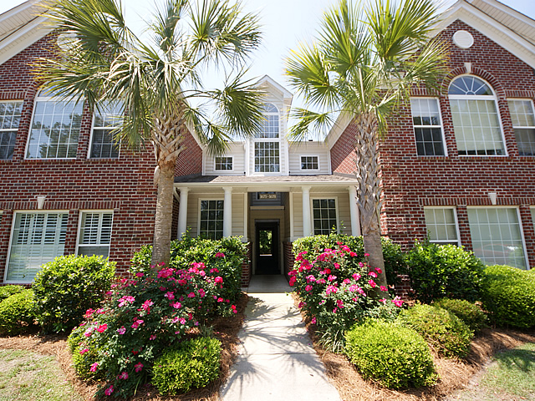
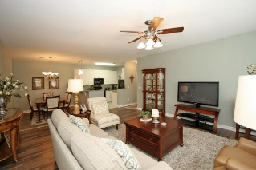
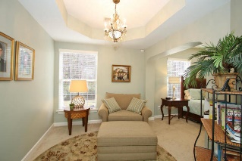
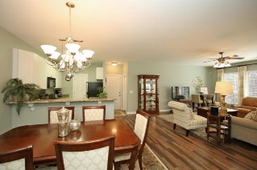
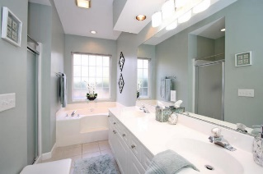
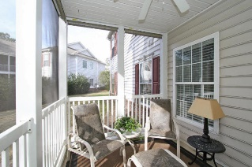
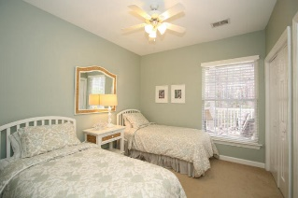


1676 Camfield Lane Dunes West ~ Mount Pleasant MLS# 16001389 ~ $224,000
Just Listed!
This stunning 1st floor condo backs up to a wooded buffer with views from most every room including the screen porch. You will love all of the natural light streaming in as well as the open plan this home offers. It has been meticulously decorated with neutral paints, lovely light fixtures and fans, granite counters and ready for anyone to easily move in. The master bedroom enjoys a connecting sitting room/office area. There is plenty of room in the master bath with a garden tub, double sinks and a separate shower. This is a spectacular property! Ownership provides you the benefit of joining Dunes West amenities.
Darlene Smith Office - (843) 886-8110
Mobile - (843) 696-7824
darlenesmith@carolinaone.com
DarleneSmithTeam.com
Carolina One Real Estate
1503 Palm Blvd Ste
Isle of Palms, SC 29451

