Slide 1
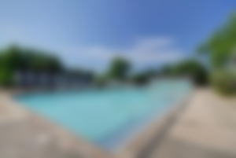
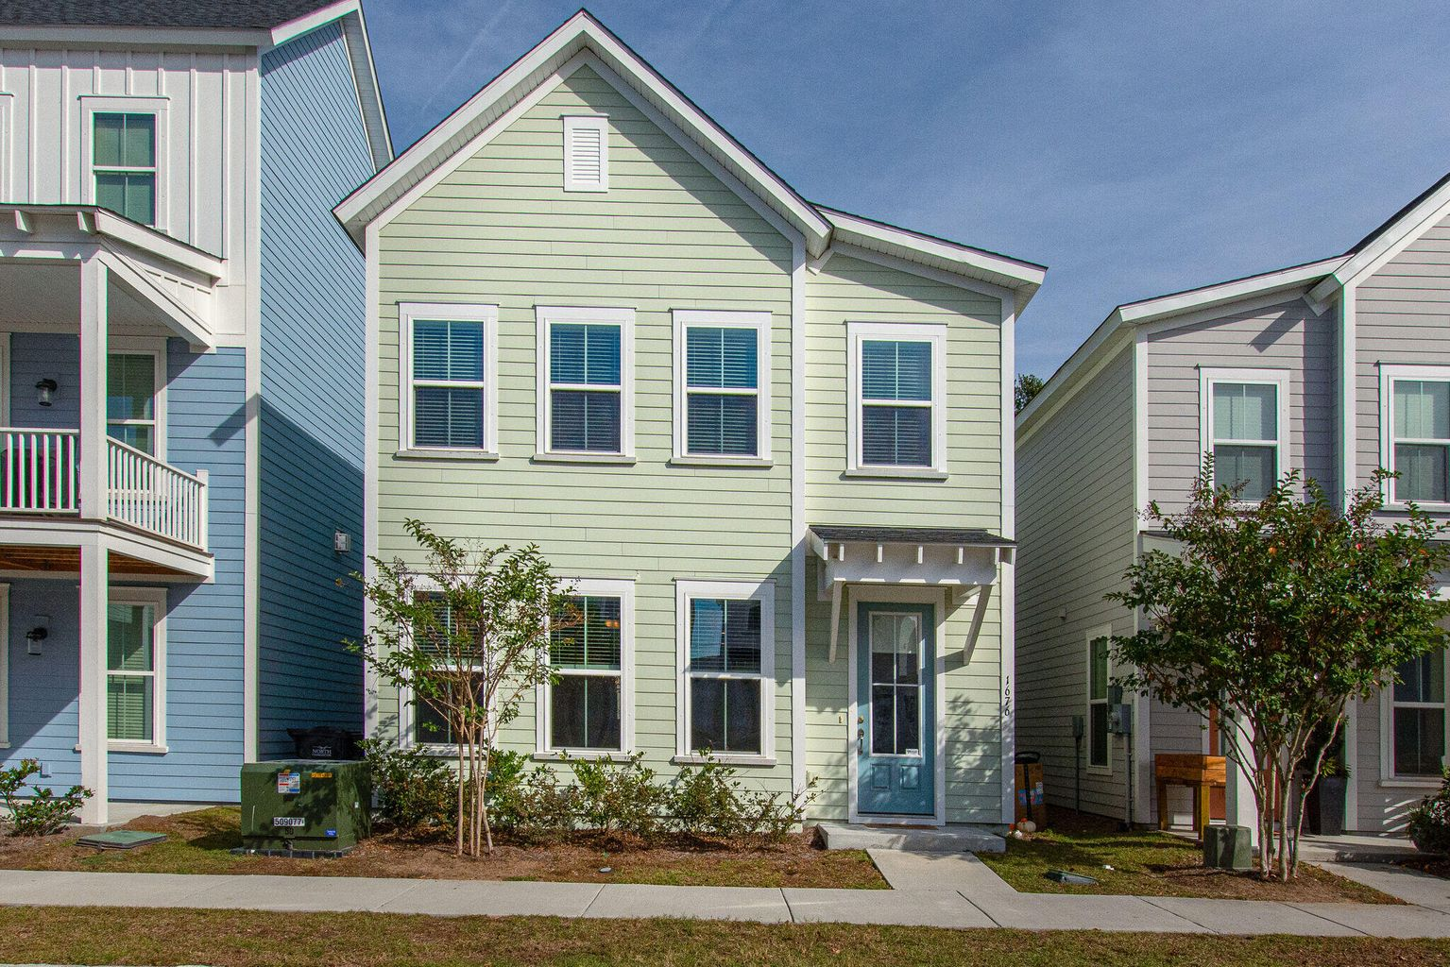
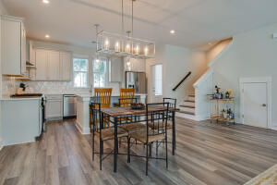
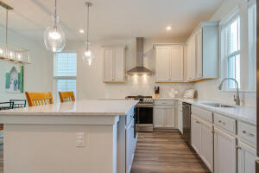
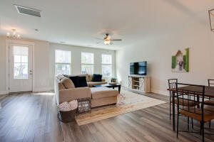
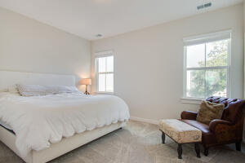

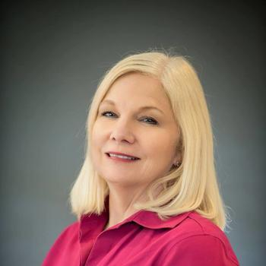
MOTIVATED SELLERS!
1676 Indy Drive
Park Circle
North Charleston, SC 29405
MLS# 22029562
$475,000
A Chance to have a beautiful, like new home in Mixson. A popular community in the Park Circle area with shops, a pool and clubhouse just steps away. This 3 bedroom 2 and a half bath home is very attractive and has a barely lived in appearance. Large living area open to a gorgeous kitchen with a huge island to gather around. All bedrooms are upstairs. The home gets lots of natural light on both levels and is a real showplace for entertaining and easy living. Just added the Virtual Tour, take a look!
http://nbtour.showcasephotographers.com/mo2211211
Jan Miller
Cell (843) 345-9719 | Jan.Miller@nvrealtygroup.com
NV Realty Group | 91 Broad St, Ste A | Charleston, SC 29401
janmiller.nvrealtygroup.com

