Slide 1
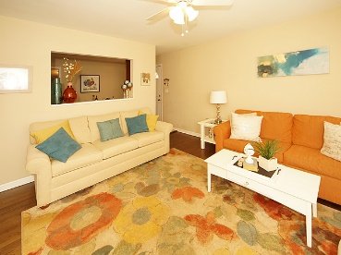
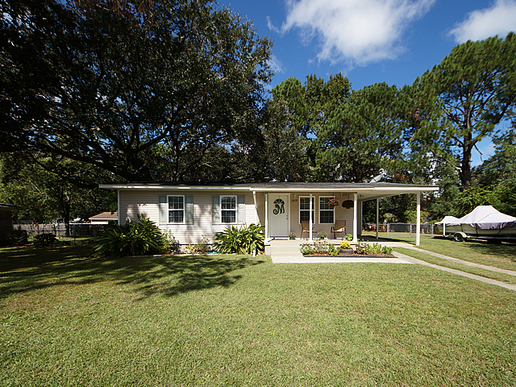
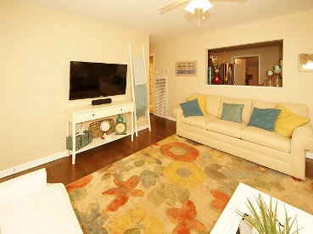
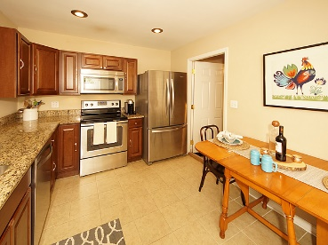
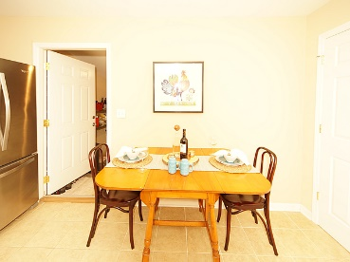
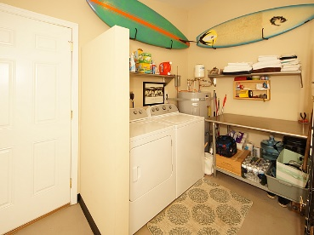
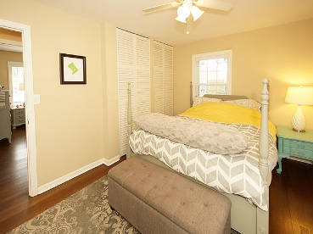
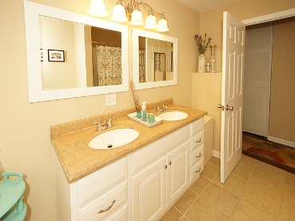
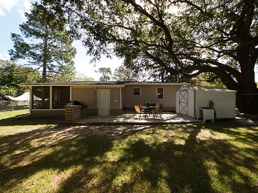


1678 Mepkin Road
West Ashley Plantation | Charleston, SC 29407
MLS# 17027386 | $219,900
Just Listed in Park West
Reduced - West Ashley $219,900!
Centrally located, move-in ready and renovated 3 bedroom and 2 full bath. This home is cute inside and out. The living room fills with sunlight accentuating the wood floors that run throughout the house. The living room opens to the kitchen which was totaling renovated in 2015 with new cabinets, granite counter-top, large farmhouse style stainless sink and stainless appliances. The three bedrooms all have wood floors. The master bedroom has direct access to a renovated bathroom with a double vanity. A great utility room is off the kitchen that is large enough to include a nice pantry area and laundry room. Through the utility you have access to the screen porch and fenced backyard both are great entertaining areas with a new large deck for grilling out. Don't overlook the storage shed complete with electricity. Mepkin Road offers easy access to I-26, 526, Hwy 17 and downtown Charleston.
Caroline Jumper
ABR, REALTOR
(843) 814-0314
2carolines@gmail.com
RE/MAX Alliance
1200 Two Island Ct., Ste. A
Mt. Pleasant, SC 29466

