Slide 1
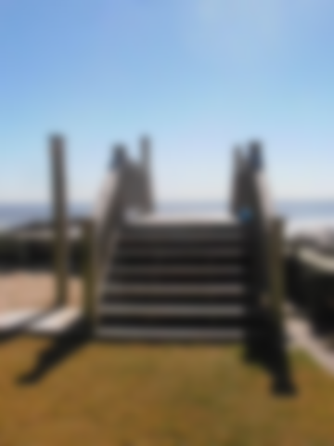
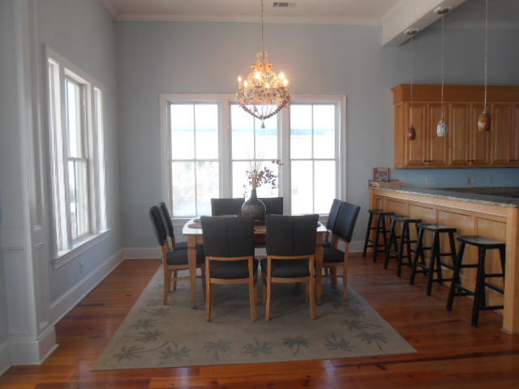
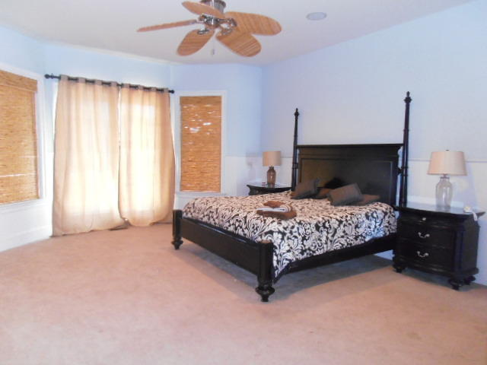
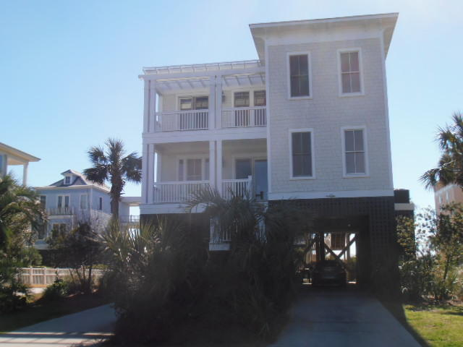
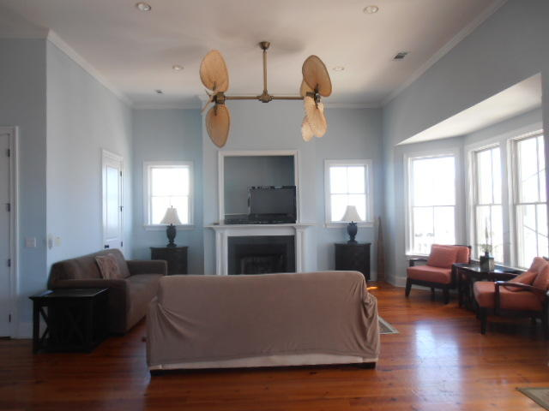
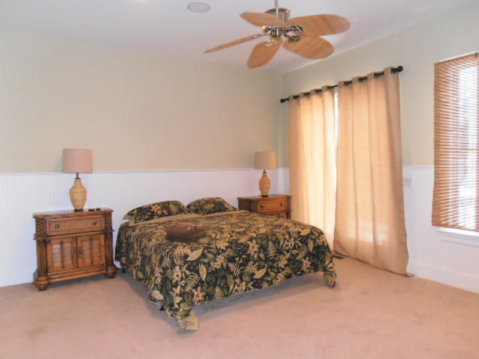
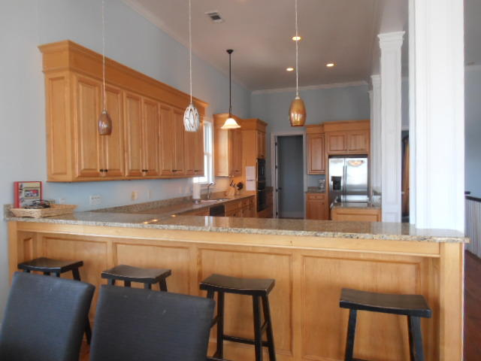
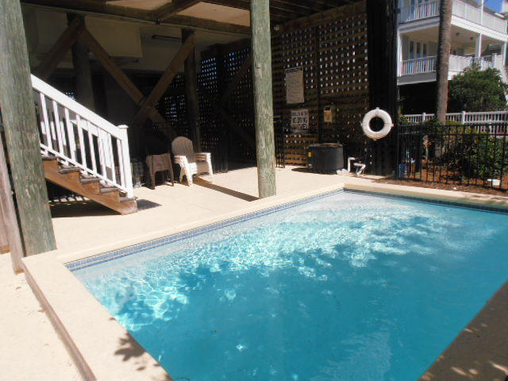
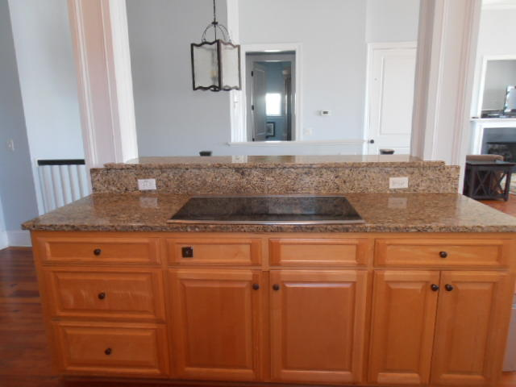
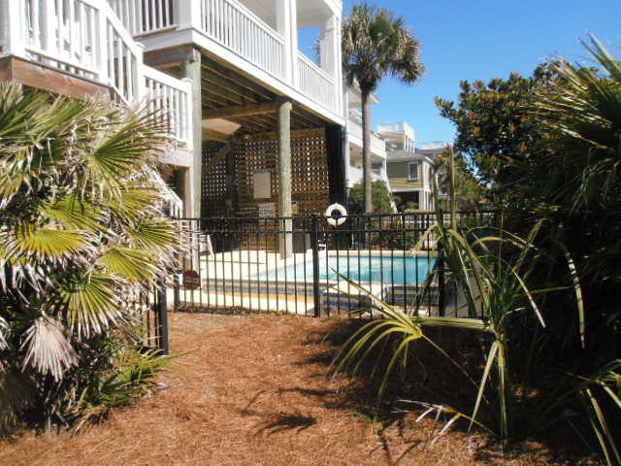
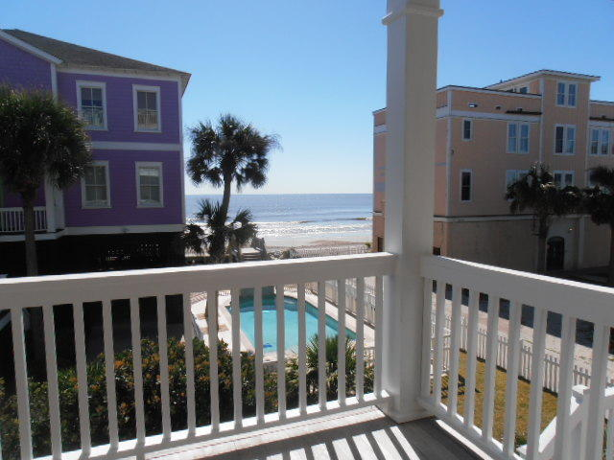
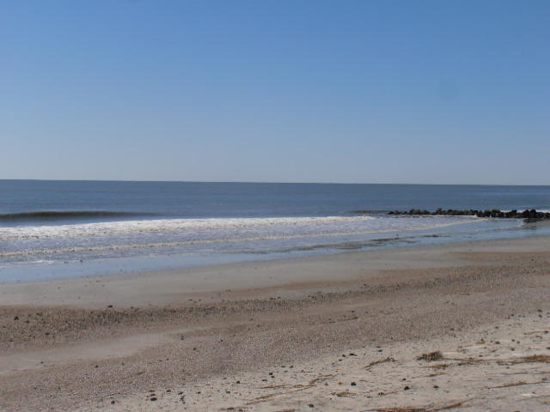
Great Short Term Rental Past The “Wash-Out”
1679 E Ashley Avenue A
Folly Beach, SC 29439
MLS# 17005506 | $1,329,000
This beautiful Custom Built Home was designed by Carl McCants, III. Along with the breathtaking views of the Atlantic Ocean you will have from practically every window, including the rooftop deck, your personal in-ground pool is in your back yard. This 2 story spacious 5 BR 5 BA home has all the comforts of prestige beachfront living. Antique heart pine floors throughout. The kitchen is equipped with State of the Art Appliances, including dual convection oven, Built-in microwave, refrigerator and dishwasher, Along with custom built cabinetry & granite countertops. The Dual Masters come with amazing Ocean Views. The Master Baths are equipped with garden tubs and separate walk in steam showers. Home is equipped with an elevator that services all floors.
Charles Salmonsen
M (843) 224-0300 | O (843) 388-6613 | charles@salmonsen.com
Salmonsen Realty | 864 Lowcountry Blvd Ste B | Mt Pleasant, SC 29464

