Slide 1
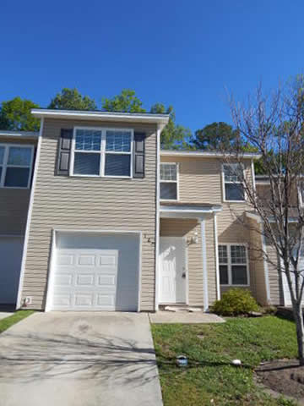
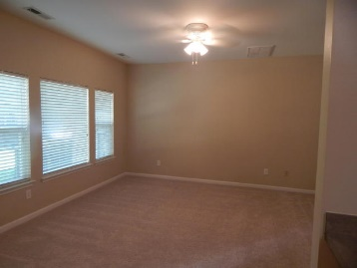
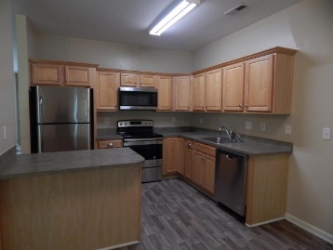
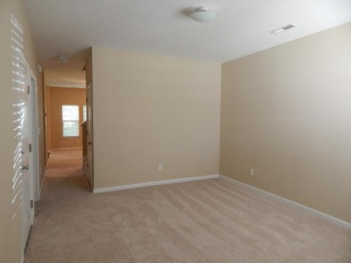
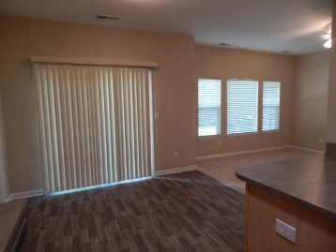
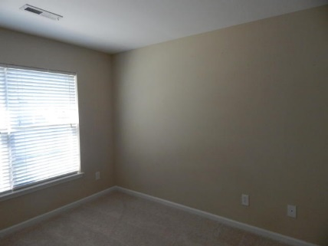
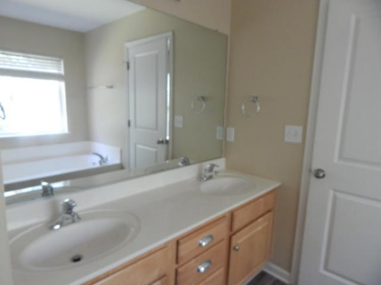
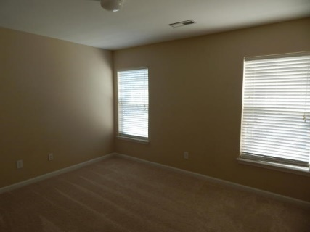
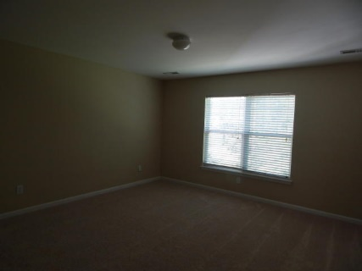
FANTASTIC VALUE 3 BEDROOM TownHOME WITH GARAGE!
167 Grand Oaks Drive
Grand Oaks Preserve
Ladson, SC 29456
MLS# 17009737
$121,500
3 Bedroom | 2½ Baths
OWNER SAYS SELL NOW!!! PRICE SLASHED ON THIS BETTER THAN NEW TOWNHOME WITH 1-CAR GARAGE!!! PRICED BELOW MARKET VALUE! This is the one you've been waiting for!! Brand new flooring throughout! Brand new stainless steel appliances including refrigerator, microwave, smooth-top range and dishwasher! Brand New exterior lights! New vertical blinds on sliding glass door off dining area! New white ceiling fan in family room, which will go with any decor! This large townhome offers 3 good-sized bedrooms on 2nd floor, including Master Suite with 2 WALK-IN CLOSETS! Master bath has large soaking tub and separate shower, plus his & her sinks. Nice patio area in back for grilling out and relaxing. One car garage has storage room off back wall.
Darlene Bollettino
Miler Properties
Office: 843-821-1111
Cell: 843-209-8955
dbollo84@yahoo.com www.milerproperties.com

