Slide 1
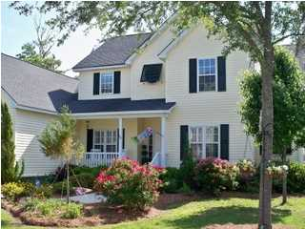
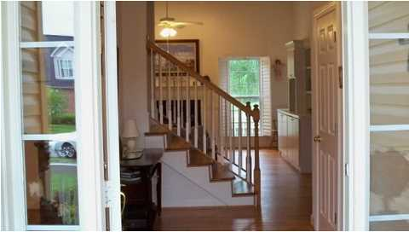
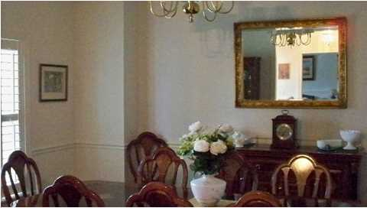
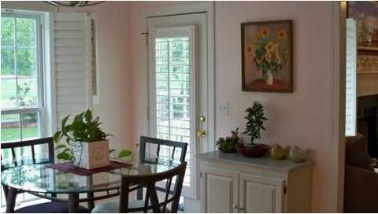
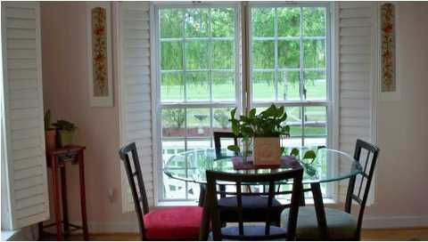
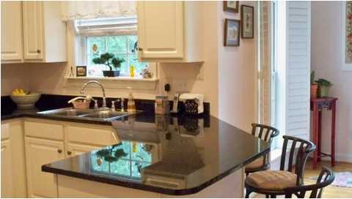
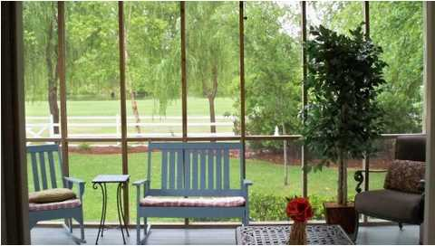
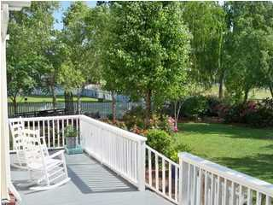
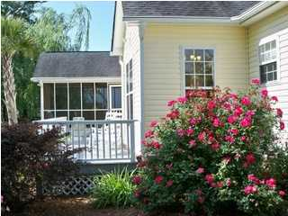
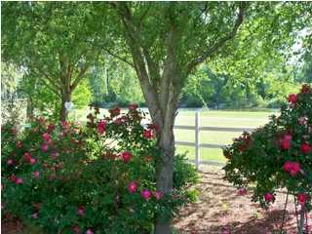
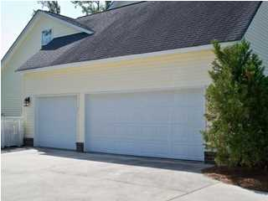
167 Shadowmoss Parkway
Shadowmoss ~ Charleston ~ MLS# 1420211 ~ $399,000
Country Club Living Without Breaking the Bank
This home has 5 bedrooms, 2 1/2 baths plus a home office. There is a separate living room and dining room and the home has many custom built-ins and lots of storage space. There are beautiful hardwood floors in the kitchen, dining room, living room, family room and upstairs bedroom. Kitchen has new granite counter tops, nice large cabinets and an eat-in breakfast area. You'll find a gas log fireplace in the great room that is so nice for cold winter evenings. There are some plantation shutters. The master bedroom is conveniently located on the first floor, has built in shelves and has a separate entry to the screened porch. There is a large master bathroom with double sinks in the vanity, separate shower, garden tub and large walk-in closet. The large screened porch and deck off the back of the home, overlook the golf course and pond; what a view and such a nice place to relax. When you view this home, you'll know the owner is a garden lover as it is well landscaped with a beautifully maintained yard. This home has a 3 car garage so there is room for your boat. Shadowmoss has great amenities and can be accessed from Bees Ferry Rd or from Hwy. 61.
Jack Bennett
Mobile - (843) 708-8300
jockbennet@gmail.com
Harbourtowne Real Estate | 672 Marina Drive, Ste 110 | Daniel Island, SC 29492

