Slide 1

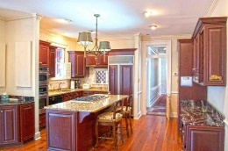
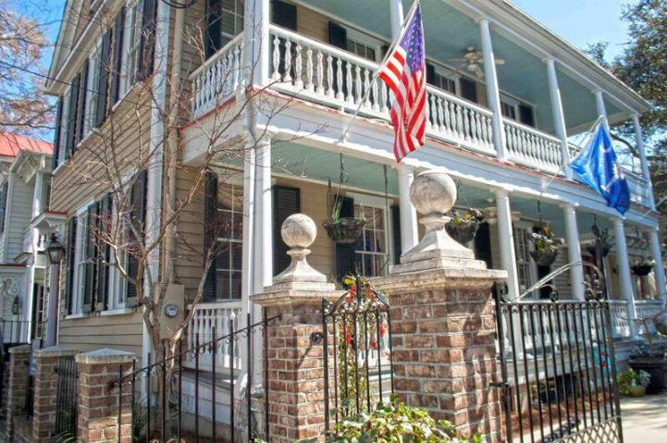
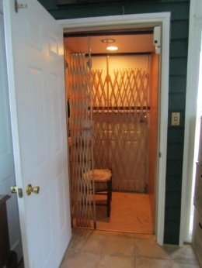
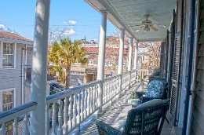
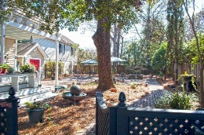
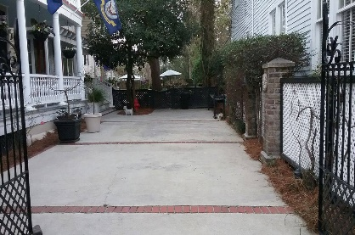

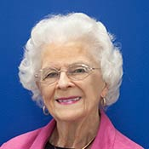
Historic Downtown Charleston
Price Reduced
167 Tradd Street
South of Broad ~ Charleston ~ MLS# 17002343 ~ $1,700,000
This beautiful historic home, known as the William Izard Bull House, built circa 1888.
It is a traditional Charleston Single house by design, with heart of pine flooring and 10 foot ceilings.
It offers off-street parking behind a beautiful wrought iron gate that accommodates 4 cars.
The home has been meticulously restored and renovated to include an elevator.
Claudia FitzGerald, REALTOR
(843) 693-5161
cvbf32@aol.com
Elaine Brabham and Associates, LLC • 1890 Sam Rittenberg Boulevard, Suite 217 • Charleston, SC 29407

