Slide 1
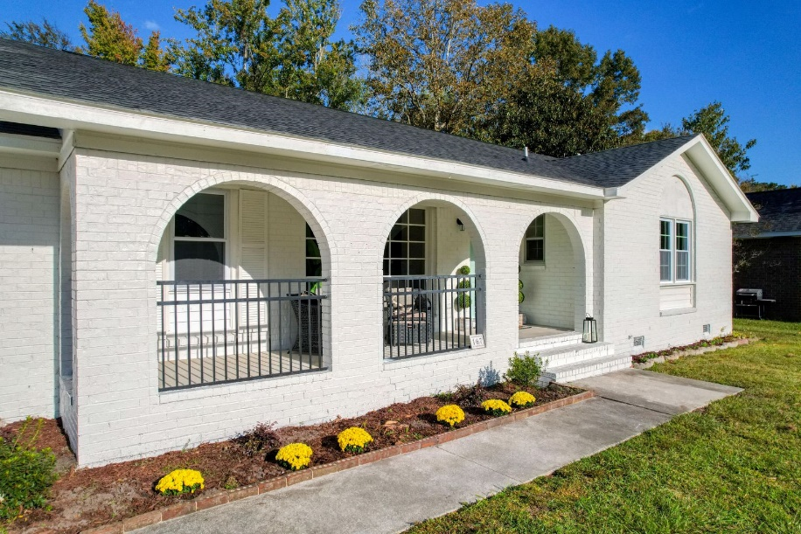
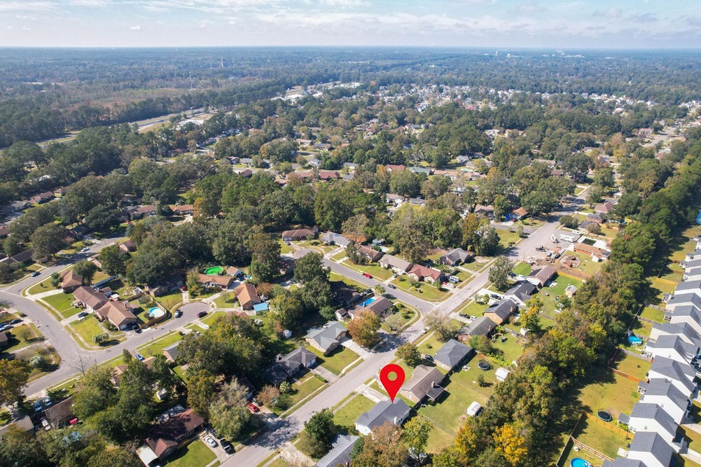
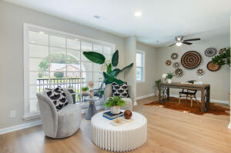
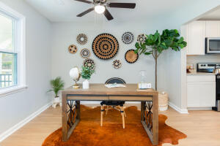
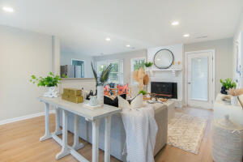
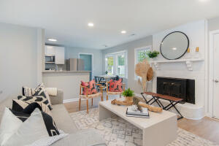
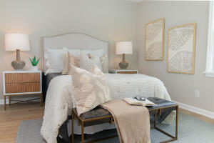
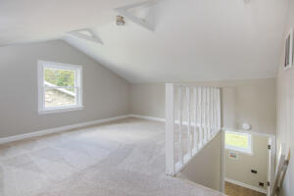
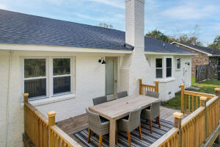
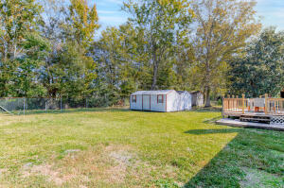



167 Tall Pines Road
Tall Pines | Ladson, SC 29456
MLS# 22027485 | $325,000
Tall Pines Complete Renovation
Fresh, New Completely Renovated Home in very Convenient & Peaceful location of Tall Pines! Immediately notice quaint front porch to relax anytime of the day. Enter into a very spacious living area w/ beautiful wood laminate flooring, ceiling fan & where you can cozy up to a fireplace on cooler days. Brand new roof, Granite countertops, stainless kitchen appliances, New HVAC system & new windows. Large deck to enjoy entertaining friends & family. The backyard has two amply sized, large sheds for storing equipment and more. There are two new full baths with nice hardware, as well as a total of 3 bedrooms. The Master Bedroom has its own new bathroom with custom sliding barn door & walk-in closet.
Enjoy this video tour: https://youtu.be/gX2D781p18g
Susan Stanley
832-323-5573
susancstanley@gmail.com
Brand Name Real Estate
4 Carriage Lane Suite 106
Charleston, SC 29407

