Slide 1
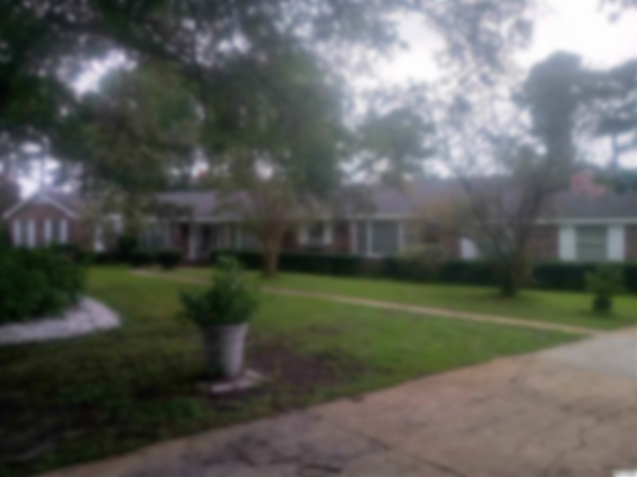
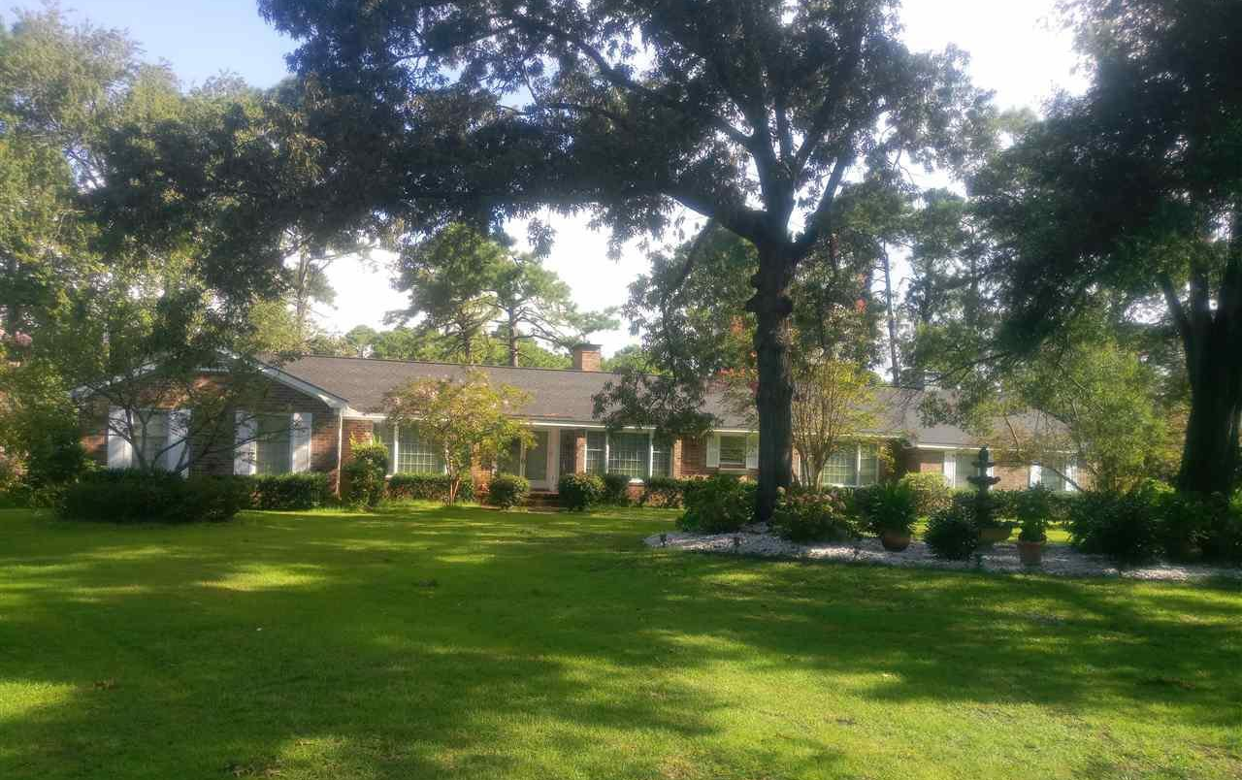
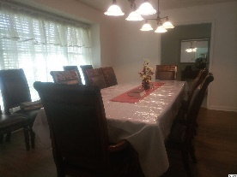
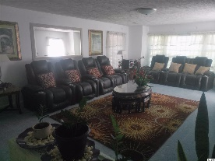
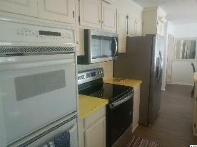
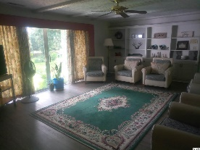
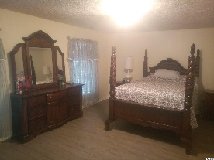
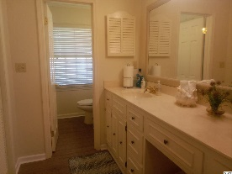
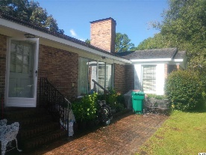
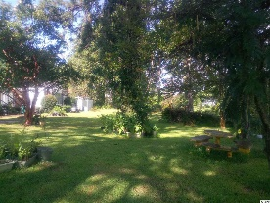
Large Home on Stunning 1/2 Acre Lot!
1680 Crooked Pine Dr
Deerfield ~ Myrtle Beach ~ MLS# 2016277 ~ $309,000
A stunningly large 4 BR/3 BTH (with an additional shower) ranch style home (over an approximate 3700 sq. ft.) on an equally impressive lot (approximately 0.54 acres). Unusual in every respect. Bonus room at end of the house could serve as an additional 5th bedroom. Extensively updated, but,...with room still for tailoring the property to one's individual tastes. All kitchen appliances to convey,...Buyer to verify all measurements/property data. A great value, given the size/location of the property, as well as the lot. A nice location,...close to everything, yet so quiet/relaxing,...and, well landscaped. Won't last too long! Sold "as is".
The Sun Group
P.O. Box 2278
Murrell's Inlet, S.C. 29576-2278
Don Morris
843-543-2272 (Cell/Text)
dimorris7@gmail.com

