Slide 1
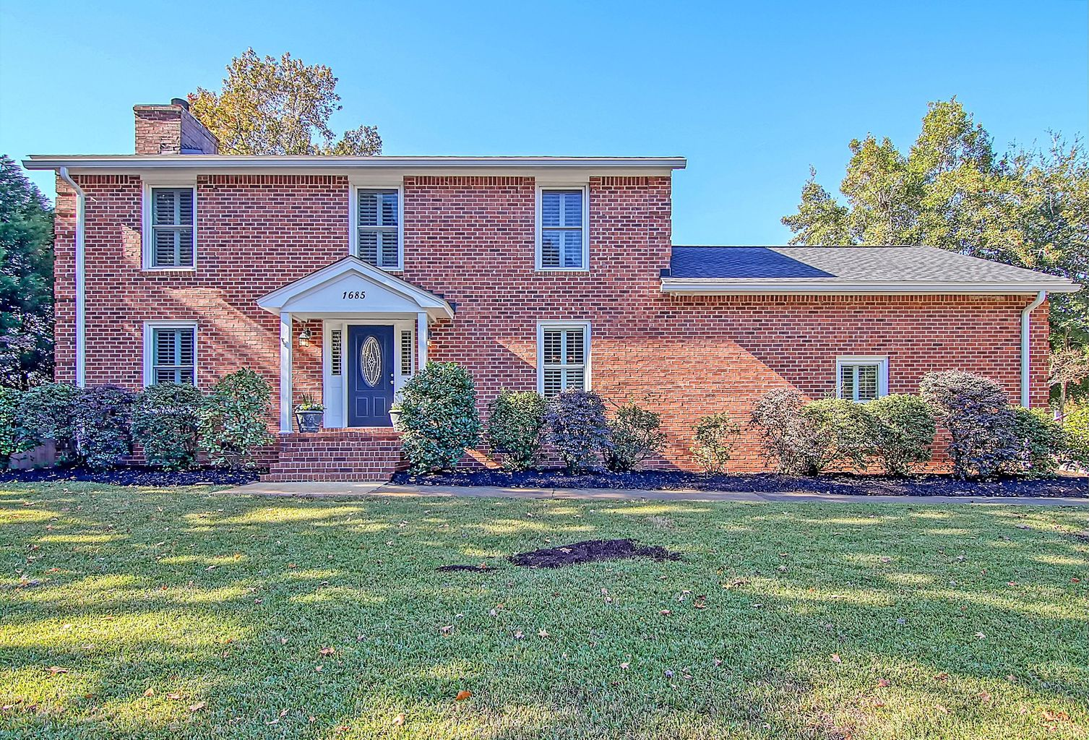
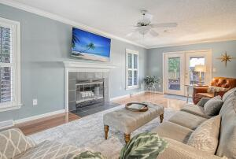
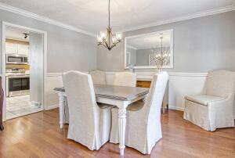
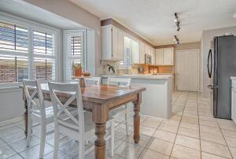
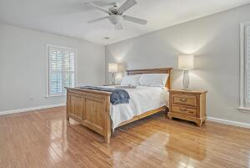
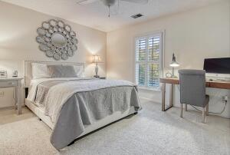
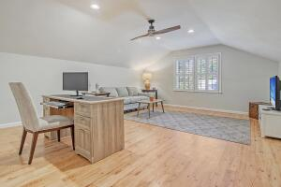
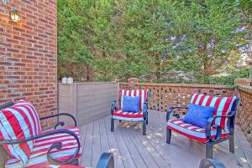
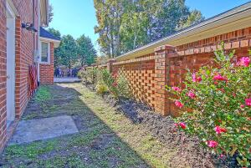

1685 Fairway Place Ln Fairway Place · Mount Pleasant, SC 29464 MLS# 21030989 · $560,000
Location, location, location and NO HOA!!!
Beautiful 3-4 bedroom, 2.5 bath brick home at the end of the IOP connector. Upon entering the home you are greeted with handsome hardwood floors, plantation shutters, and an abundance of natural light. To the right is the dining/flex room and to the left is the family room with fireplace and entrance to the private courtyard. The kitchen can be accessed from the family room and dining room and has white cabinets, bay window, eat-in area, breakfast bar, and pantry. The master bedroom is upstairs and has wood floors, ceiling fan, multiple windows, his and her closets, and an ensuite bath. There are 2 additional nicely sized bedrooms upstairs that share a recently renovated full bath with gorgeous tiled floor, stunning tiled tub/shower combination and marble top vanity. There is a FROG/bonus room that has a private entrance from the two car attached garage that could be a 4th bedroom, media room, office, or exercise room. The wonderful fenced backyard courtyard has a deck, grilling area, and room for a garden! There is a lawn well and irrigation system for maintaining a well manicured yard! Fairway Place neighborhood is extremely close to local shopping and grocery stores and is a short drive to downtown Charleston with 5-star restaurants, world class shopping and iconic history as well as minutes to the beaches, the airport, Boeing and Daniel Island.
Take a video tour: https://vimeo.com/646919867
Stan Huff
843-670-2835 stan.huff@agentowned.com
Jill Marcacci
843-297-5590 jill@agentowned.com
www.agentownedrealty.com
AgentOwned Realty Co. Preferred Group, Inc. | 824 Johnnie Dodds Blvd | Mt Pleasant, SC 29464

