Slide 1
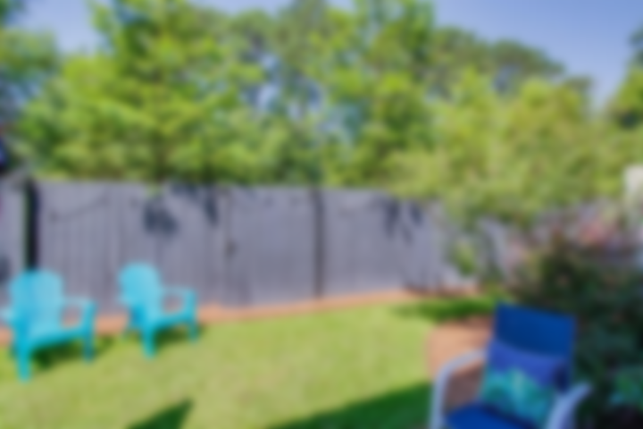
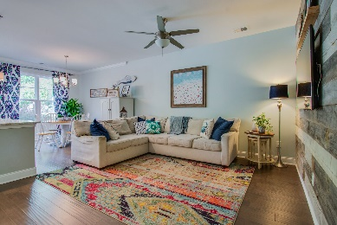
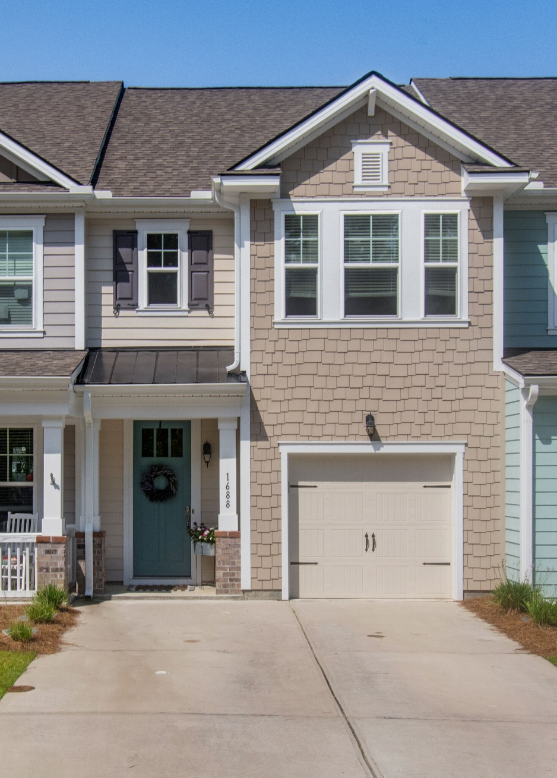
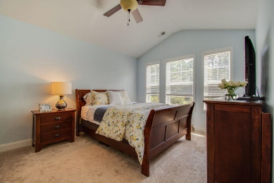
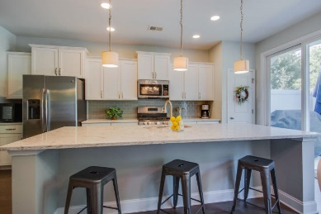
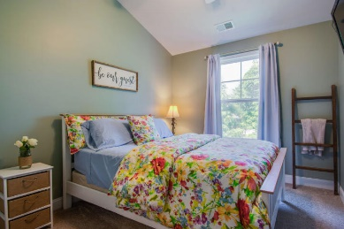
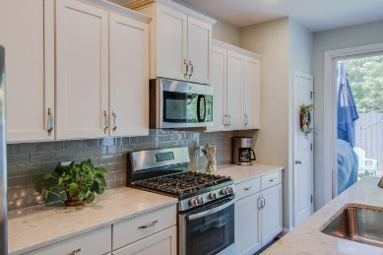
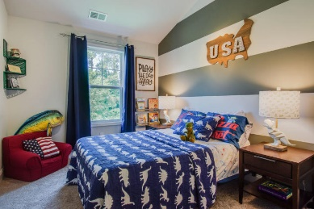
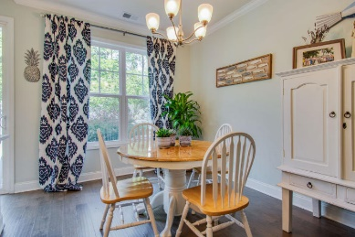

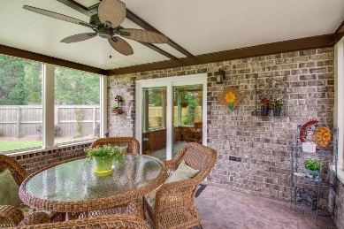
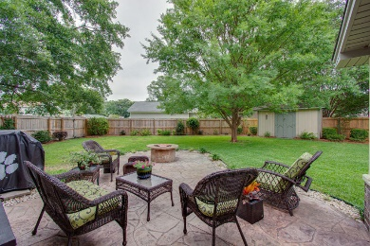
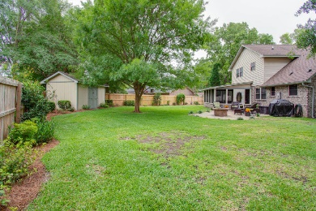


LIKE NEW PARK WEST TOWN HOME!
1688 Bridwell Lane
Park West | Mount Pleasant, SC 29466
MLS# 20019461 | $320,000
Easy living, Located in Park West, This Open floor plan town home is like new! All high end appliances, reclaimed barn wood accent wall in living area gives a great custom look. Beautiful kitchen, just look!All wide plank hardwood flooring and molding on the first floor. This three bedroom two and one half bath home is very attractive . All bedrooms upstairs, owners bath has double vanity and walk in closet. A nice patio and gas grill hook up in the area in back, all lawn care and maintenance is included in homeowner fees. Shelving in attic for additional storage. The access to 41 is very easy from this location. This is a must see. Schools, restaurants and lots of shopping nearby. Please confirm school district, square footage, and anything else important to buyer. Pool access & more!
Jan Miller
Cell (843) 345-9719 | Jan.Miller@nvrealtygroup.com
NV Realty Group | 91 Broad St, Ste A | Charleston, SC 29401
janmiller.nvrealtygroup.com

