Slide 1
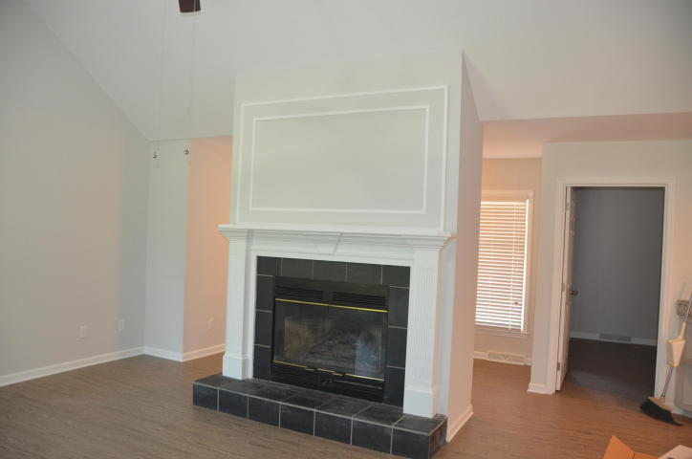
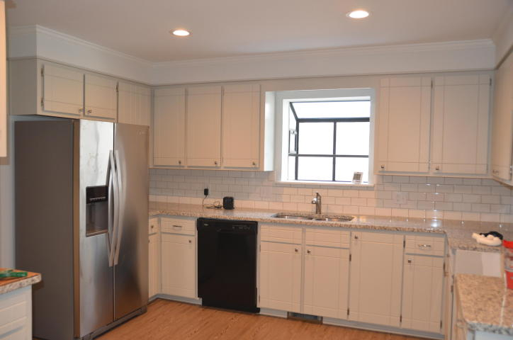
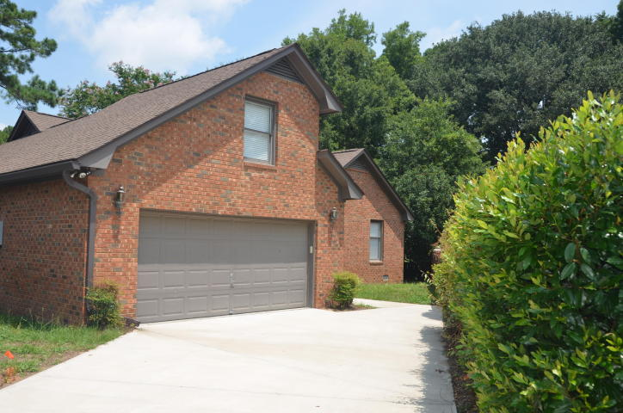
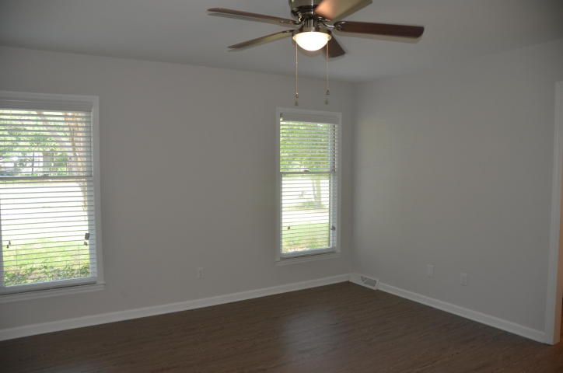
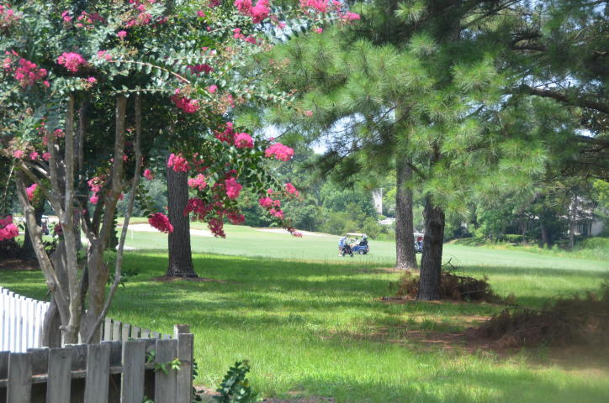
Completely Renovated Home For Rent Available Now
1688 Fairway Pl Lane
Fairway Place ~ Mount Pleasant, SC 29464
MLS# 18020013 ~ $2,795
Completely renovated 3 bedroom 2 bath plus a FROG patio home located on the Snee Farm golf course. All new floors, paint, and countertops. Open floor plan. Deck overlooks the golf course. Great home! Available Now!
Bonnie Miller 843.884.3901 O ~ 843.693.2647 M
bcm.olddom@gmail.com
Old Dominion, REALTORS · 890 Johnnie Dodds Blvd · Mt Pleasant, SC 29464

