Slide 1
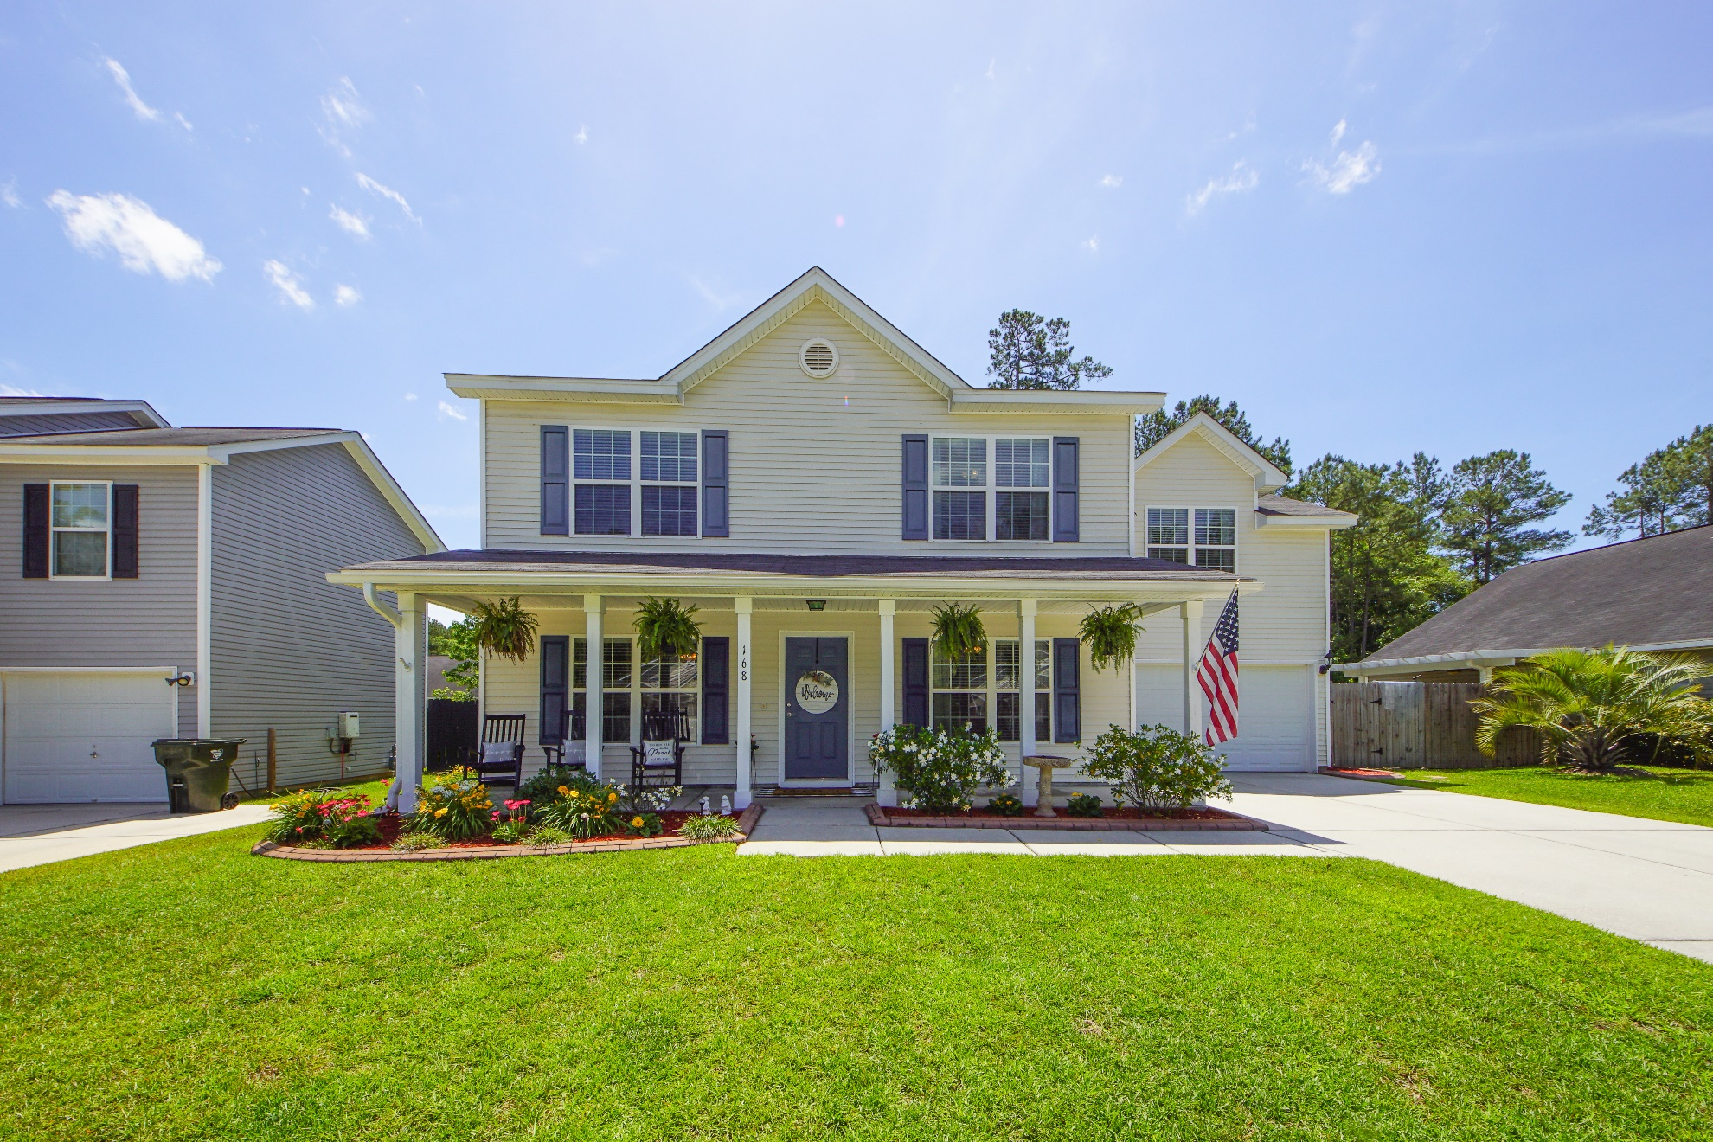
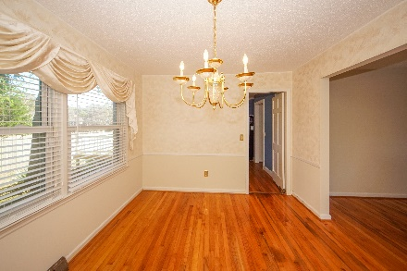
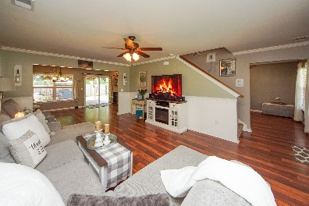
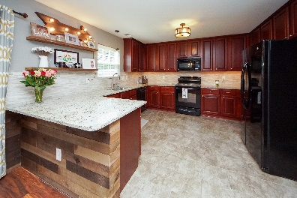
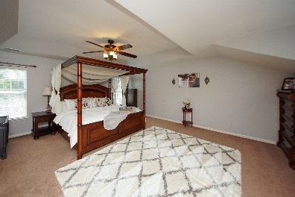
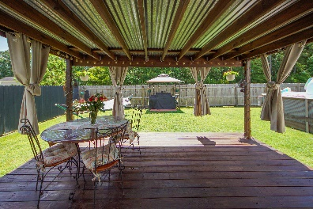
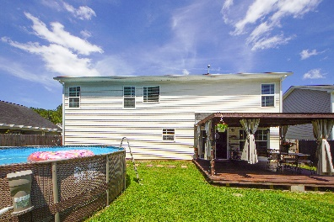


168 Blackstone Drive
Blackstone :: Moncks Corner
MLS# 21016380 :: $299,000
Otranto Beauty
$318,000
Just Listed!
Stunning 4 Bedroom home with Above Ground Swimming Pool!
You will love the 2 car garage and large "Rocking Chair" porch that welcomes you home. You are greeted by tall ceilings, crown molding, hardwood floors, custom wainscotting, and a bright and open floor plan boasting upgraded fixtures and lighting. The spacious eat-in Kitchen is filled with wood cabinets and offers granite countertops, a tile floor, a breakfast bar, under cabinet lighting, a pantry, and sliding door access to the back deck. The main floor also offers a flex room that would make a perfect dining room or home office. Upstairs you will find a huge master suite featuring a tray ceiling, a walk-in closet, and a relaxing en-suite bath with a dual vanity, separate shower, and a soaker tub! There are 3 additional generous sized bedrooms on the second floor that share a full hall bath. So there is plenty of room for the family! Step outside to the 16x16 covered back deck. This is the perfect spot to entertain, grill out, or just sit and watch the kids and pets play! The home is nestled on a large lot with curbcrete edging, and a fenced backyard that backs to protected woodlands filled with mature trees for additional privacy and Above Ground Swimming Pool!
Come take a virtual tour: https://charlestonvirtualhomes.com/2210190
Connie White, Broker
843-532-3356
connie@chrepros.com · conniewhiterealestate.com
Charleston Homes · 597 Old Mt. Holly Road · Suite 301 · Goose Creek, SC 29445

