Slide 1
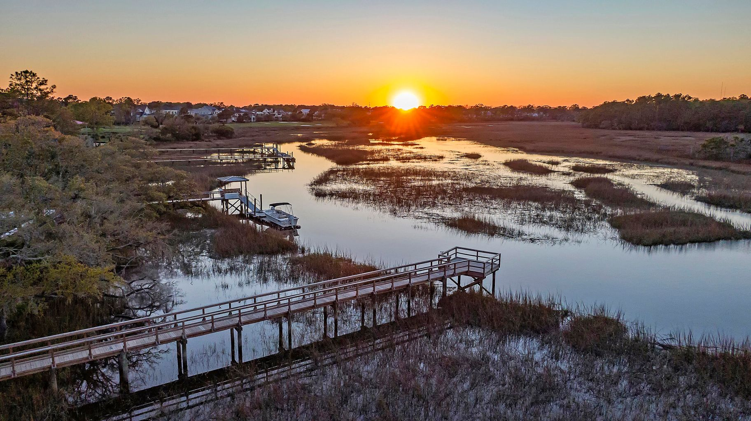

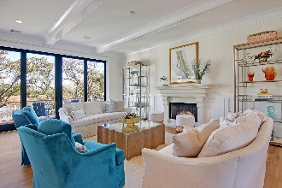
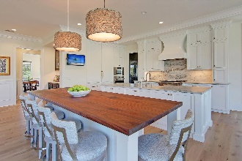
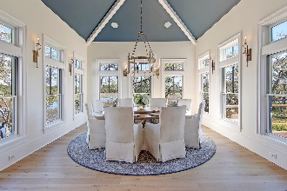
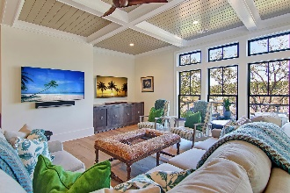
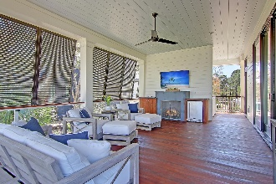
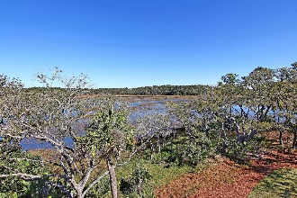
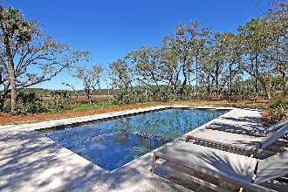
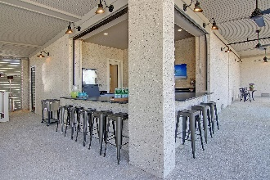
Luxury Waterfront Living on Daniel Island
168 Nobels Point Street Daniel Island Park | Charleston, SC 29492 | MLS# 21008484 | $5,250,000
Perfectly situated with a dock at the end of a cul-de-sac on one of Daniel Island's most coveted streets, this custom built marsh front home is like no other in the Lowcountry! Views of Ralston Creek and this stunning backyard oasis complete with a heated saltwater pool & spa, make coming home feel like you've arrived at a tranquil and serene vacation destination. Enjoy a cup of tea or a glass of wine while watching the gorgeous sunsets over the marsh in the evenings from multiple outdoor living areas. The open floor plan of this well designed home is flooded with natural light and is ideal for entertaining. The chef's kitchen features premium Quartzite countertops, high end appliances (Wolf & Sub-Zero), two 30-inch refrigerator/freezers, a large center island, and a second social island with bar seating for 6. The Butler's pantry has 2 additional dishwasher drawers, a sink, and a walk-in pantry. Temperature and humidity controlled glass wine room holds 800+ bottles of wine. The first floor media room has access to the outdoor porch with an infrared heater in the ceiling and a gas fireplace. Additional highlights of this home include an elevator that services all 3 floors, a garage that holds 5+ cars, a separate grilling porch overlooking the water, and an outdoor bar by the pool complete with a commercial ice maker - perfect for loading up coolers before a fishing trip in the boat! Two home offices are perfect for the working couple or the studying at home student. Second floor Owner's suite features a balcony overlooking the marsh and tidal creek, sitting area, oversized dressing room, coffee/scotch bar and access to a second home office and laundry room. Master bathroom is plumbed for a tub and features an oversized walk-in shower with Carrara marble tile, heated porcelain floors, and dual vanities with Carrara marble and under cabinet lighting. All secondary bedrooms have en-suite baths and walk-in closets. This home is a nature lover's sanctuary and must be seen to truly appreciate all it has to offer!
Take a video tour: https://vimeo.com/charlestonrem/review/531059850/5a450b3f9a
Paige Rhodes 843-830-3281 paige.rhodes@carolinaoneplus.com

