Slide 1

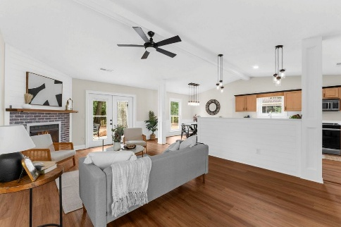
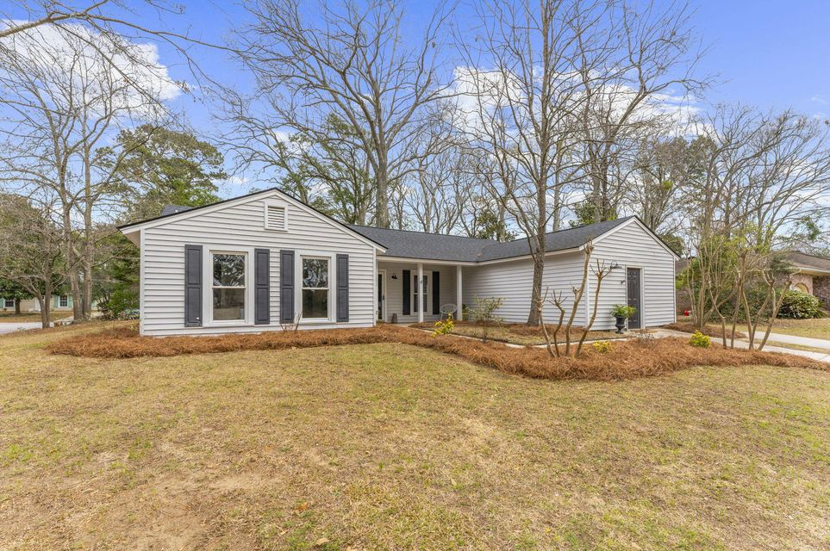
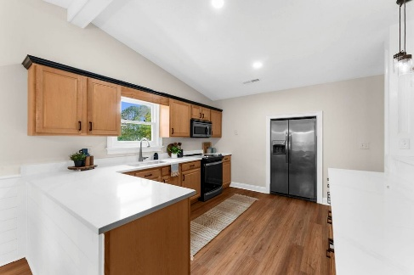
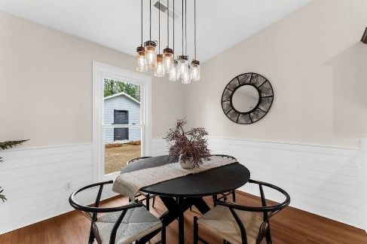
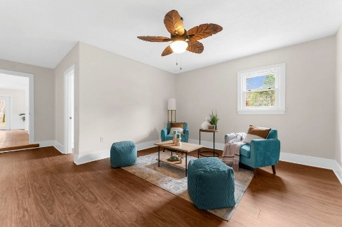
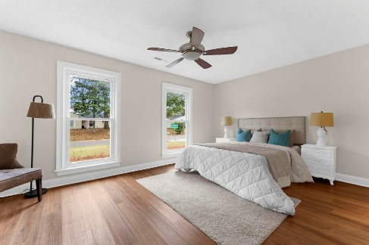
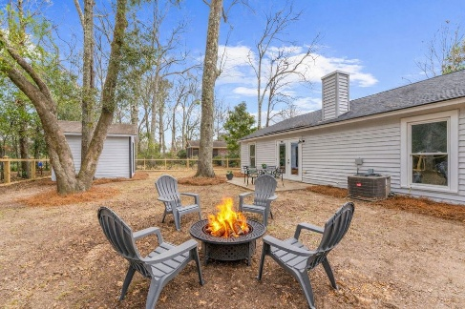


1690 Nantahala Boulevard Wando East · Mount Pleasant, SC 29464 MLS# 26005542 · $750,000
New Price!
Gorgeous Property ~ Move In Ready
Welcome home! Easy living in the heart of Mt. Pleasant. Fantastic corner lot with a brand new living fence in the back yard. Great for kids, pets, gardening and entertaining. The entire house was just freshly painted, new flooring in laundry and flex space, new flooring 2 years ago in the rest of the house.
Flex space perfect for home office, play room or 4th bedroom Two years ago extensive renovation to the kitchen, beautiful quartzite countertops, new pulls, new stove, microwave, dishwasher and refrigerator.
Spacious primary bedroom with private bath and a gorgeous walk in fully tiled shower. New vanity and toilet. Secondary bathroom features ceramic tile around the tub new toilet and new vanity. Lighting throughout the home all replaced in the last two years. Beautiful new French doors with interior blinds leading to the back yard. Fireplace gas line is in (capped) and the brand new guts are still in the box for your discretion to hook up and enjoy those evening fires. Shed has been freshly painted and ready for all your toys and lawn equipment. New Roof in 2021.
Great location to Charleston (20 min), 15 min to IOP beach and walk to Lucy Beckham High School. Must see to appreciate this great home!
Saturday, May 5th At 11:00a
ANN EVANS
Carolina One Real Estate
843-452-4605
aevans@carolinaone.com
www.charlestonluxuryrealestate.com
Carolina One Real Estate
195 W Coleman Blvd
Mt Pleasant, SC 29464-3495

