Slide 1
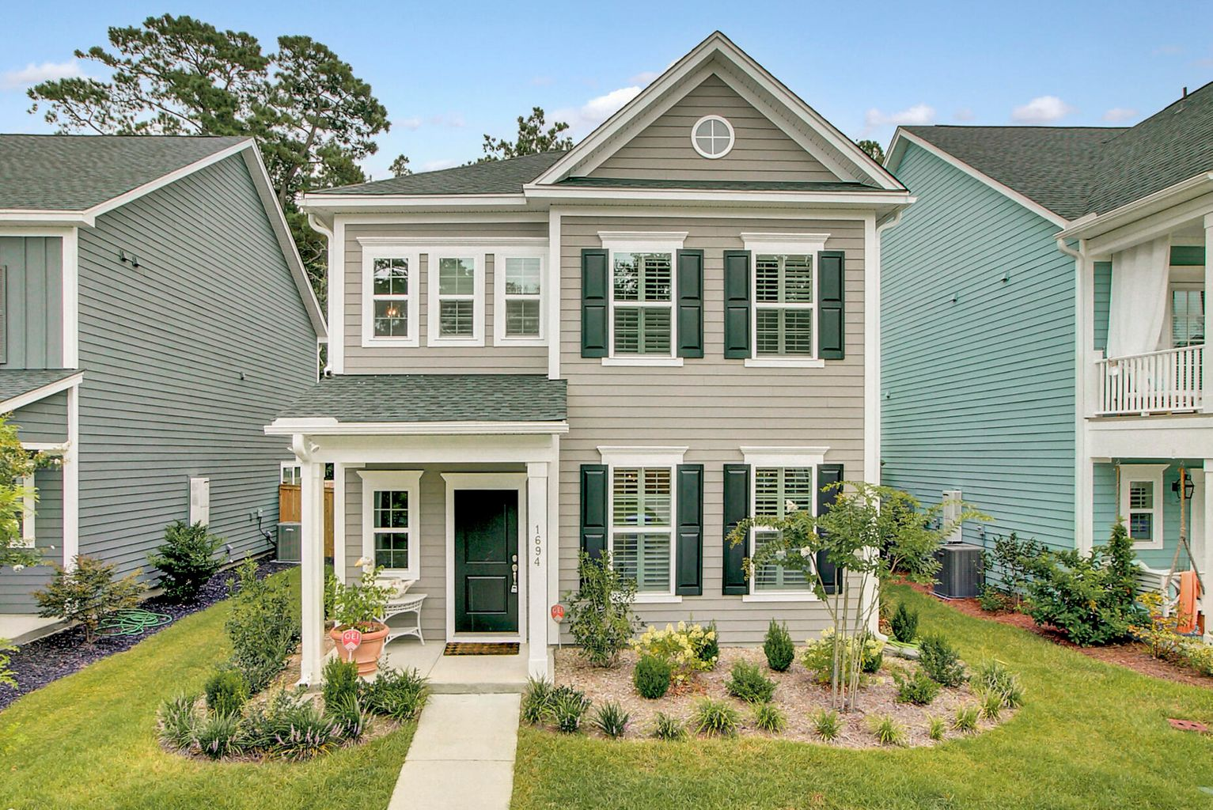
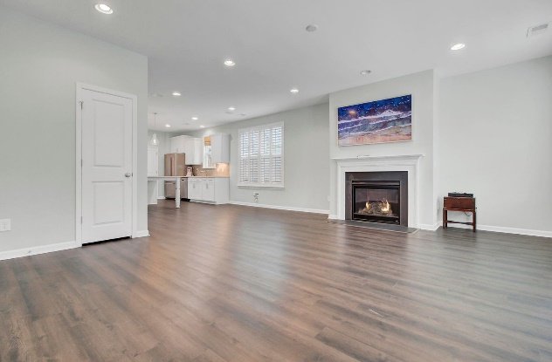
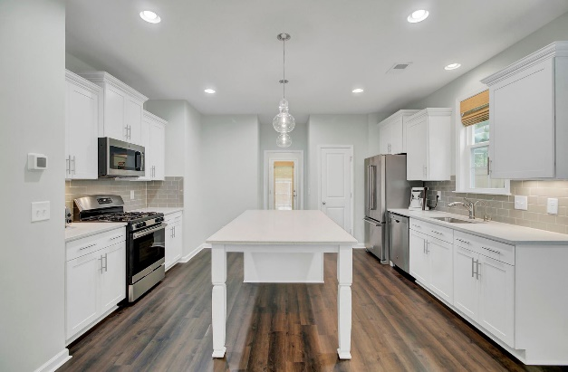
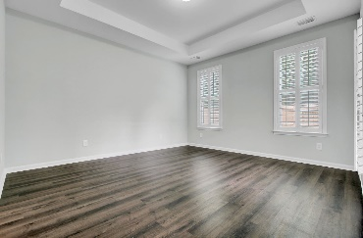
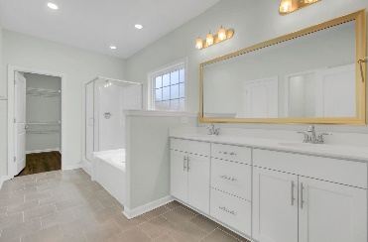
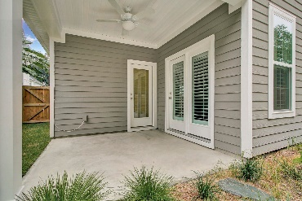
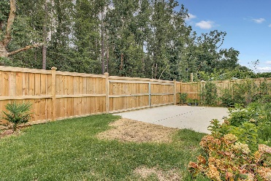


OPEN HOUSE SATURDAY AUGUST 7TH 1-3PM
1694 Emmets Road
The Oaks at St Johns Crossing
Johns Island, SC 29455
MLS# 21021274
$460,000
CHARLESTON SINGLE STYLE HOME
4 BEDS/2.5 BATHS/LOFT
MASTER BEDROOM DOWN
YARD W/PRIVACY FENCE
HARDIPLANK SIDING
HOME ONLY 2 YEARS OLD
QUARTZ COUNTERTOPS
STAINLESS APPLIANCES
REFRIGERATOR INCLUDED
COVERED PORCH
PERFECT JOHNS ISLAND LOCATION
1 MILE FROM SEVERAL RESTAURANTS/SHOPS
BLINDS AND WASHER/DRYER INCLUDED
LESS THAN 10 MILES TO DOWNTOWN CHARLESTON
12 MILES TO KIAWAH OR FOLLY BEACH
2 YEARS OLD ~ MOVE IN READY
CHARLESTON SINGLE STYLE
ONE OF THE MOST CONVENIENTLY LOCATED COMMUNITIES ON JOHNS ISLAND
SPACIOUS LIVING ROOM
BEAUTIFUL KITCHEN WITH A LARGE ISLAND
STAINLESS APPLIANCES, QUARTZ COUNTERTOPS AND GOOD SIZED PANTRY
LIVING ROOM IS VERY OPEN
GAS FIREPLACE
4 BEDROOM / MASTER DOWN
MASTER BATH INCLUDES DOUBLE BOWL SINKS, SEPARATE TUB AND SHOWER ALONG WITH A LARGE WALK IN CLOSET
3 BEDROOMS UPSTAIRS
HOME BACKS UP TO A WOODED AREA, HAS A COVERED PORCH, FENCED IN YARD AND IS JUST STEPS AWAY FROM THE NEIGHBORHOOD WALKING TRAIL.
LESS THAN 10 MILES FROM DOWNTOWN CHARLESTON
Pam Bosart
843.452.0757
pam@adlerrealtychs.com
Adler Realty, LLC
518 Parrot Point Drive
Charleston, SC 29412
adlerrealtychs.com

