Slide 1
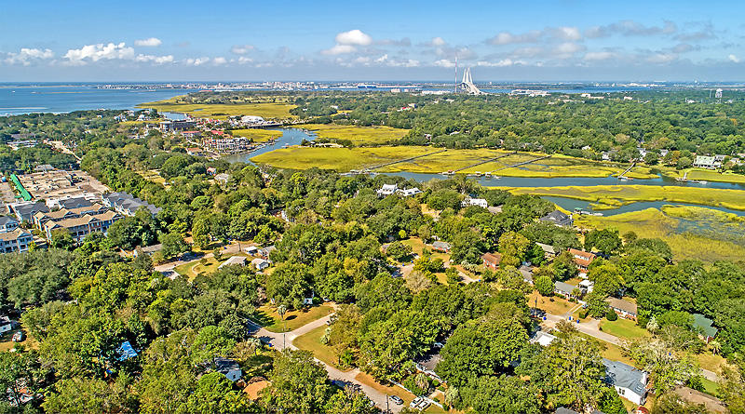
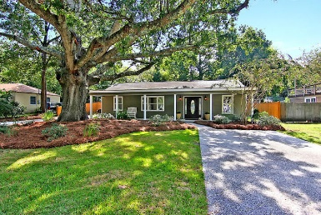
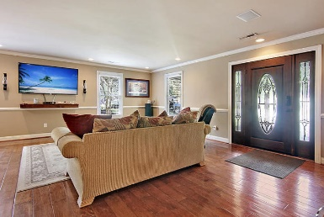
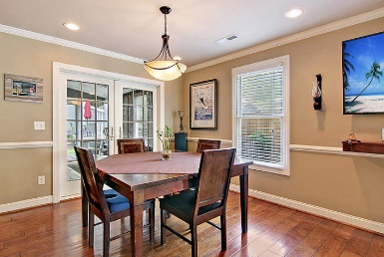
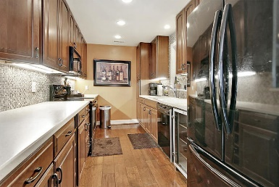
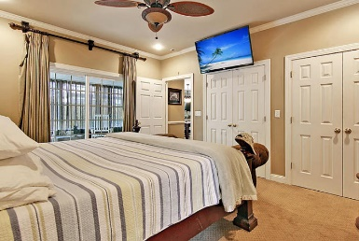
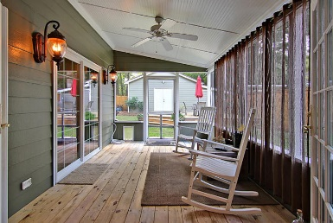
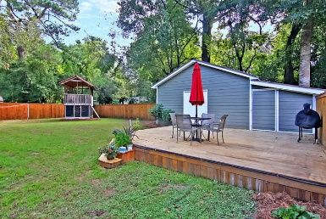
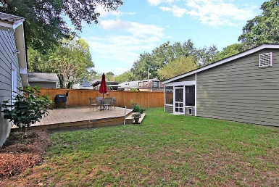

16 Joyce Avenue
Brookgreen Meadows ~ Mount Pleasant ~ MLS# 18026910 ~ $519,900
Deepwater Dock in Place
Great Location!!!
Easy short distances to shops and restaurants. Beautifully renovated open floor plan NO FLOOD INSURANCE, NO HOA. Privacy fence and beautifully landscaped yard. Enjoy afternoons relaxing on the front porch. Great open floor plan with custom hardwood floors in the Great Room, kitchen and eating area. Screened in back porch accessible from the great room and master bedroom. Big shed and huge deck in the backyard. Home has been meticulously cared for and is ready to move in!
Jonathan Vroon
(843) 514-3114
jvroon@southernlivingre.com
www.southernlivingre.com
Southern Living Real Estate 2249 Salt Wind Way, Mt. Pleasant, SC 29466

