Slide 1
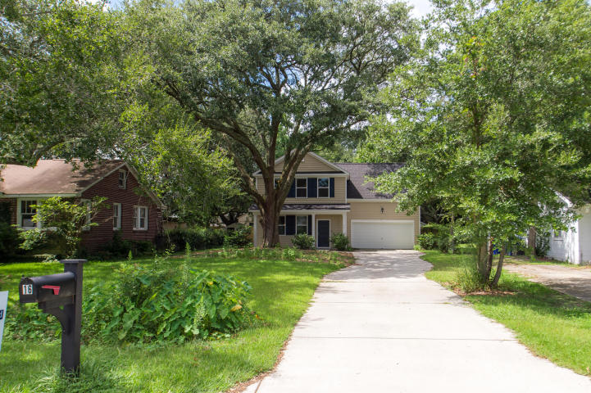
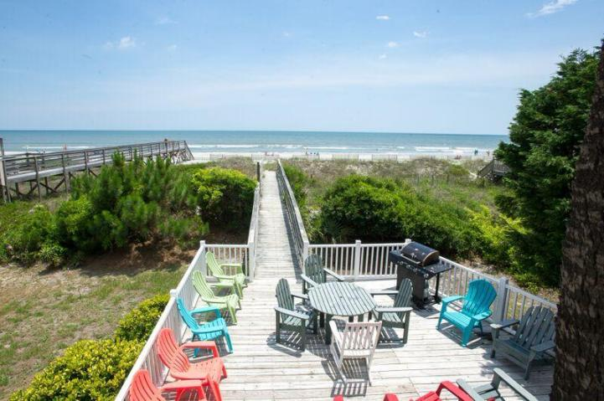
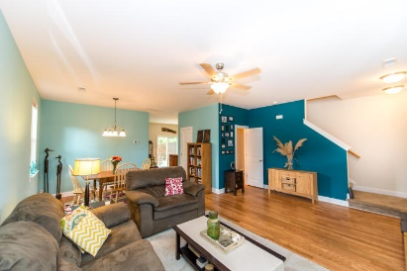
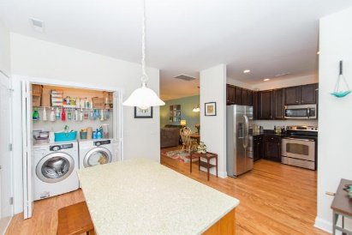
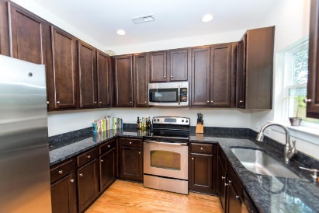
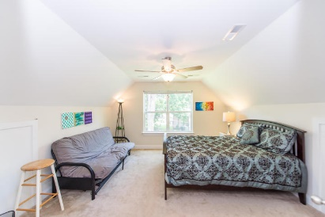
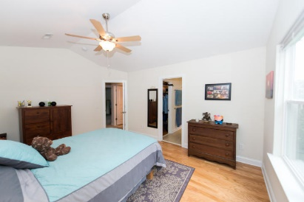
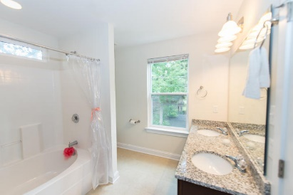
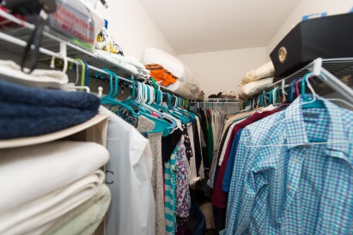
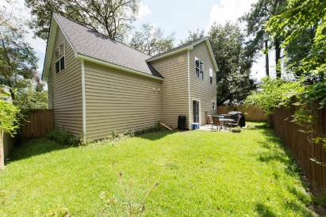


Like New Home in Excellent Condition
16 Tovey Road
Carolina Terrace
Charleston, SC 29407
MLS# 15023593 - $399,900
4 Bed | 2½ Bath
***4 Bedrooms**** Near Avondale in Carolina Terrace This home is almost brand new and is perfect for entertaining with a modern and open downstairs flow which includes hardwood floors and high 9ft ceilings, 42'' maple cabinets, and full granite counters. All top quality kitchen appliances are included. Upstairs the master suite has a walk-in closet, private en-suite bath with dual-vanities with granite counters and a large soaking tub. There are three additional bedrooms and a full hall bath, all with deluxe Shaw carpet and custom italian tile in baths. Energy efficient dual zone HVAC, 30 year architectural roof. Home is fully landscaped and has a stunning Oak tree in the front. Flood zone ''x'' which does not require flood insurance. 7 years left on ten year builders warranty.
Bryan Thompson
Office - (843) 769-5100
Mobile - (843) 452-1686
bryan.thompson@agentownedrealty.com
www.bryanthompsonrealestate.com
AgentOwned Charleston Group | 902 Savannah Hwy | Charleston, SC 29407-7802

