Slide 1
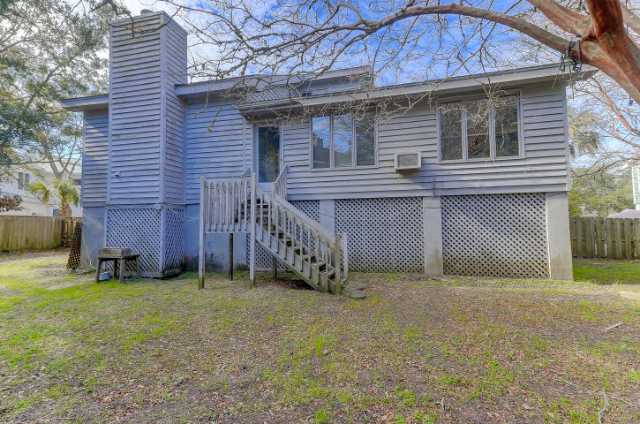
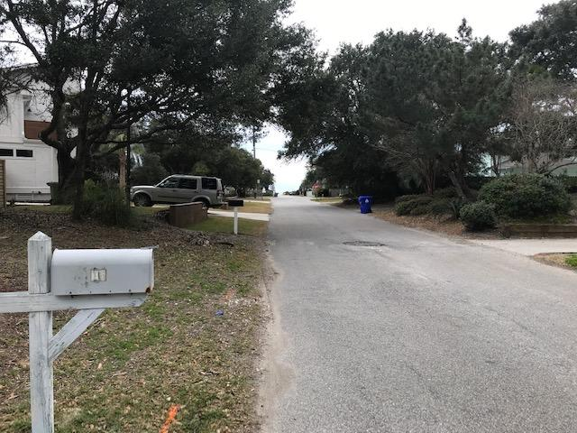


16 42 Avenue
Isle of Palms, SC 29451
MLS# 19002737
$870,000
Primarily Lot Value
0.25 Acres
A Short Walk to the Beach
Open House This Weekend
1:00 - 3:00 Both Days
16 42nd Avenue is a Great Location!
A WONDERFUL OPPORTUNITY TO BUILD YOUR DREAM HOUSE!
Listed as Residential [MLS# 19002737] and Vacant Lot [MLS# 19002756].
Please call me with any questions...843-696-7824!
Darlene Smith
Office - (843) 886-8110
Mobile - (843) 696-7824
darlenesmith@carolinaone.com
DarleneSmithTeam.com
Carolina One Real Estate
1503 Palm Blvd Ste
Isle of Palms, SC 29451

