Slide 1
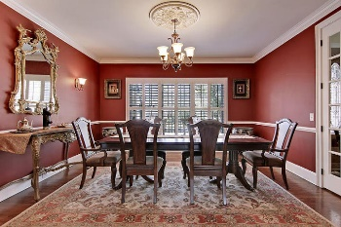
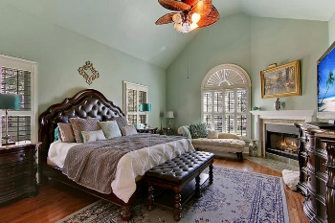
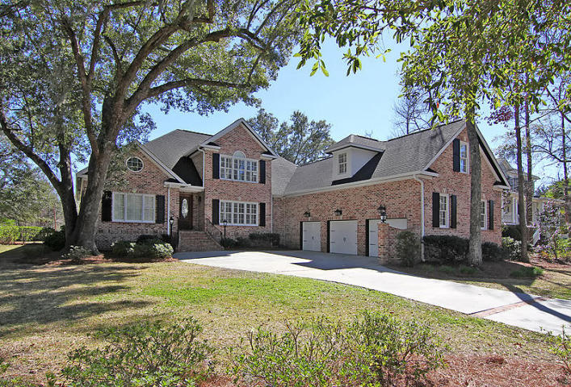
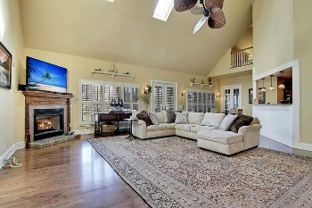
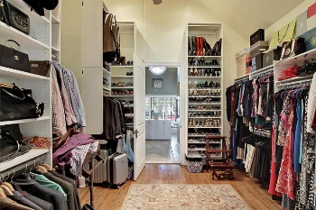
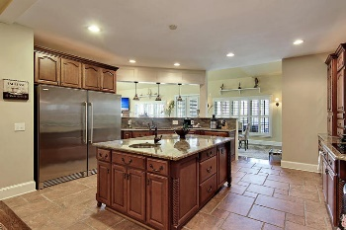
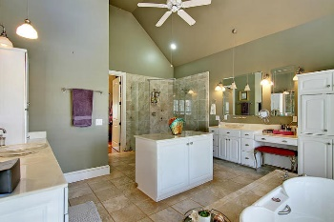
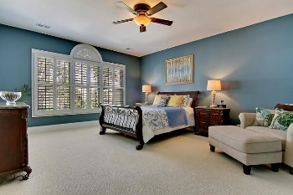
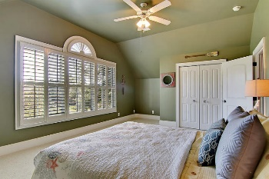
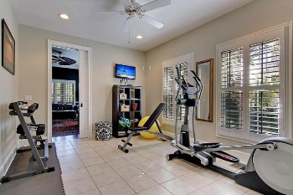
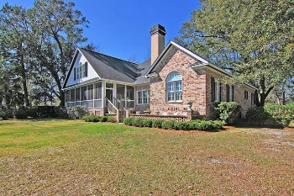
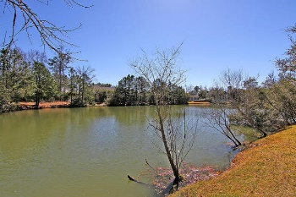

1700 Sewee Fort Road
Mount Pleasant · MLS# 17004736 · $799,000
Park West Reduced Below $800,000
Loaded with Updates
Rare all brick exterior with 3 car garage! Amazing spacious home with large open rooms and a lot of details throughout. Wonderful home for entertaining. This all custom home has wood floors, tile floors, cathedral ceiling, recessed lighting, fireplaces, plantation shutters, crown molding, chair rail and french doors. The very spacious open kitchen is a delight with an abundance of granite counter-tops, 3 sinks, wet bar, custom cabinetry, massive center island, double ovens, upgraded appliances, dual cabinets for a microwave and large breakfast room. The oversized master bedroom also has a fireplace, the grand walk-in closet is like nothing you've ever seen with floor to ceiling organizing. The equally impressive master bathroom houses a large glass-surround shower with multi shower heads, spacious double vanities, center island and jetted tub. On second floor you will find three large bedrooms and a spacious bathroom, offering a sitting area. Just off the kitchen you will find a downstairs multi-purpose mud room/laundry large enough for exercise equipment The adjoining Library has its own entrance onto the extra large screened porch. The library could also serve as a fifth bedroom offering plenty of private space. This is the perfect setup for a mother in law suite with a separate entry, near the kitchen, a full bath and laundry room. The oversize screened porch is overlooking a pond and patio with brick privacy fence that make it the perfect space for grilling. The three car garage offers additional space for storage/work area. There are two heat & air systems, this home is wired for a generator, includes irrigation and a tankless hot water heater. Settle into this amazingly spacious home and let the comforts of low-country living begin!
Stan Huff
843-670-2835
stan.huff@agentowned.com
Jill Marcacci
843-297-5590
jill@agentowned.com
www.agentownedrealty.com
AgentOwned Realty Co. Preferred Group, Inc. | 824 Johnnie Dodds Blvd | Mt Pleasant, SC 29464

